Slide 1
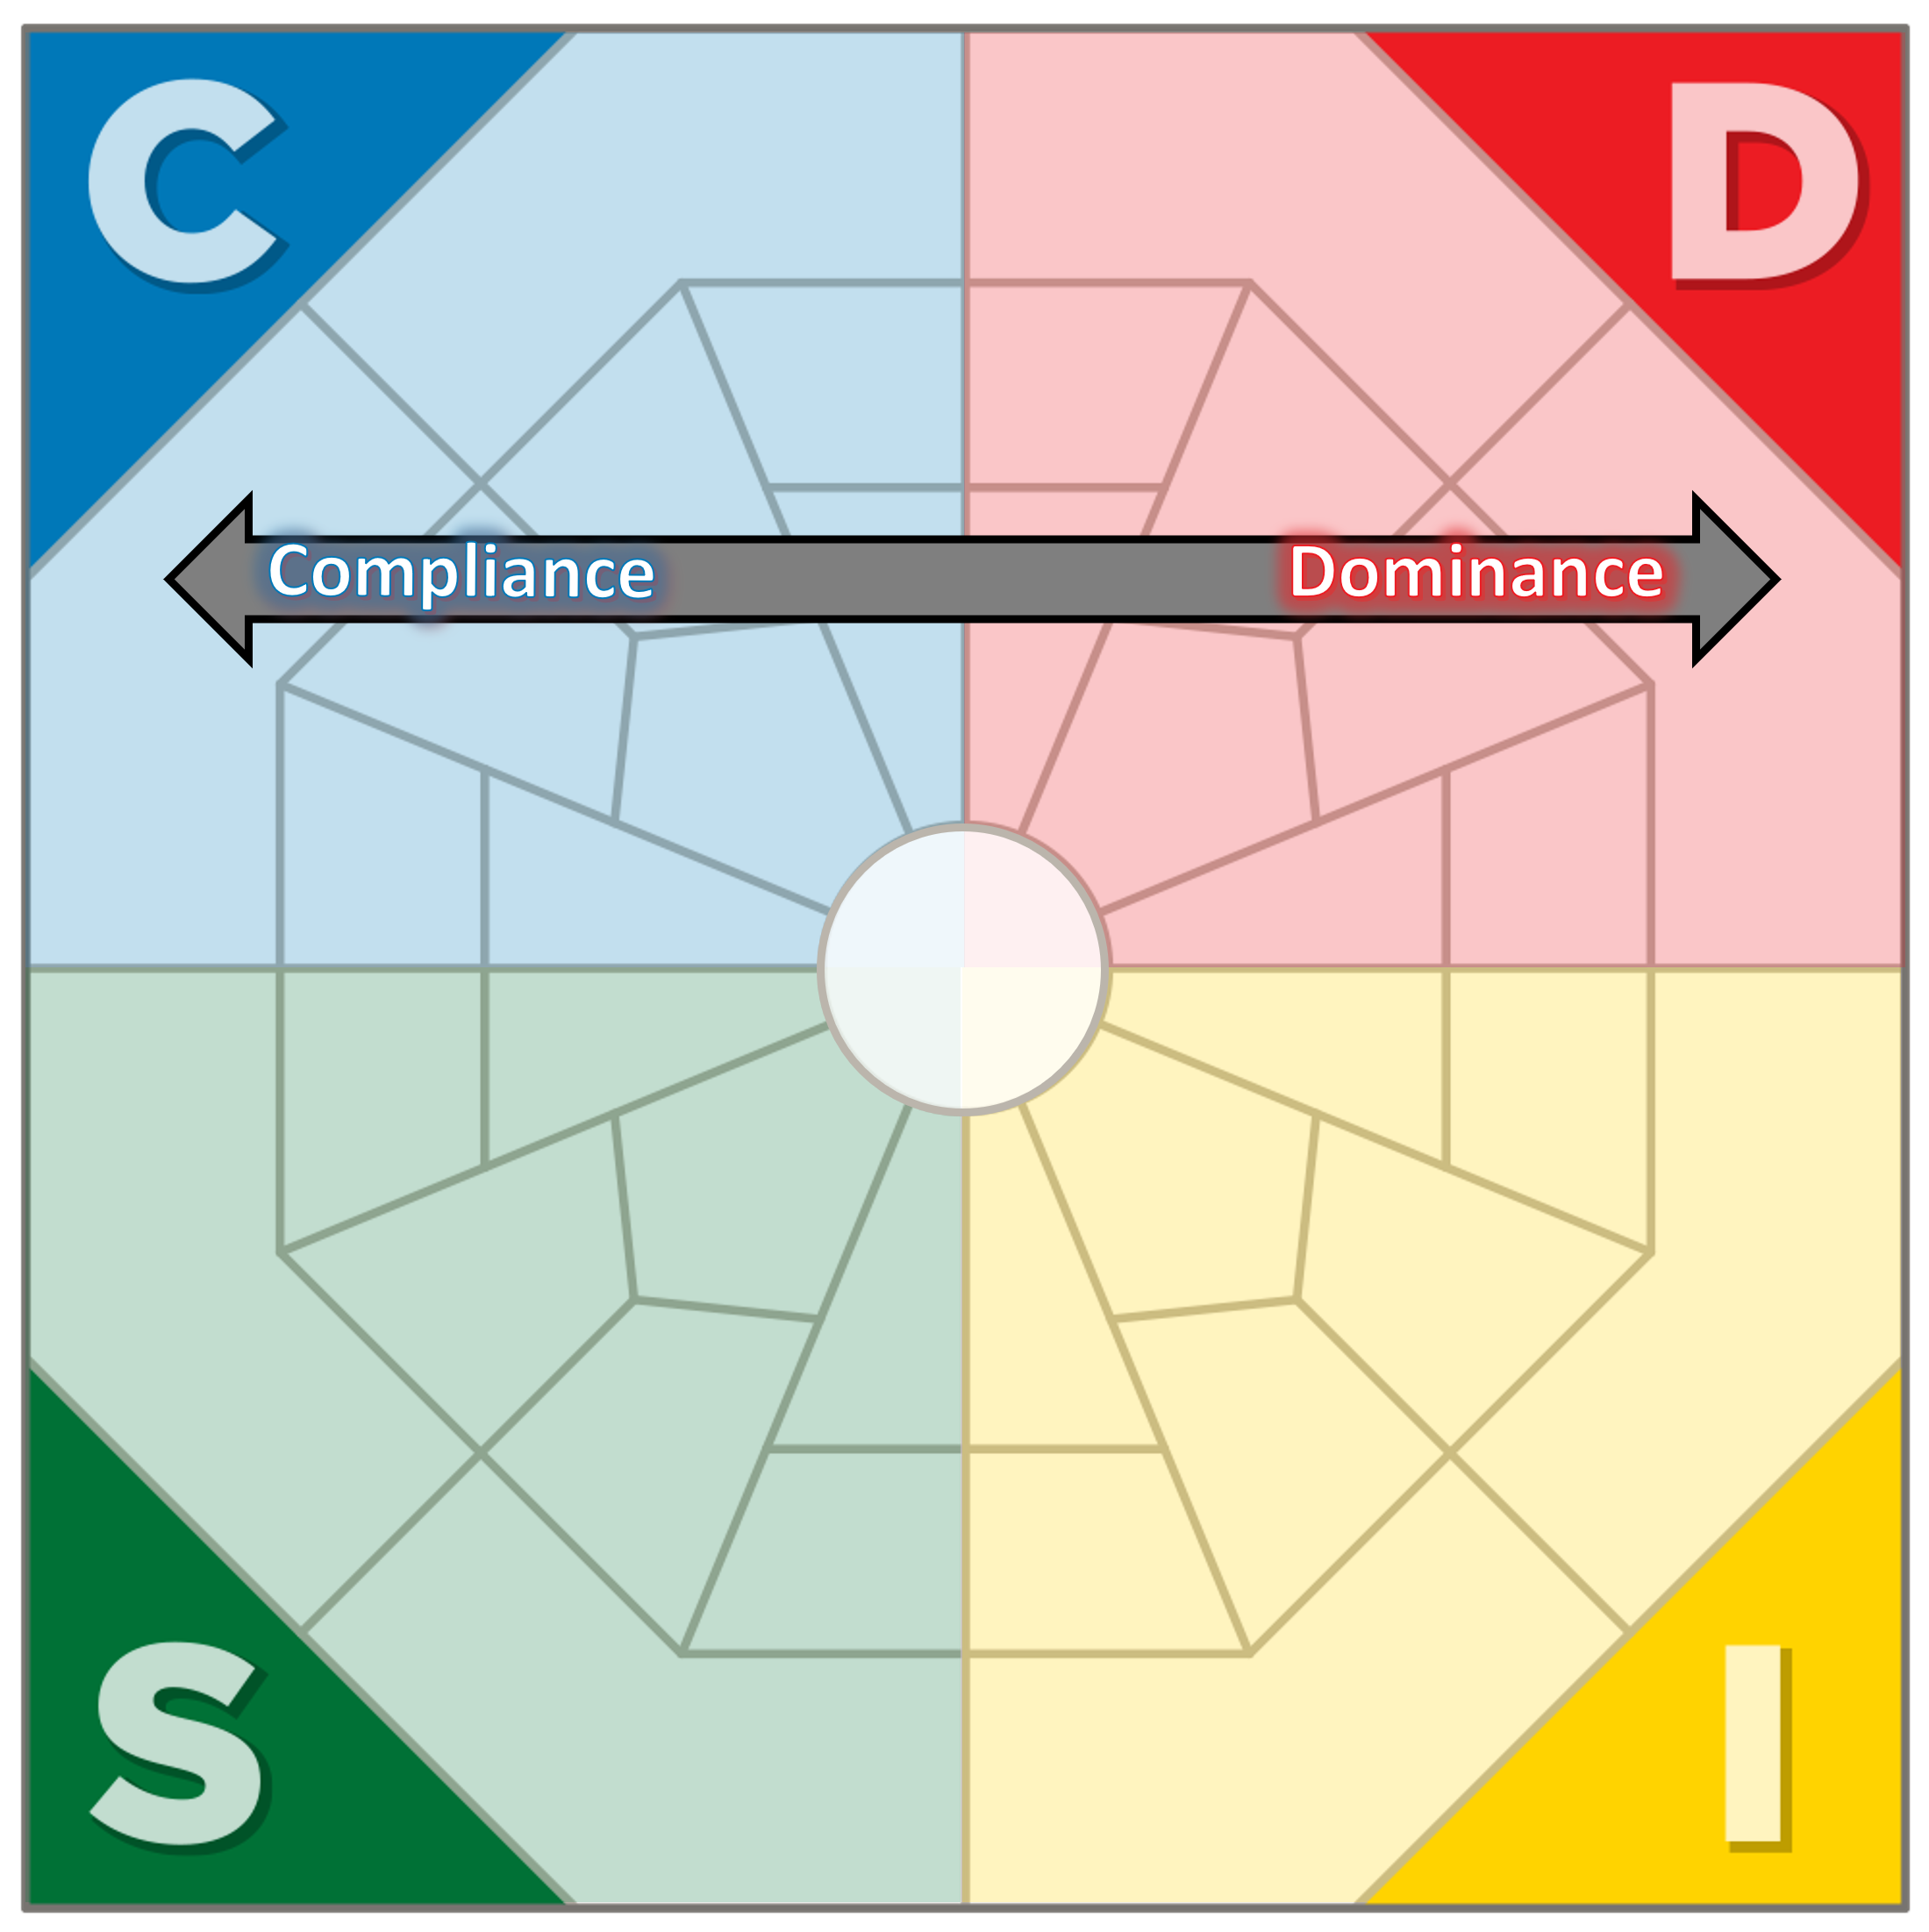
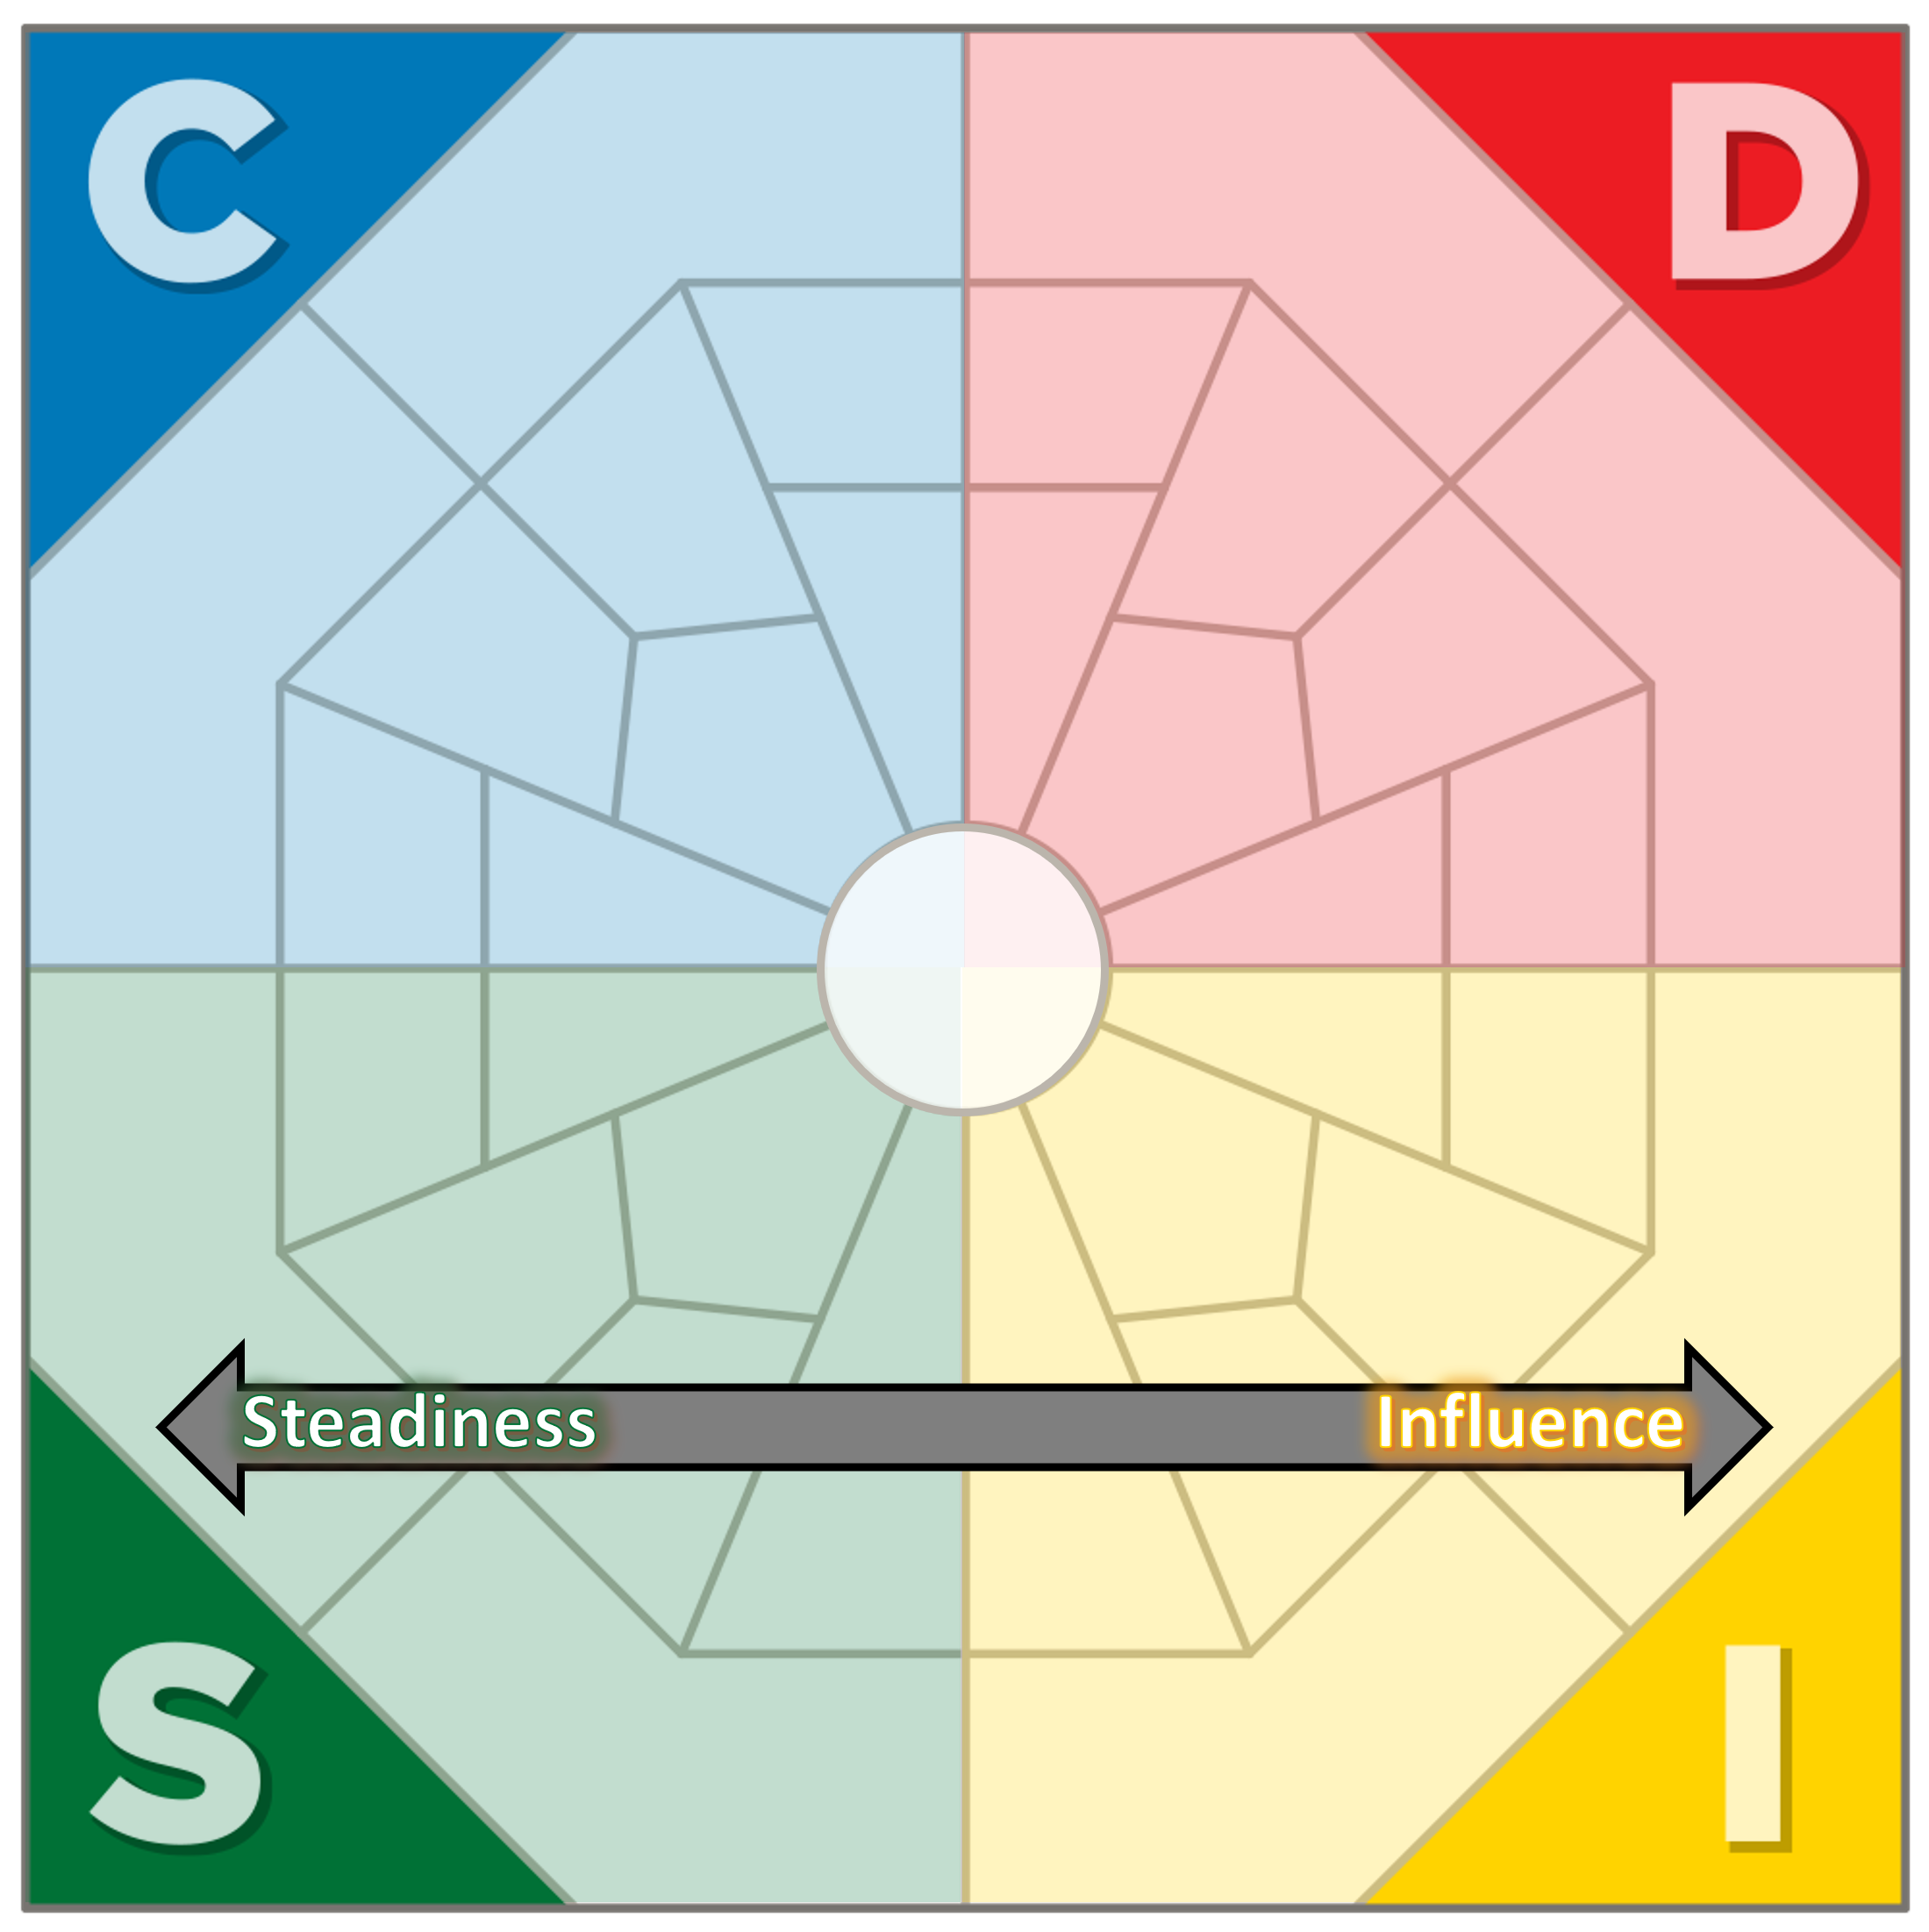
Tension
Reserved Paced vs. Fast Paced:
The cautious, analytical, indecisive C-style may conflict with the fast-paced, risk-taking, impatient D-style.
Reserved Paced vs. Fast Paced:
The steady, careful and patient S-style contrasts with the persuasive, impulsive and competitive I-style.

Slide 2
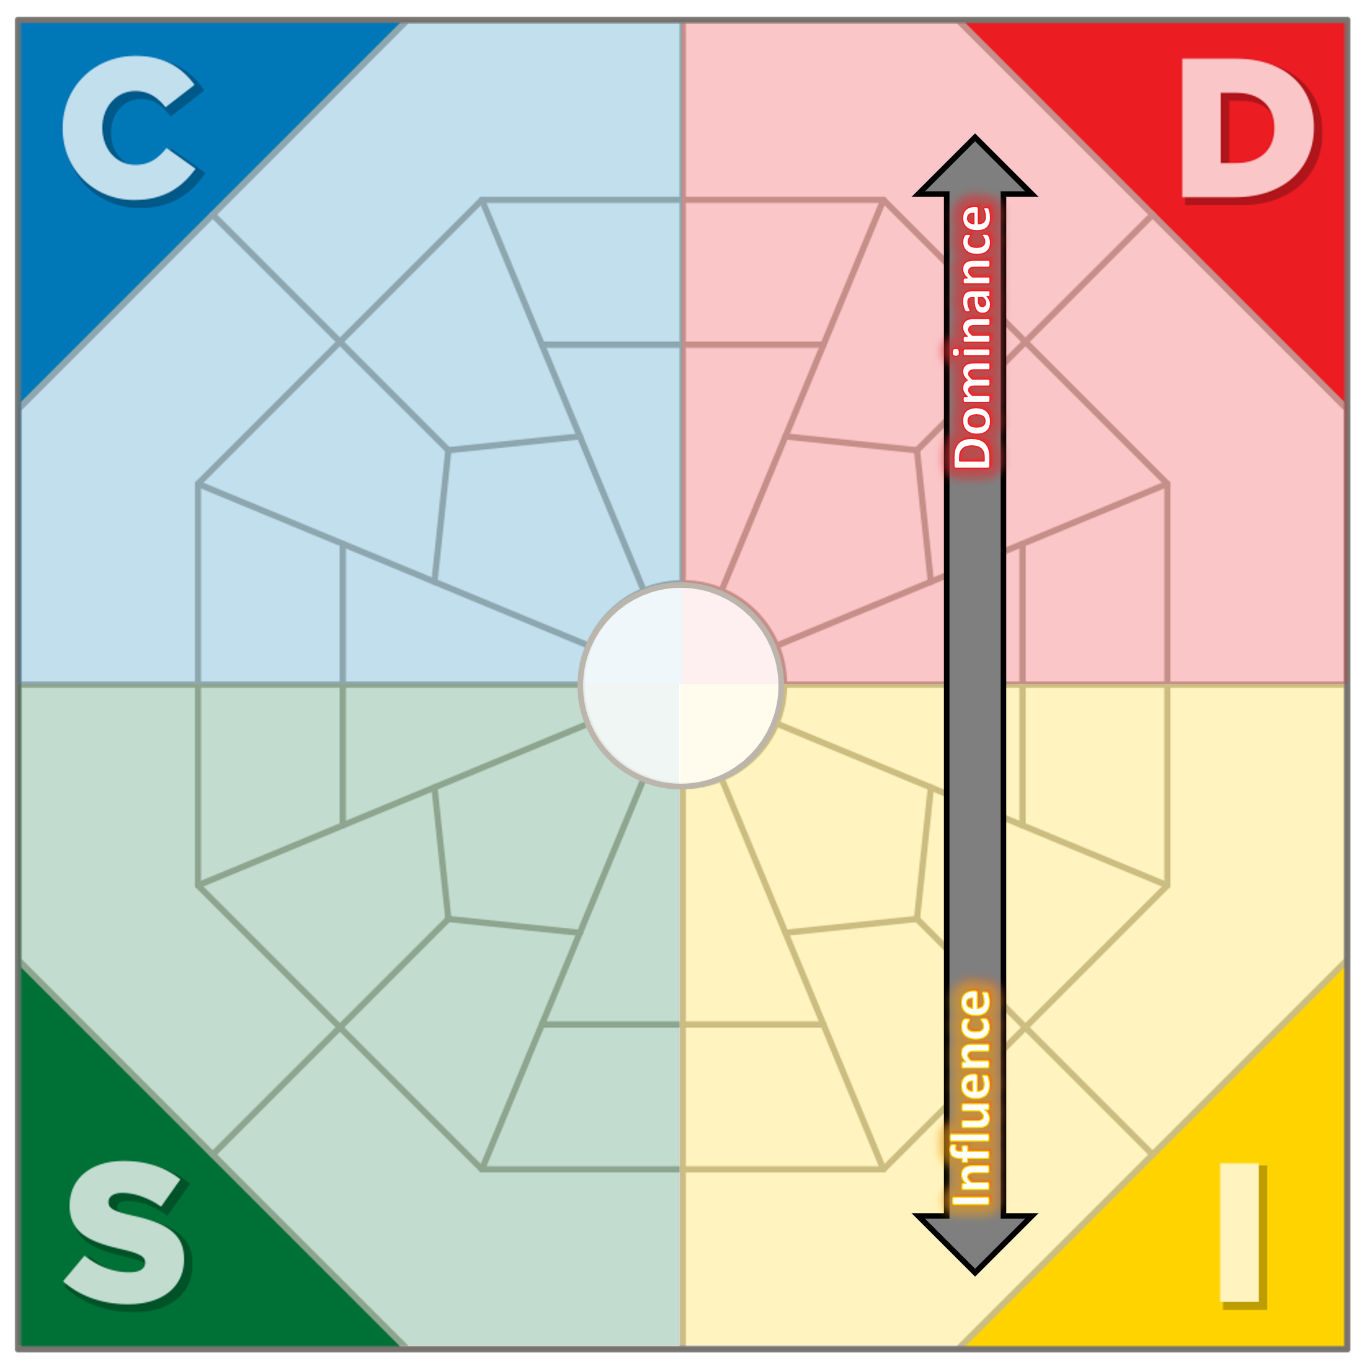
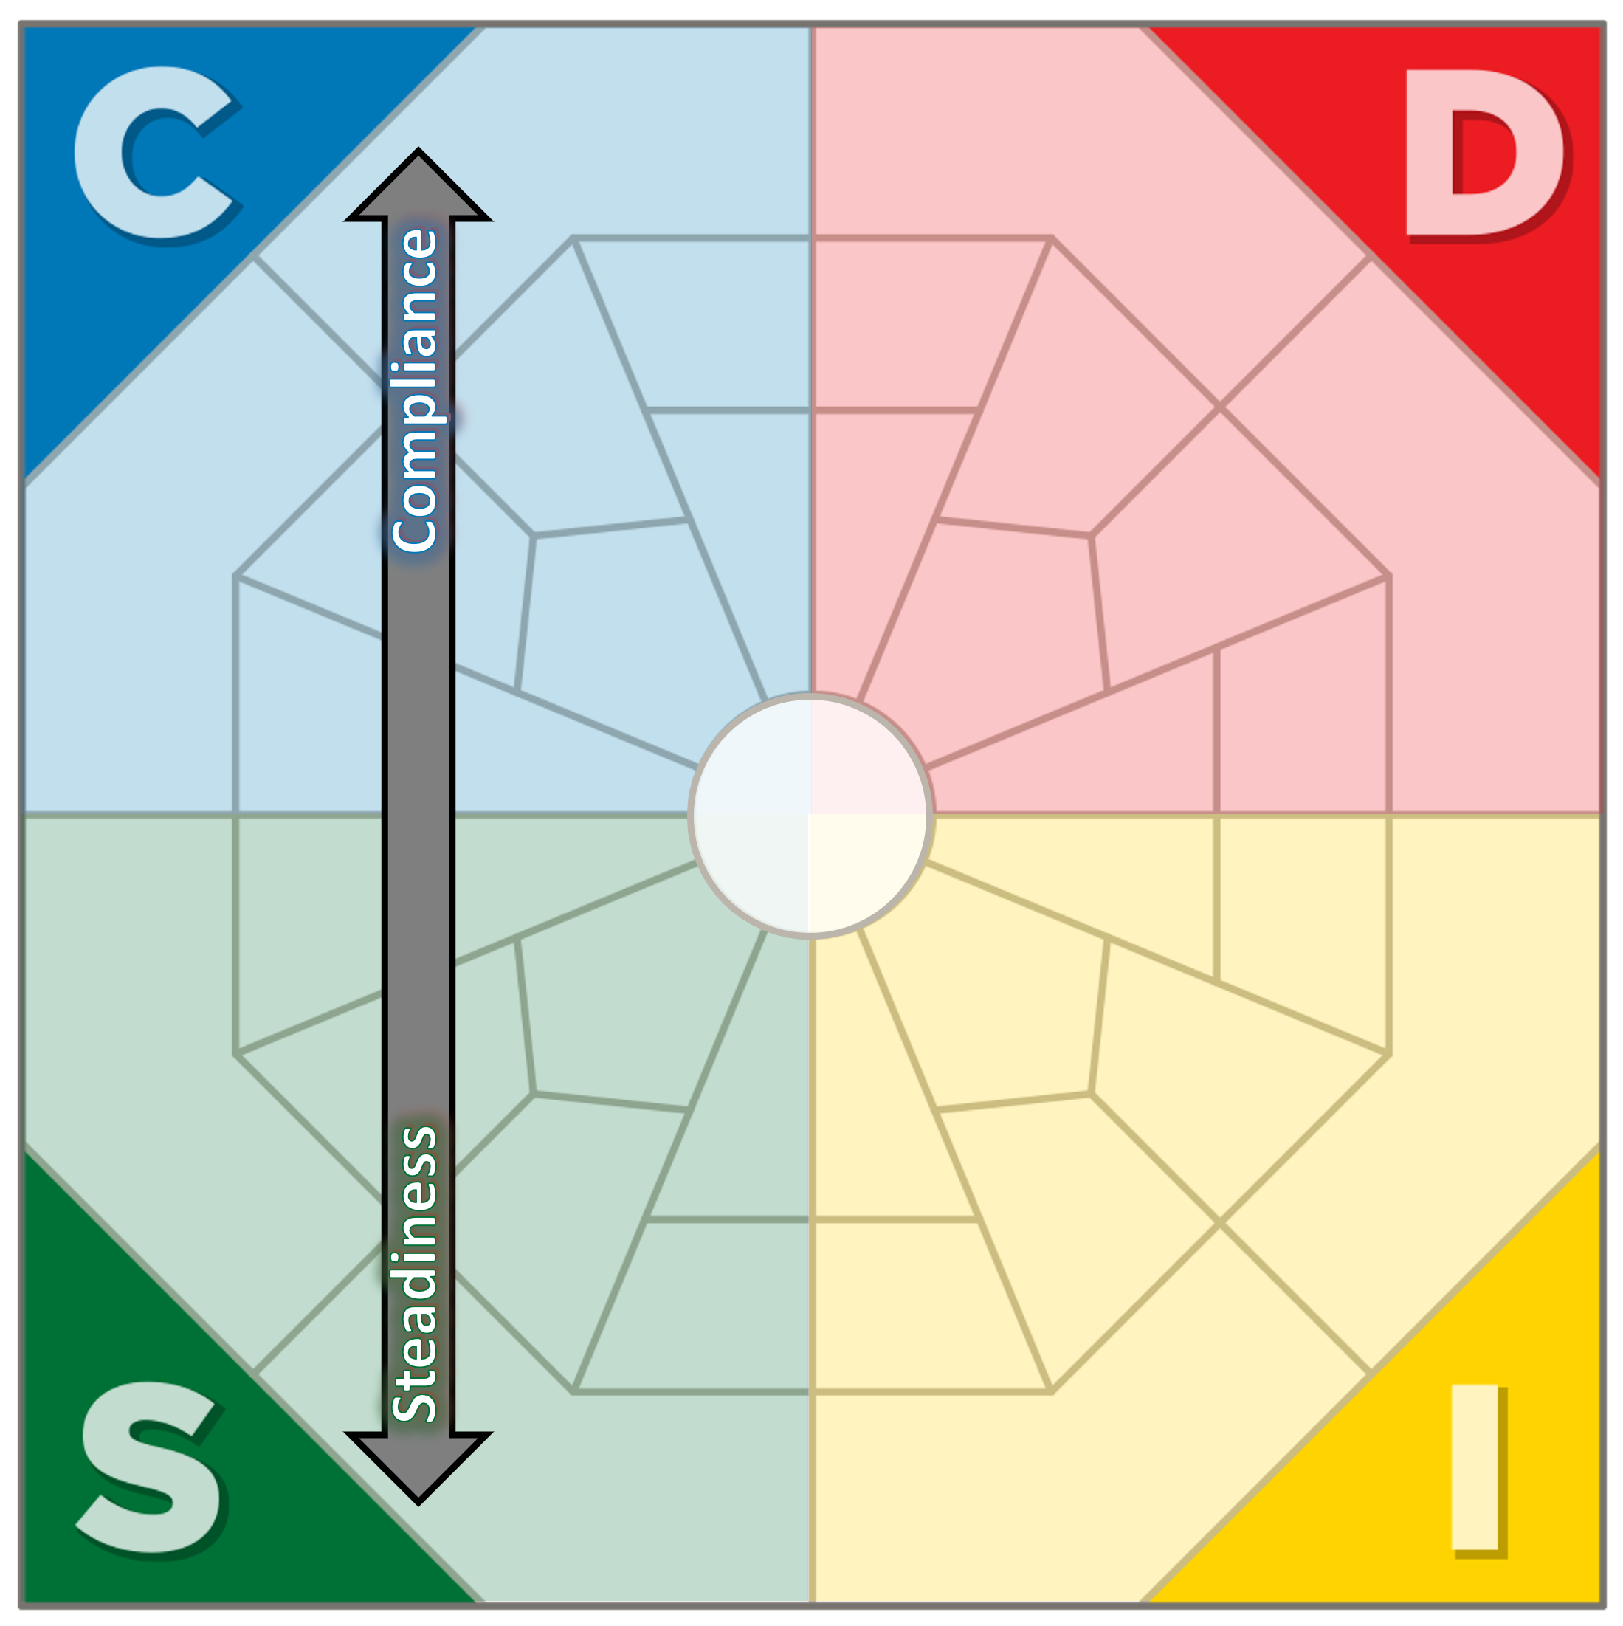
Tension/Disconnection
Task Orientated vs. People Orientated:
The demanding, driven and independent D-style may conflict with the animated, enthusiastic and sociable I-style.
Task Orientated vs. People Orientated:
The analytical, distant, detail-focused traits of the C-style contrast with the warm, team-focused, emotional style of the S.

Slide 3
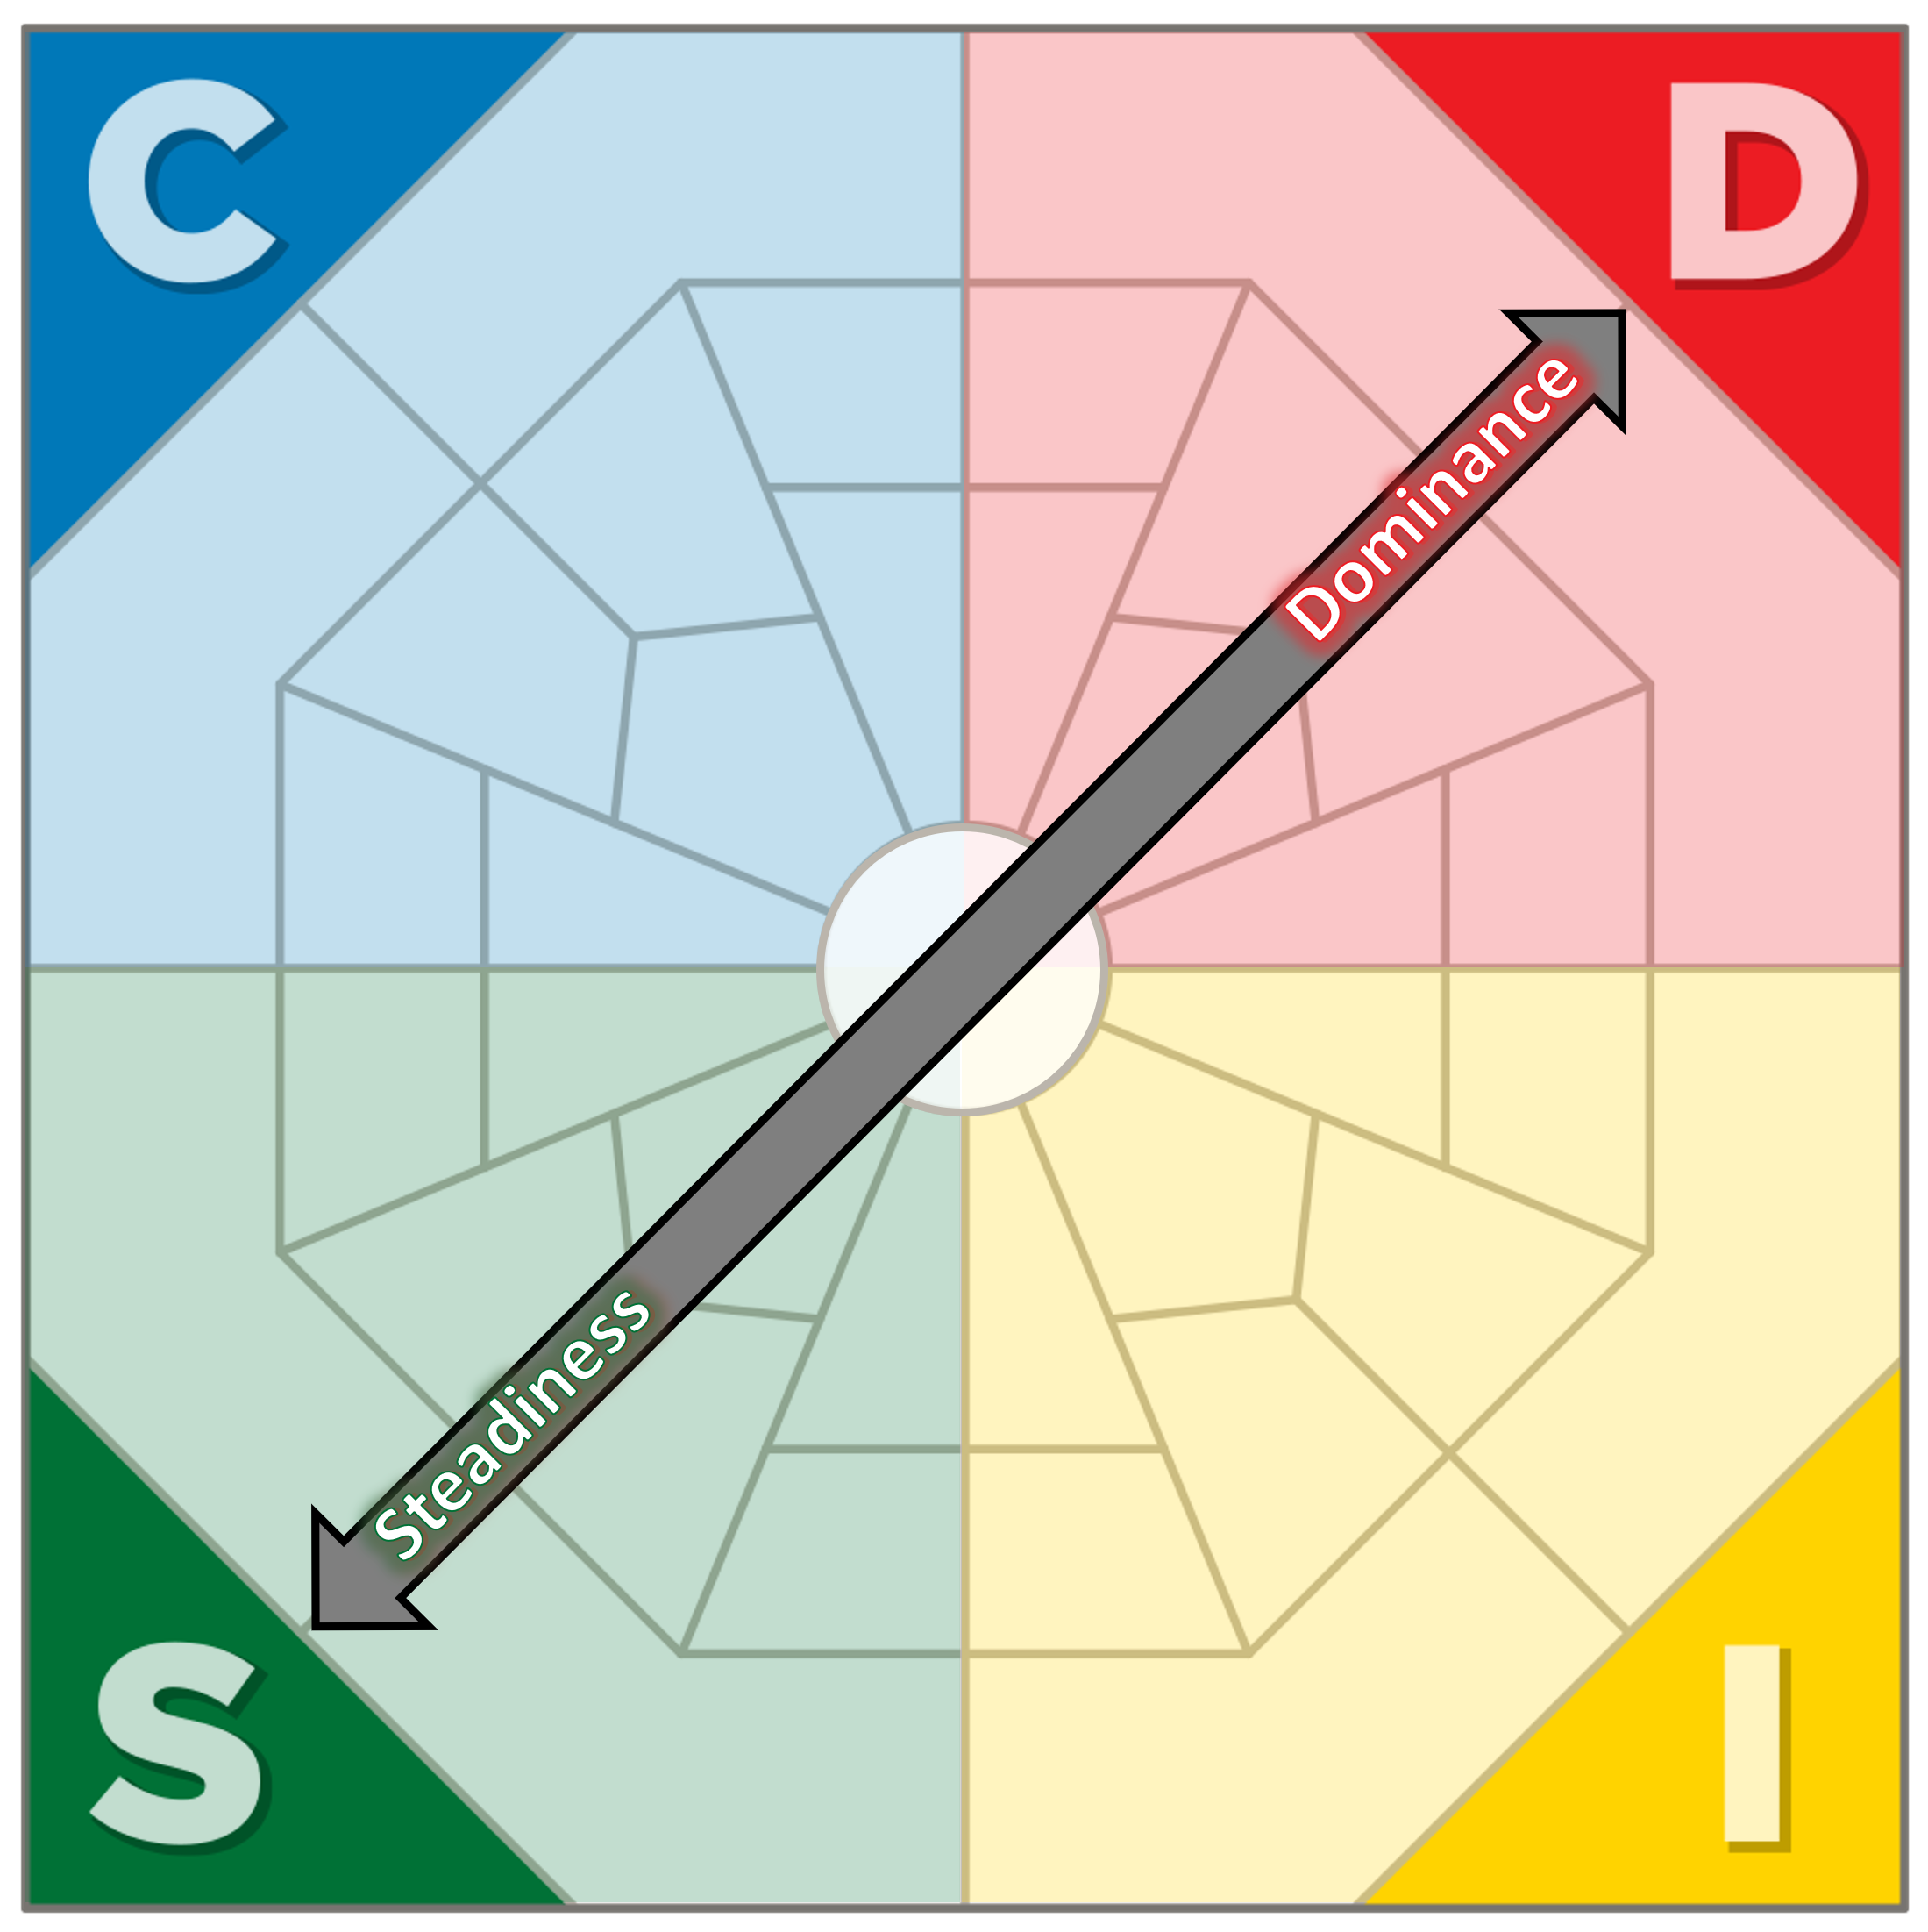
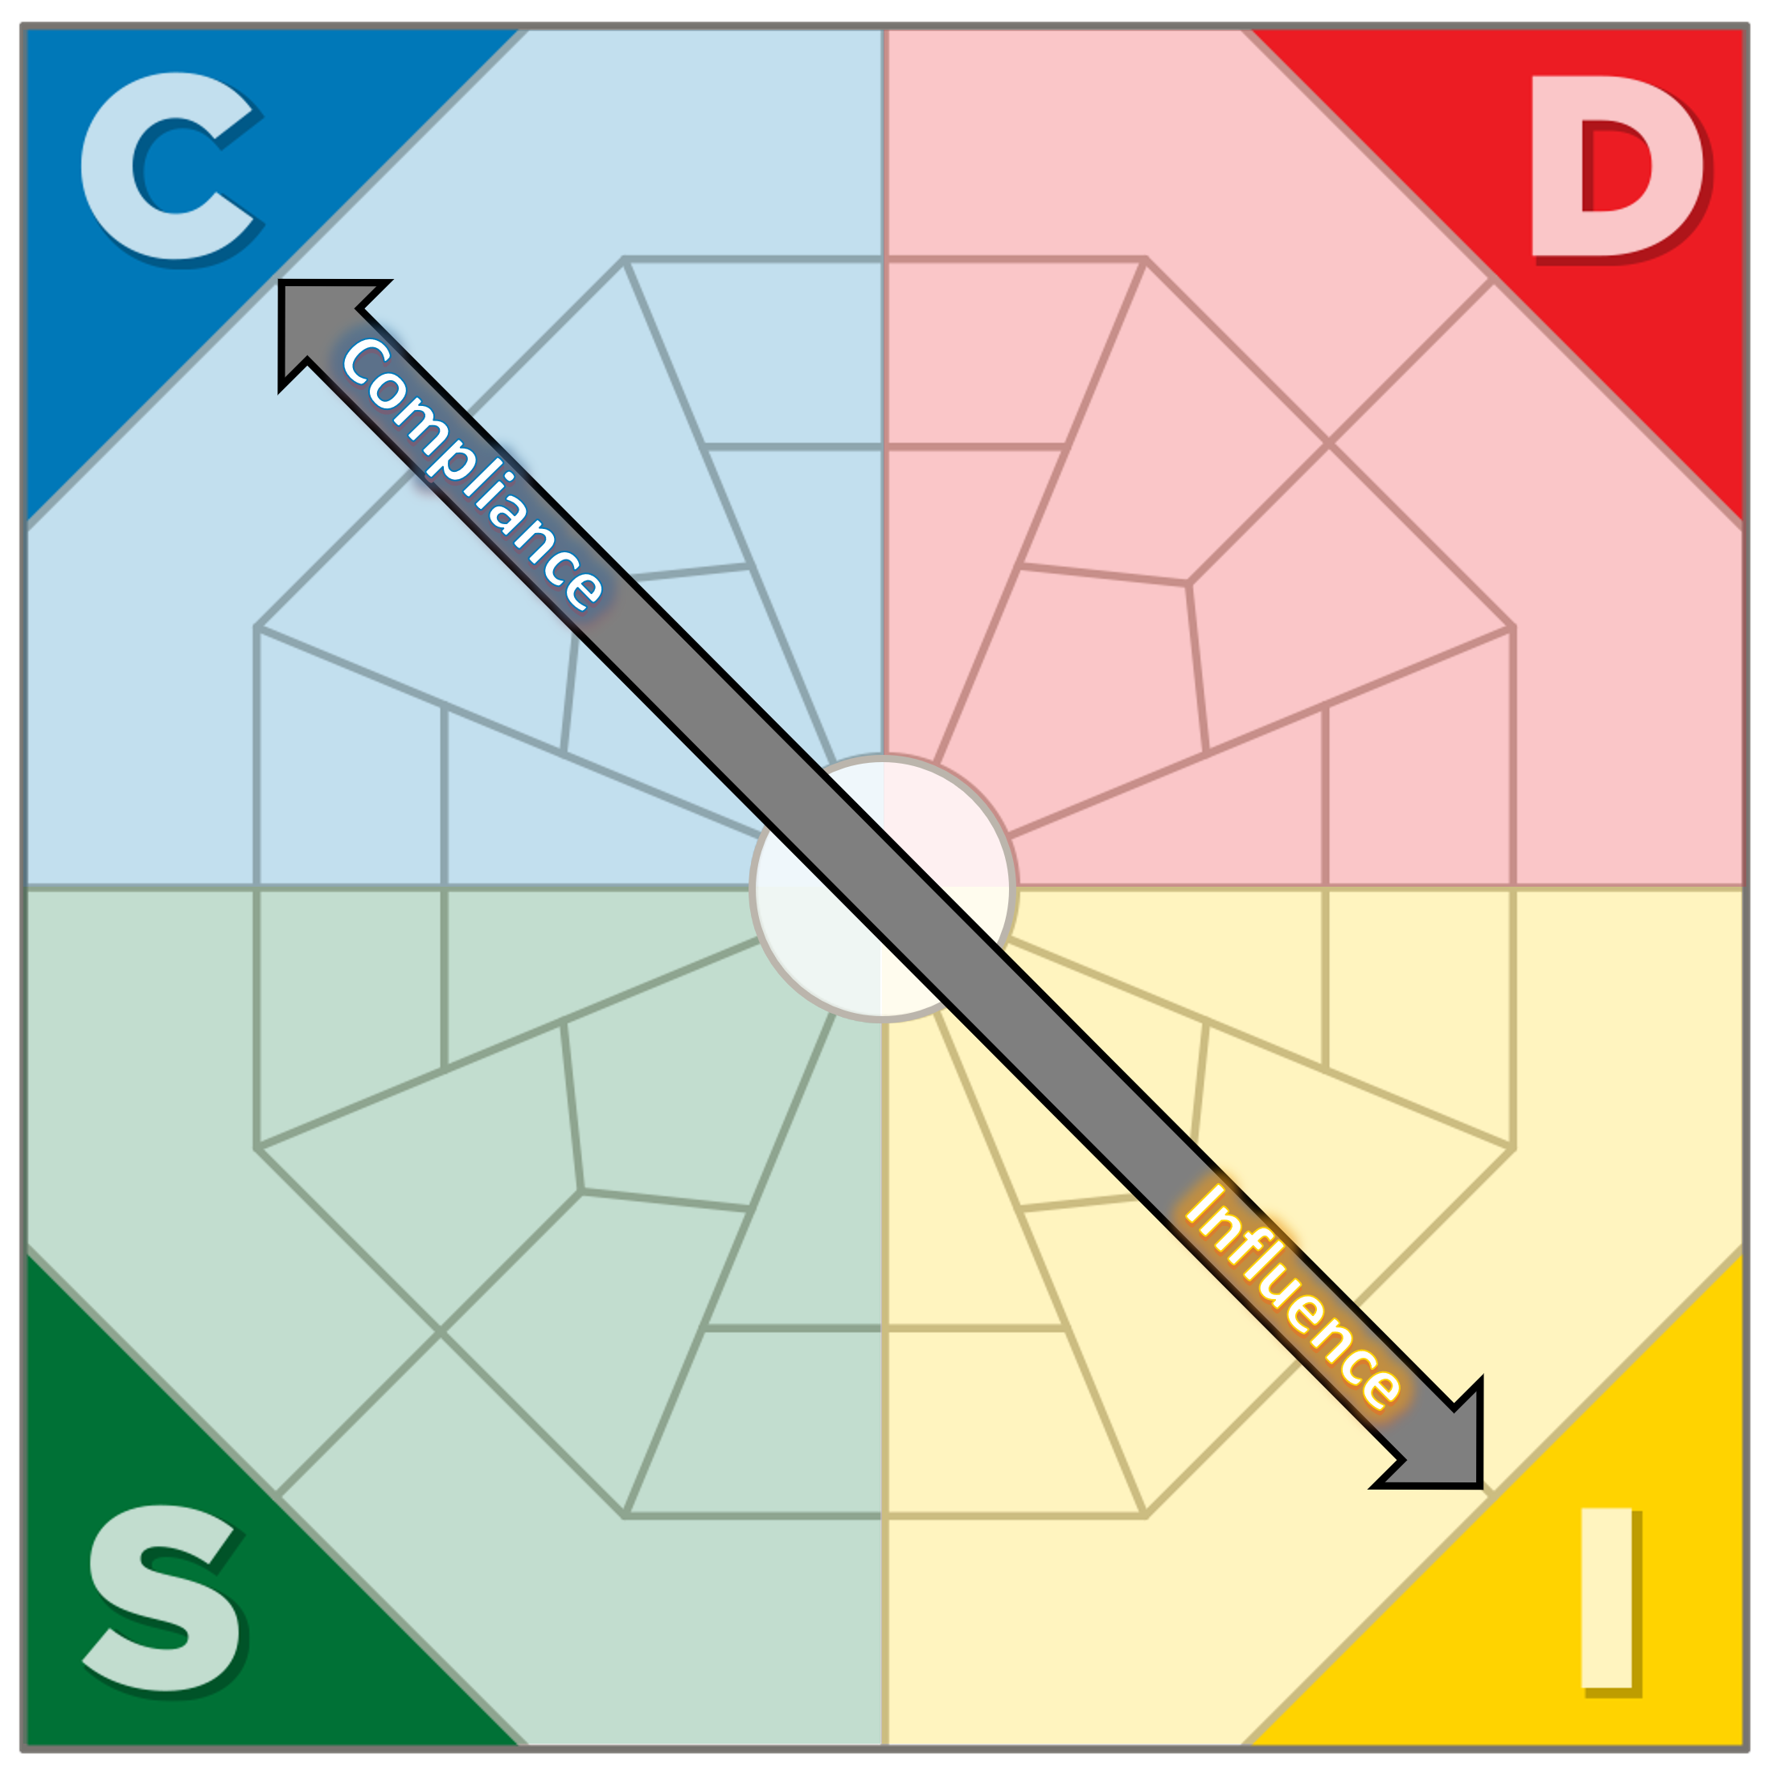
Tension/Disconnection
Fast Paced vs. Reserved Paced
AND Task Orientated vs. People Orientated:
The fast-paced, demanding, need to win attitude of the D-style contrasts strongly with the supportive, accepting and careful traits of the S.
Fast Paced vs. Reserved Paced
AND Task Orientated vs. People Orientated:
The spontaneous, influencing, talkative I-style contrasts strongly with the thorough, logical, quiet and very focused C-style.

