Slide 1



Adjusting Our Styles
Safety
Extended DISC®

Slide 2
Behavioural Styles and Safety Issues
All behavioural styles recognise the importance of safety.
None of the styles are “better” at dealing with safety issues.
Other factors, such as our values, attitudes, and experience, affect the way we deal with safety issues.
We’re focusing here on our behavioural styles.
Every style has its unique benefits and challenges in terms of safety issues.
We need to adjust our own style, so we can maximize our strengths and consciously work on our development areas.

Slide 3

Safety Issues - Overview

Slide 4
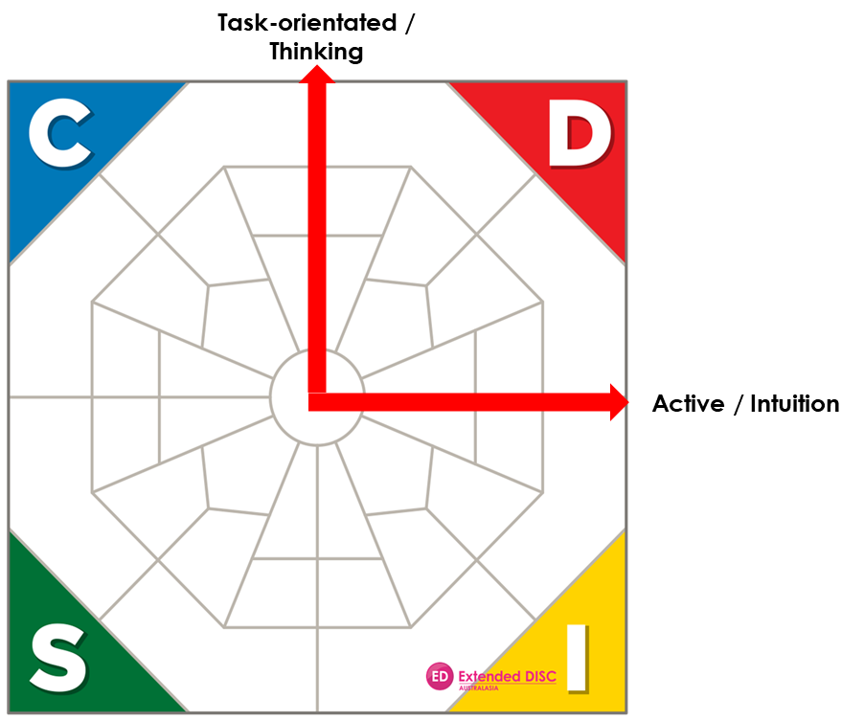
Safety Issues - Overview
D-Style:
Keeps the “big picture” in mind
Ties safety issues into the main objectives/goals
Good in crisis situations
May ignore the necessary details
May view safety concerns as distracting and even unnecessary
May forget safety reporting
May not pay enough attention to the human issues

Slide 5
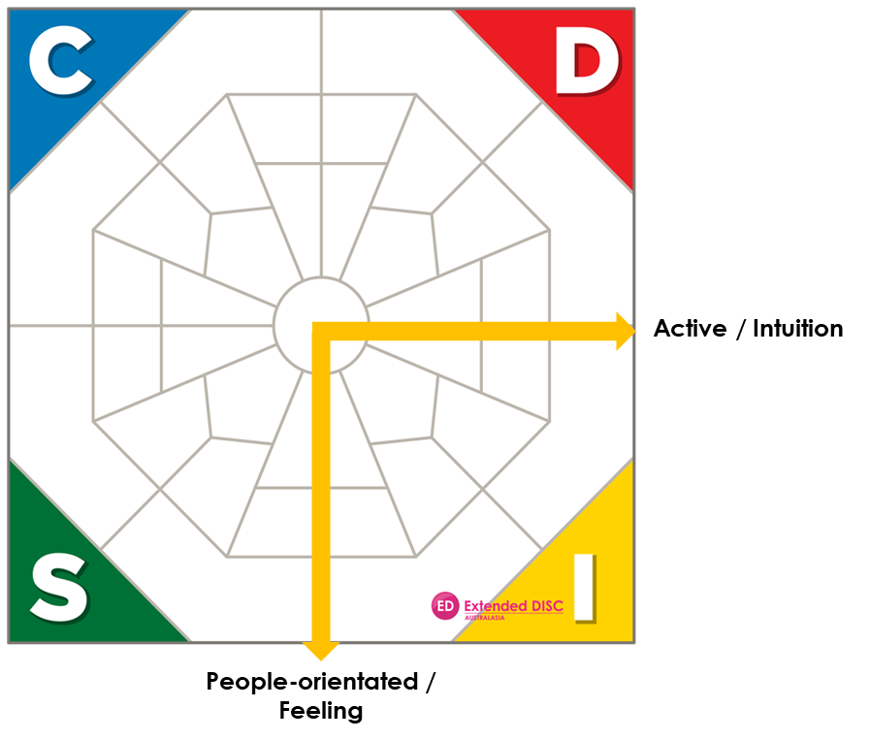
Safety Issues - Overview
I-Style:
Gets others enthusiastically involved
Keeps human safety issues in focus
May forget the details
May be unrealistic in assessing risks
May get bored with “restrictive” procedures and policies
May forget reporting

Slide 6
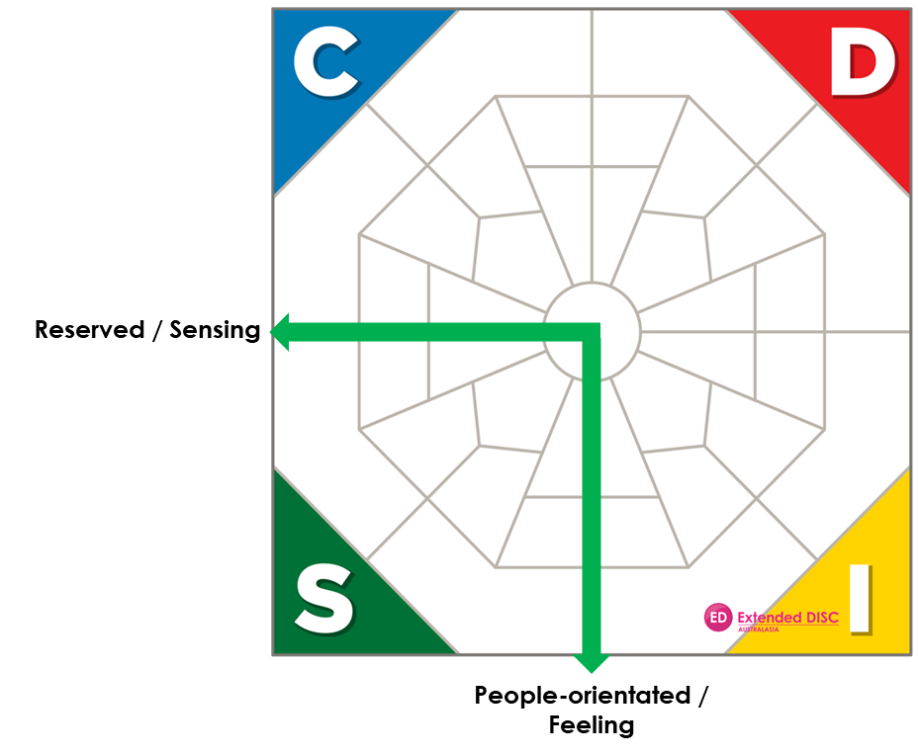
Safety Issues - Overview
S-Style:
Systematic and conventional approach to risk issues
Proceeds carefully; risk averse
Shows concern for employees
May become overly focused on the safety issues, forgets the other objectives/goals
May resist new safety procedures
May become emotional about their own team’s safety

Slide 7
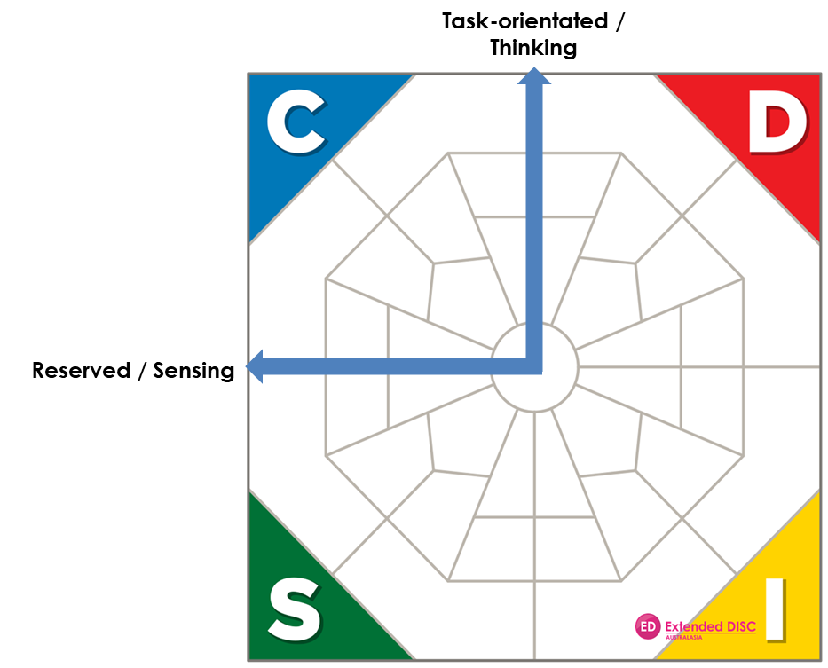
Safety Issues - Overview
C-Style:
Avoids risks
Very conscientious approach
Thorough analysis of all related risk factors, even over-analysis
Looks to the past for guidance
May forget to promote and sell the importance of safety issues to employees
May require instructions and support from others

Slide 8

Safety Issues - Planning

Slide 9

Safety Issues - Planning
D-style:
Tends to take an aggressive approach; is a risk taker
Keeps the main objectives in mind; “How does this fit into the big picture?”
May forget the impact on employees; forgets people issues
Is comfortable making “difficult and cold decisions”
May not be thorough enough

Slide 10
Safety Issues - Planning
I-style:
Focuses on the people aspects
May procrastinate or get sidetracked while planning
May forget the details
May be overly optimistic
Has difficulty making “tough” decisions
May let emotions direct the planning process

Slide 11
Safety Issues - Planning
S-style:
Conventional and systematic planner
Plans to avoid risks and remove threats
Remembers the human aspects
May look for support and help
May have difficulty finding new solutions and alternatives
May get stuck on the details

Slide 12
Safety Issues - Planning
C-style:
Very precise and meticulous planner; strives for perfection
May get stuck on the details and lose the “big picture”
Follows the established rules in safety planning
Documents thoroughly
May be overcautious
May overlook the impact on employees

Slide 13

Safety Issues –
Risk Analysis

Slide 14
Safety Issues –
Risk Analysis
D-style:
Calculated approach; is a risk taker
“What is the associated impact on productivity?”
Comprehensive, big picture analysis
Wants to make the final decision
Keeps the “unknowns” and the unexpected in mind
Focuses on results and goals

Slide 15
Safety Issues –
Risk Analysis
I-style:
Intuitive in risk analysis
Engages in discussions with others; seeks input
Optimistic attitude
Avoids the details, figures, facts
May be careless and make small mistakes
May forget to follow up
May let emotions direct self

Slide 16
Safety Issues –
Risk Analysis
S-style:
Analytical and conventional approach; focuses on details
Evaluates alternatives carefully
Is slow to make decisions
Unexpected developments cause resistance to moving forward
Is realistic, even pessimistic in assessing risk factors
May overestimate own team’s abilities

Slide 17
Safety Issues –
Risk Analysis
C-style:
Methodical analysis of all issues and details
Analysis based on facts and figures
Effective in analysing a lot of detailed information
Makes decisions/draws conclusions only after careful analysis; may be too slow
Analysis based on “right-wrong” way
May be overly critical of others

Slide 18

Safety Issues –
Areas for Improvement

Slide 19
Safety Issues –
Areas for Improvement
D-style:
Remember the human aspects
Keep in mind your tendency to take risks
Take more time to discuss safety issues with your colleagues
Listen to your colleagues’ viewpoints and ideas
Remember the importance of details and documentation
Don’t over-delegate safety issues

Slide 20
Safety Issues –
Areas for Improvement
I-style:
Remember the importance of details, facts and figures
Be realistic in assessing situations and people
Be more critical when the situation and/or behaviour calls for it
Do not procrastinate when it comes to talking about negative issues
Remember the importance of details and documentation

Slide 21
Safety Issues –
Areas for Improvement
S-style:
Keep in mind your tendency to be risk averse
Keep the big picture in mind
Be more critical when the situation and/or behaviour calls for it
Don’t get lost in the details
Plan for the unexpected
Be realistic in assessing your own team
Accept change

Slide 22
Safety Issues –
Areas for Improvement
C-style:
Remember the human aspects
Keep in mind your tendency to be overcautious
Take more time to discuss safety issues with colleagues
Keep the big picture in mind
Take a more active role with colleagues; be less critical
Share information with others
Look for new, better ways

Slide 23

Tailored solutions to enhance organisational performance.
Contact
Info@hrprofiling.com

