Slide 1



A General Description Of The DISC Styles
Extended DISC®

Slide 2
DISC Styles – A General Description
D Style
I Style
D-styles are competitive, aggressive, decisive and results-oriented. They prefer to move fast, take risks and get things done now. D-styles also like to be in charge, in control and have the power. They like change and challenges.
D-styles can also be impatient, overbearing and even rude. They are often not very good listeners and are prone to making snap decisions. Others may perceive D-styles as being somewhat self-centred, demanding, blunt, and aggressive.
I-styles are talkative, sociable, optimistic and lively. They are people-oriented, spontaneous, energetic and enthusiastic. I-styles tend to be positive and good at influencing others.
I-styles can also be inattentive to details, overly talkative and emotional. They may over-promise because they are so optimistic and are eager to be popular. Others may perceive I-styles as being somewhat careless, impulsive and lacking follow-up.

Slide 3
DISC Styles – A General Description
S Style
C Style
S-styles are calm, helpful, patient, modest, and laid back. They are eager to help, loyal and often make excellent team players. S-styles tend to be patient listeners, trustworthy, and balanced between tasks and people. They are very persistent.
S-styles need stability and security and, therefore, need help with change. They may be too willing to pitch in and at times might be taken advantage of. Others may perceive S-styles as being too slow, stuck on the status quo, indecisive, stubborn and even quietly resentful.
C-styles are precise, logical, matter-of-fact, analytical and careful. They need data, information and analyses. They are focused on tasks and ensure things get done correctly. C-styles tend to produce high quality work.
C-styles may also focus too much on the details, becoming nit-picking, slow and losing the big picture. At times, they get lost in the analysis, focusing too much on the trees and not enough on the forest. Others may perceive C-styles as being too critical, distant, pessimistic, and even cold.

Slide 4
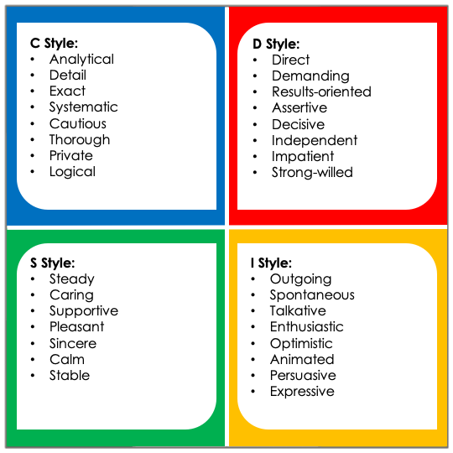
Summary of the Styles

Slide 5

Tailored solutions to enhance organisational performance.
Contact
Info@hrprofiling.com

