Slide 1



Identifying the Styles
Extended DISC®

Slide 2
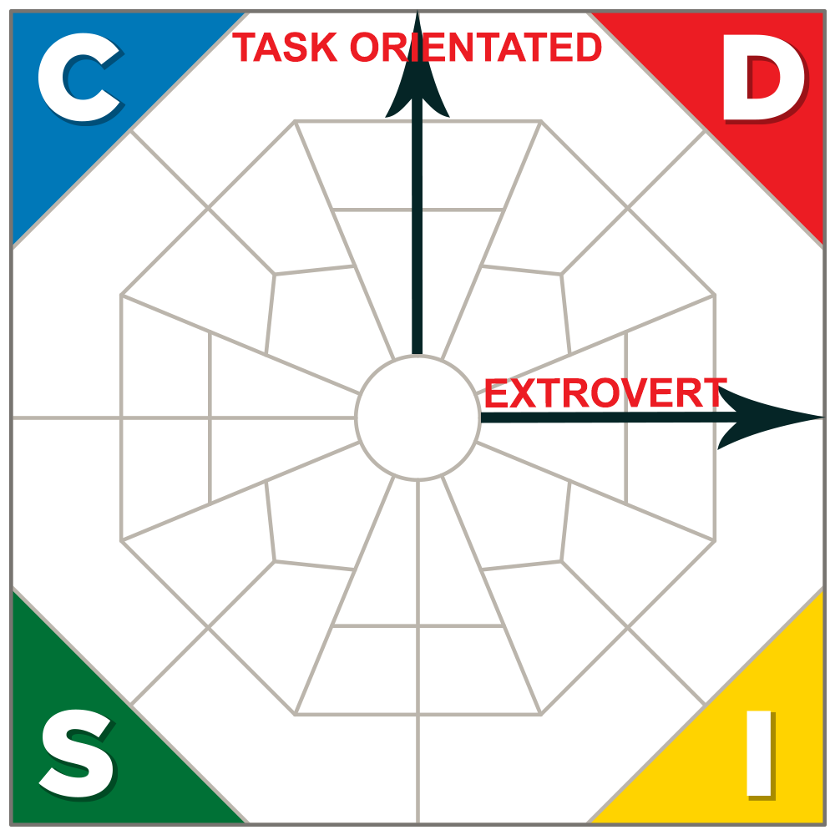
How to recognise a D-Style
Says what they think; shows their feelings
Communication goes only one way - from them
Impatient listener or may not listen at all
Own opinions are given as facts
Allows little discussion on decisions and topics
Very little small talk – the focus is on results and the big picture
Assumes control of the conversation
^{May interrupt frequently}
Thinks “How can this benefit me?” “What’s the bottom line?”

Slide 3
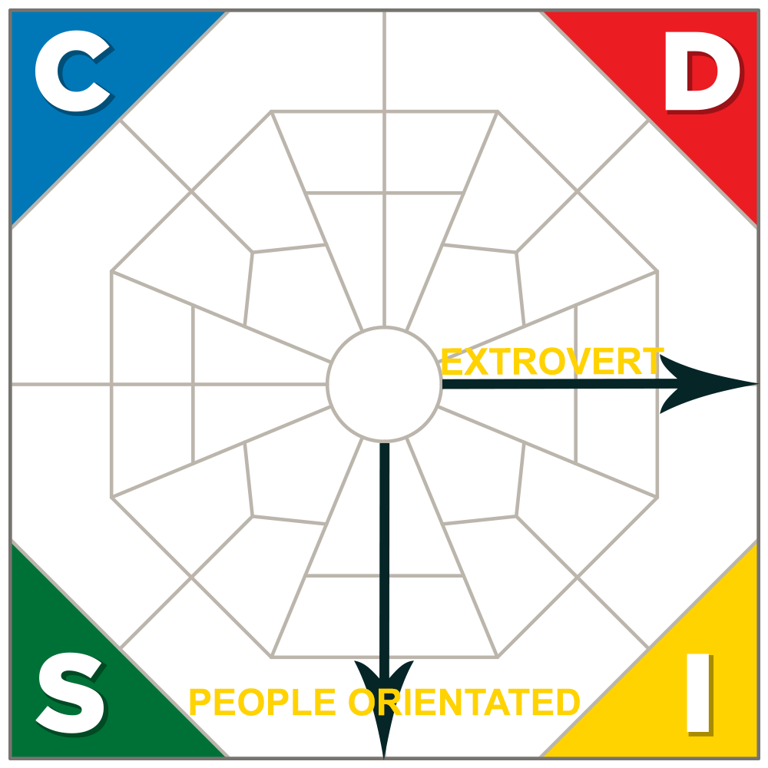
How to recognise an I-Style
Can be indiscreet as they’re often open about themselves
Uncomfortable with silences and talks to fill them in
Needs to contribute, so doesn’t listen very long
^{and can interrupt}
Likes interaction and the social aspect
Can get enthusiastic when agreeing
Focuses on emotions but may not assess
^{what’s being said}
^{Is talkative and inspiring}
^{Tells stories with ‘I’ in them}
Prefers pleasant or fun issues - avoids conflict and detail
Gives good constructive feedback
Searches for commonality but strays off topic and loses sense of time

Slide 4
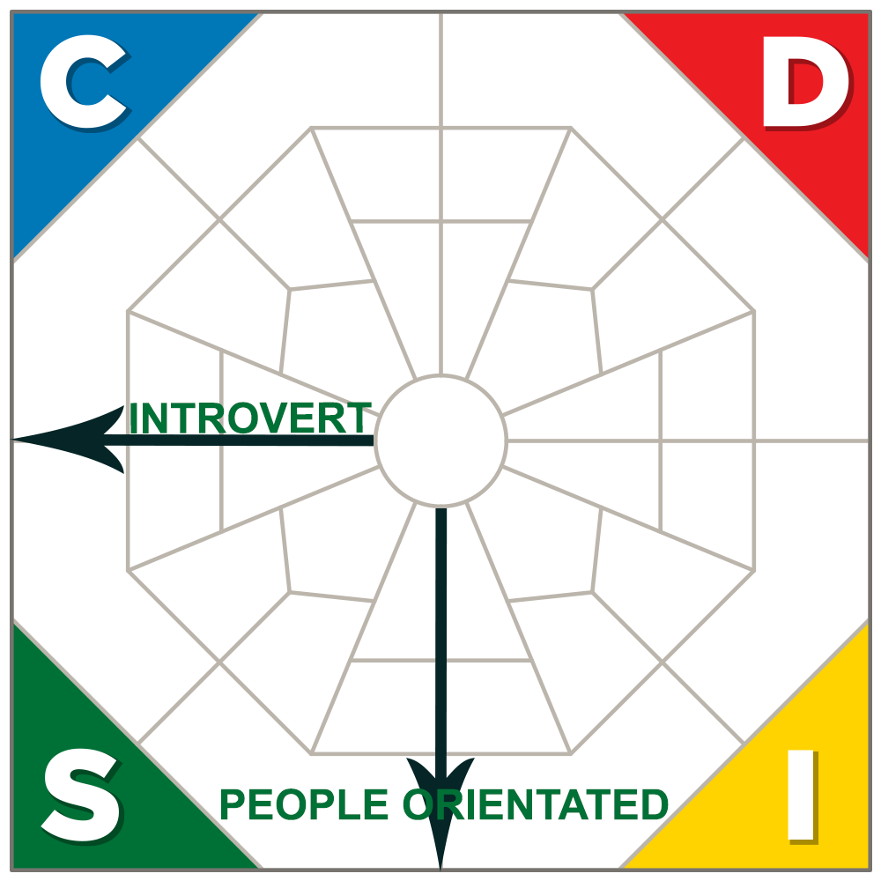
How to recognise an S-Style
Answers when asked and doesn’t interject
^{Talks calmly and logically}
Talks about issues they’ve mastered
Prefers to talk one-to-one (not to large groups)
Often a good instructor as they’re patient
^{Not overly animated}
If you interrupt, they stop talking
Doesn’t tend to offer a lot of feedback
Communication in one direction – they listen
Engages fully, actively pays attention - a patient and empathetic listener
Focuses on the message but can resist if message suggests change
^{Sees a variety of viewpoints}
Focuses on the negative and subdues excitement
May nod - even when disagreeing

Slide 5
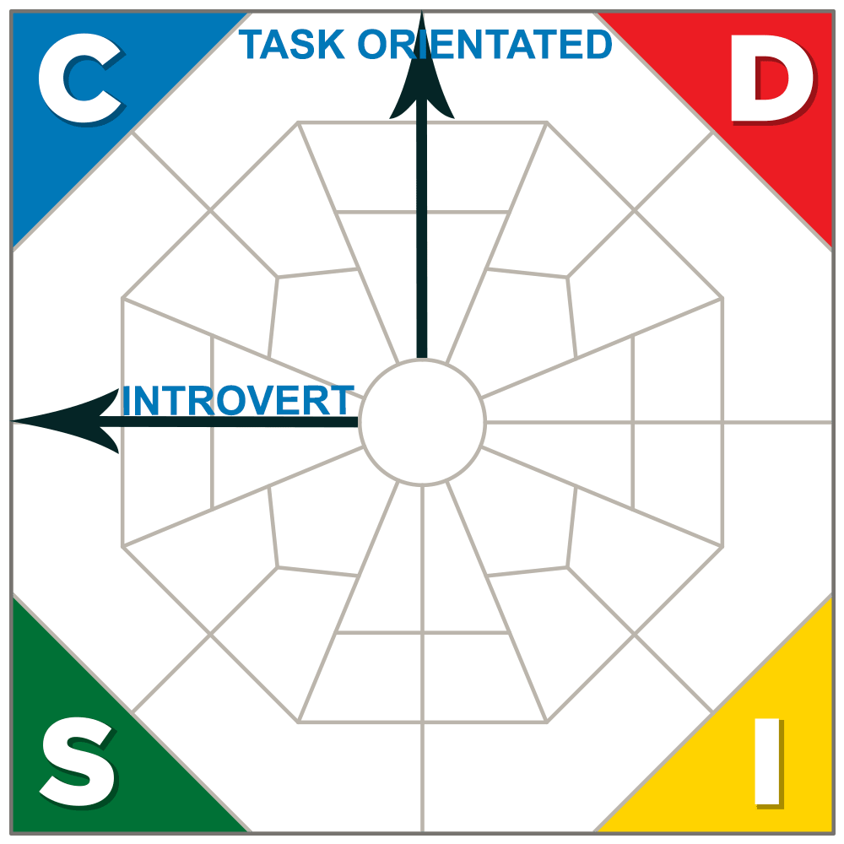
How to recognise a C-Style
^{Prefers written communication}
Masters details but often loses the essentials
^{Tends to avoid conflict}
Doesn’t like talking about opinions or abstract matters
Likes to discuss issues substantiated by facts and proof – refers to rules
^{Doesn’t order people around}
Tends to be comfortable with silence
^{Needs time to think}
Has difficulty if information is not presented logically
^{Can get hung up on the details}
^{Critical. Looks for errors}
Attentive if interested. Very eager to learn
Asks a lot of questions to determine genuine facts
^{Doesn’t provide much feedback}

Slide 6

Tailored solutions to enhance organisational performance.
Contact
Info@hrprofiling.com

