Slide 1



The Styles and Communication
Extended DISC®

Slide 2
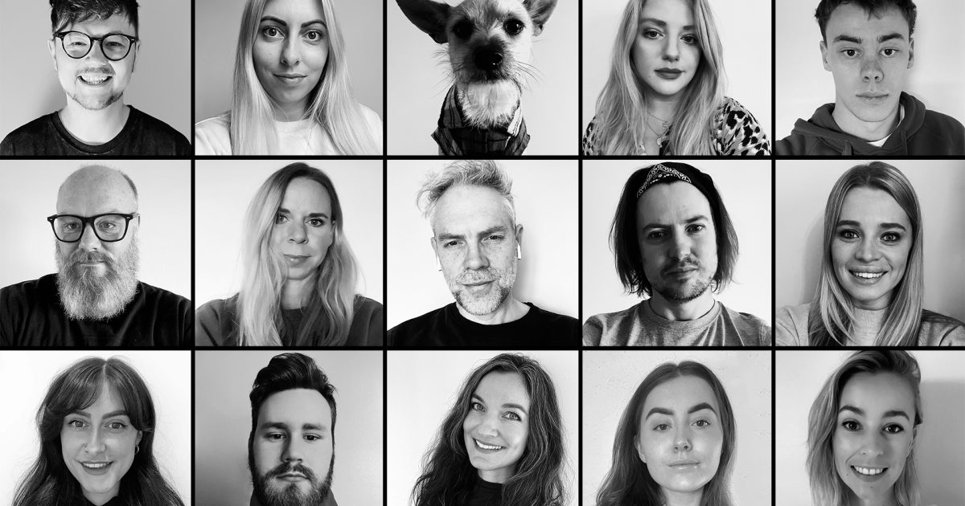
How to Recognise the Styles

Slide 3
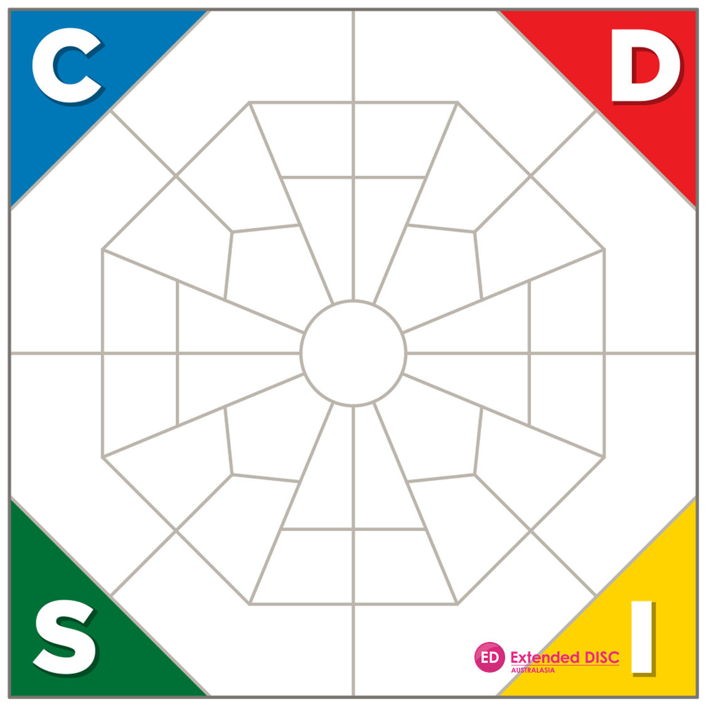
How To Recognise a D Style
Says what they think; shows their feelings
Communicates in one direction - from them
Impatient listener or may not listen at all
Delivers own opinions as facts
Allows little discussion on decisions and topics
Very little small talk – the focus is on results and the big picture
Assumes control of a conversation
May interrupt frequently
Thinks “How can this benefit me?” “What’s the bottom line?”

Slide 4
How To Recognise an I Style
Open about themselves and may be indiscreet
Uncomfortable with silence and talks to fill it
Needs to contribute, so doesn’t listen very long and may interrupt
Enjoys social interaction
Can get enthusiastic when agreeing
Focuses on emotions but may not assess what’s being said
Is talkative and inspiring
Tells stories with ‘I’ in them
Prefers pleasant or fun topics - avoids conflict and detail
Gives good constructive feedback
Searches for commonality but is prone to stray off topic and loses sense of time

Slide 5
How To Recognise an S Style
Answers when asked and doesn’t interject
Talks calmly and logically
Talks about topics they’ve mastered
Prefers to talk one-on-one (not to large groups)
Often a good instructor as they’re patient
Not overly animated
Doesn’t tend to offer a lot of feedback
Communicates in one direction – they listen
Engages fully, actively pays attention - is patient and empathetic
Focuses on the message but may resist if it means change
Can see a variety of viewpoints
May focus on the negative and subdue excitement
May nod - even when disagreeing

Slide 6
How To Recognise a C Style
Prefers written communication
Masters details but often loses the essentials
Tends to avoid conflict
Doesn’t like talking about opinions or abstract matters
Likes to discuss issues substantiated by facts and proof – refers to rules
Tends to be comfortable with silences – needs time to think
Struggles if information is not presented logically
Can get hung up on the details
Critical and looks for errors
Attentive if interested and very eager to learn
Asks a lot of questions to determine the genuine facts
Doesn’t provide much feedback

Slide 7
Communicating with a D-Style
Do
Don’t
Be direct
Give immediate feedback
Concentrate on the subject
Act quickly
Provide alternatives
Show interest
Provide too much information
Talk too much
Lose focus
Take issues personally
Slow down

Slide 8
Communicating with an I-Style
Do
Don’t
Maintain a positive atmosphere
Take time to chat
Be enthusiastic
Focus on the people aspect
Focus on the big picture
Talk about too many details
Fail to socialise
Bring up negative issues
Be too practical
Set too many restrictions
Isolate them

Slide 9
Communicating with an S-Style
Do
Don’t
Proceed in a logical order
Ask specific questions to determine true needs
Provide support
Provide precedents to reduce uncertainty
Remember fairness
Make unexpected changes
Forget to provide enough information
Move too fast
Be impatient
Be unreliable

Slide 10
Communicating with a C-Style
Do
Don’t
Listen carefully
Answer questions calmly and carefully
Be thorough - include all the details
Slow down your speech
Assess key issues and focus on them
Move too fast
Expect decisions right away
Spend too much time on small talk
Lose patience in providing
correct and thorough information

Slide 11

Tailored solutions to enhance organisational performance.
Contact
Info@hrprofiling.com

