Slide 1



Adjusting Our Styles
Customer Service
Extended DISC®

Slide 2
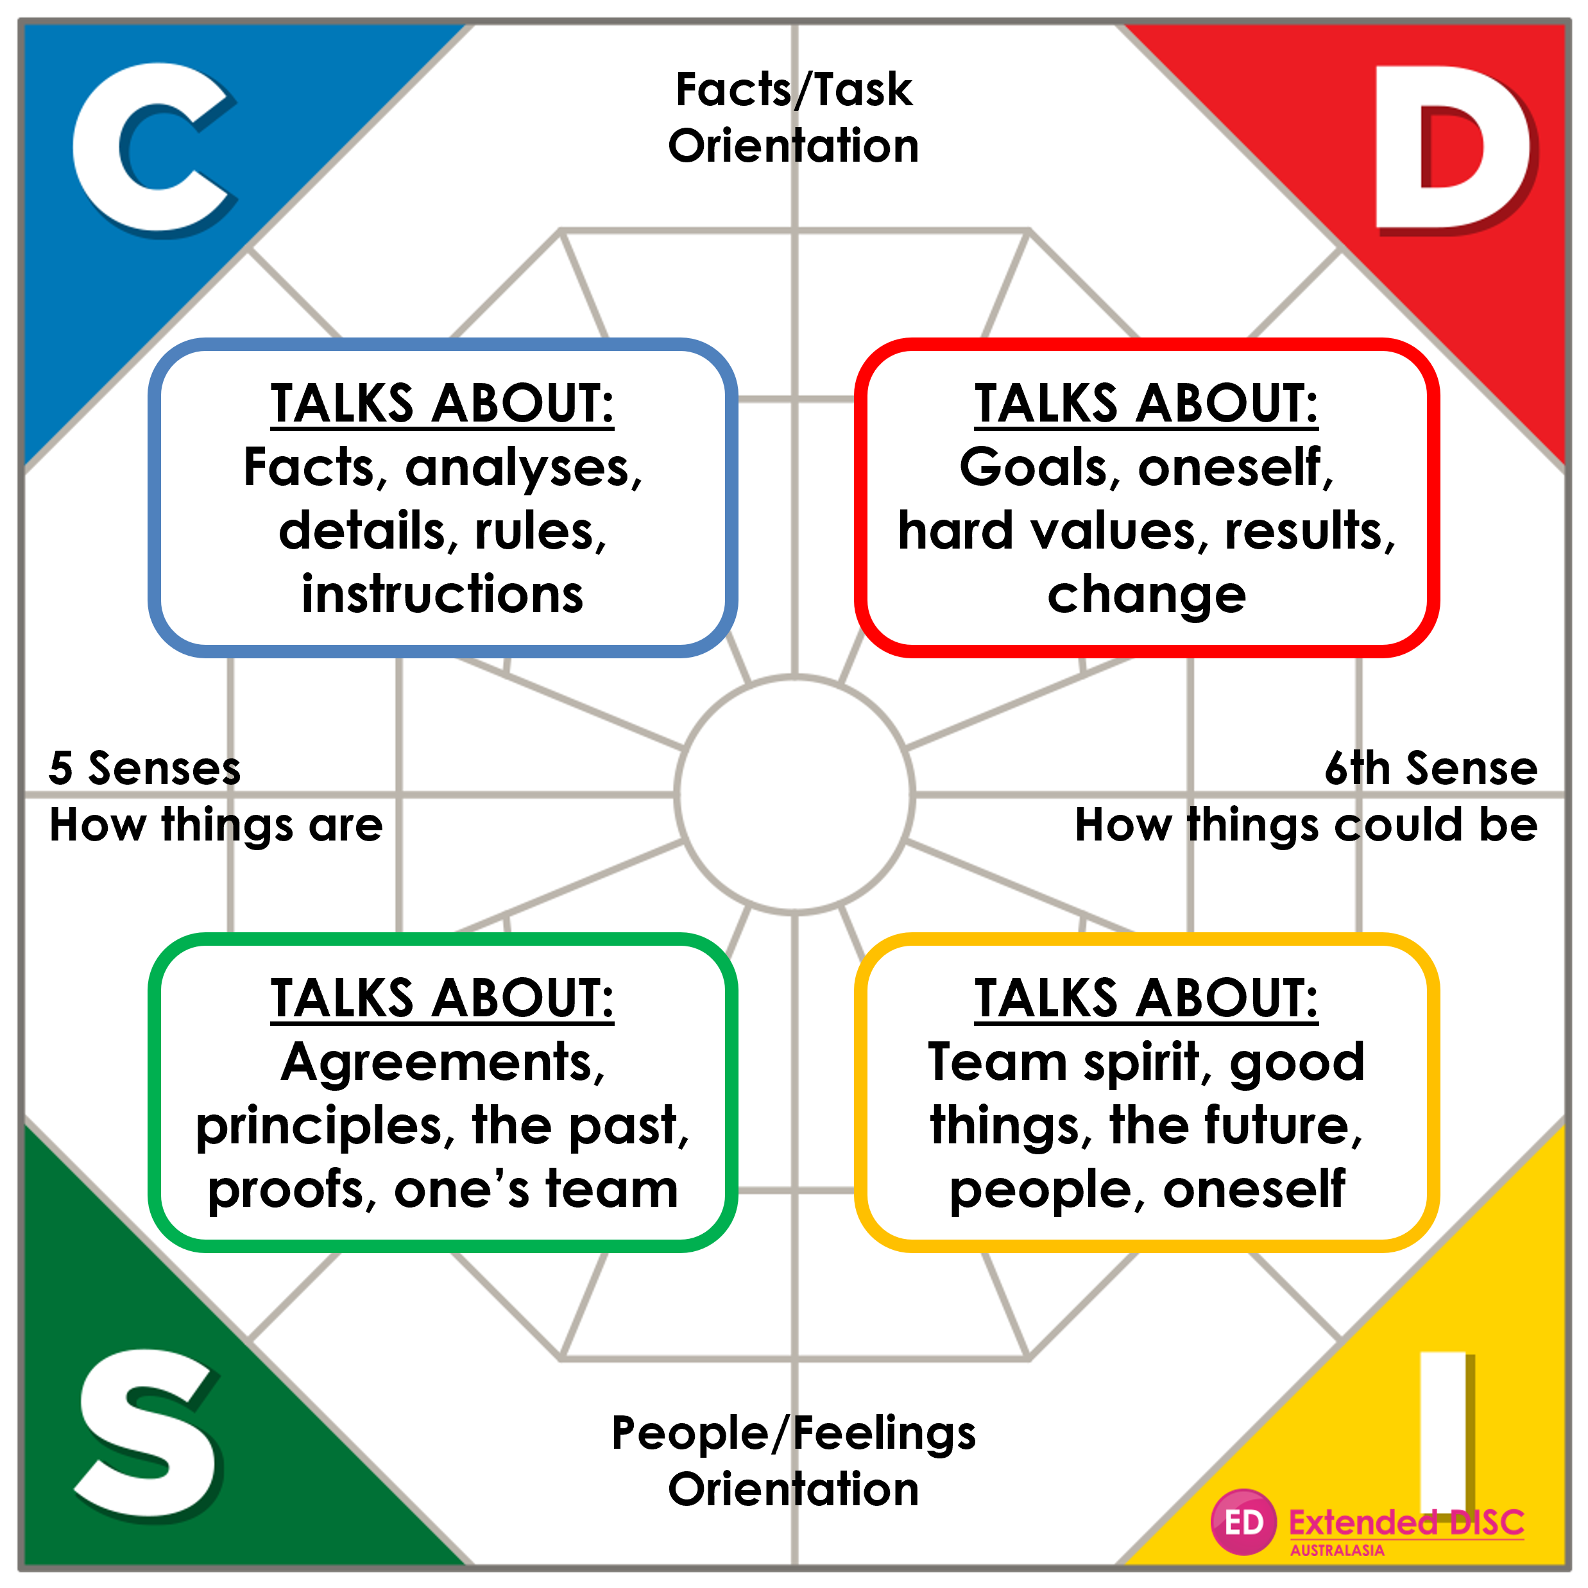
Identifying Customer Styles

Slide 3

Identifying Customer Styles

Slide 4
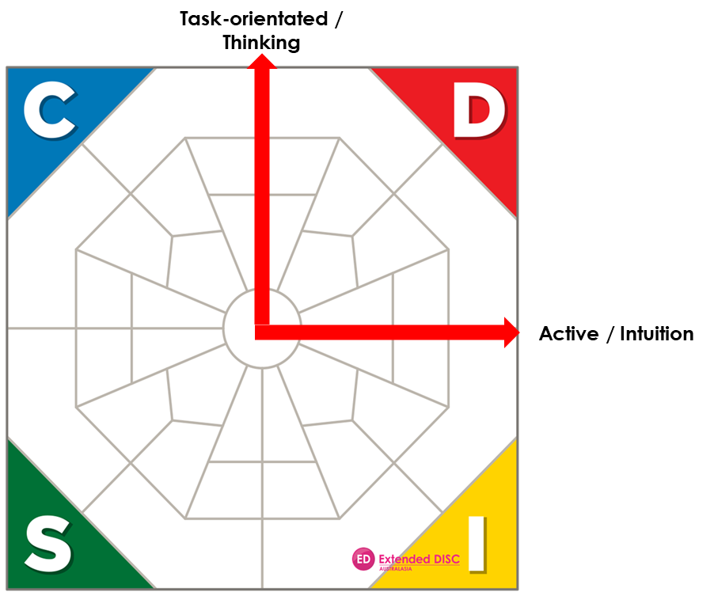
Identifying Customer Styles
D-Style:
Is aggressive
May be blunt
Is demanding
Very impatient
Interrupts others
Becomes irritated easily
Is direct; says what thinks
“What’s the bottom line?”
Focuses on the big picture
States own opinions as facts
“How does this benefit ME?”
Often appears to be in a hurry
Makes decisions quickly, almost hastily
May talk to many people at the same time
May have difficulty understanding others’ viewpoints/feelings

Slide 5
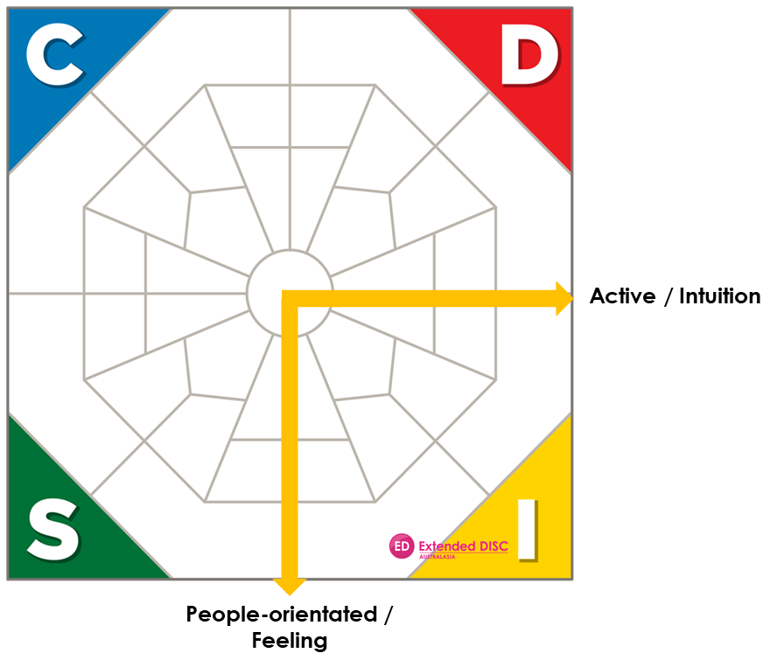
Identifying Customer Styles
I-Style:
Talks a lot
Is animated
Gets excited easily
Is open and friendly
May appear unorganised
Does not listen for long
Stays away from hard facts
Does not pay close attention
Jumps from subject to subject
Does not focus much on details
Talks about people they know
May make decisions spontaneously
May ask same questions several times
May touch; comfortable with physical contact

Slide 6
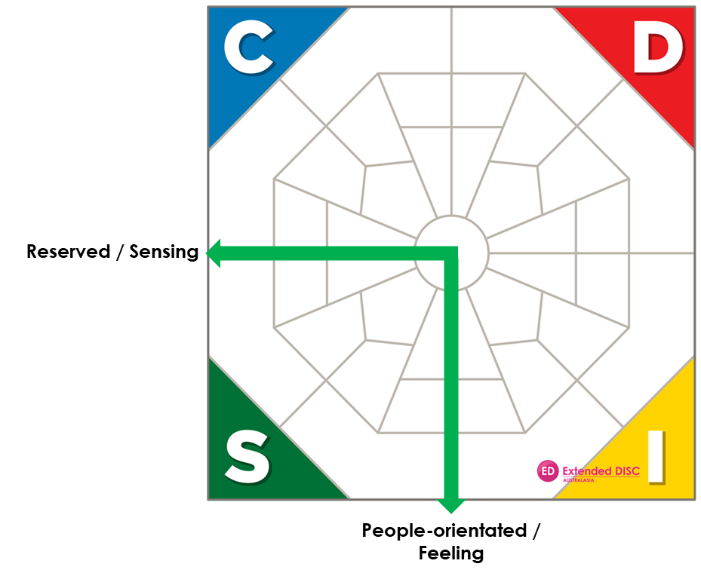
Identifying Customer Styles
S-Style:
Is easy-going
Appears calm
Listens carefully
Appears thoughtful
Nods and goes along
“Let me think about it.”
Likes own physical space
Does not get excited easily
Asks questions and enquires about the specifics
Seems to have strong opinions but does not express them vocally
Completely new ideas/things seem to make them uncomfortable
Ponders alternatives; slow in making decisions

Slide 7
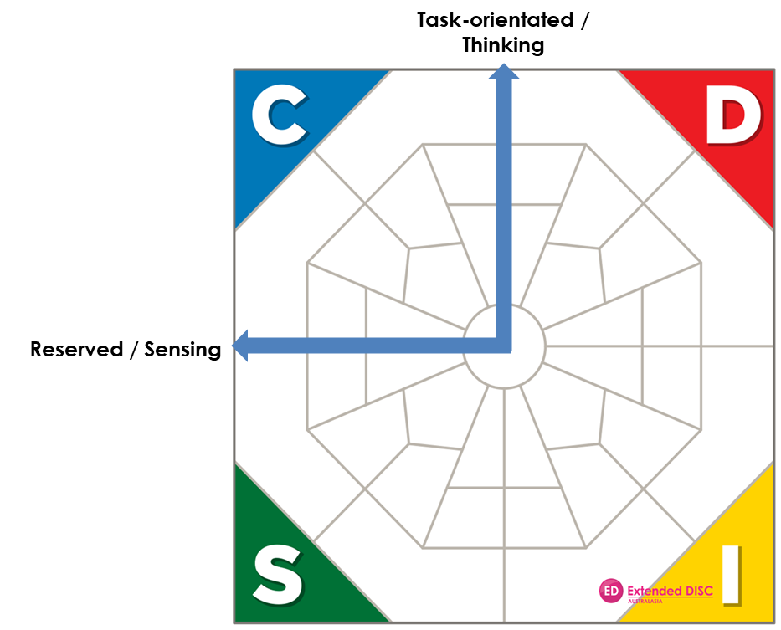
Identifying Customer Styles
C-Style:
Is quiet
Focuses on details
Proceeds cautiously
Asks many questions
Not comfortable with physical contact
Appears reserved and somewhat timid
Doesn’t easily express disagreeing views
May have done homework on the products/services
Studies specifications and other information carefully
Makes decision only after studying pertinent facts/issues
May be very critical; criticism based on facts, not opinions

Slide 8

Customer Service
Strengths

Slide 9

Customer Service -
Strengths
D-style:
Resolves issues quickly
Takes responsibility
Comes up with new solutions
Is decisive
Is responsive and fast
Handles new situations well
Can handle pressure well
Focuses on the issues
Does not get emotional
Handles issues independently

Slide 10
Customer Service -
Strengths
I-style:
Outgoing and positive
Easy to approach and makes customers feel comfortable
Is seen as open and friendly
Gets excited and enthusiastic
Puts customers in a good mood and creates a positive atmosphere
Enjoys interacting with new people

Slide 11
Customer Service -
Strengths
S-style:
Remains calm and steady
Is a patient listener; finds out the needs/issues
Reliable and thorough
Builds and maintains trust
Good with facts and details
Appears easy-going, pleasant, and neutral
Fair and just
Accepting and warm

Slide 12
Customer Service -
Strengths
C-style:
Thorough with details and facts; an expert
Systematic and exact
Provides consistent service
Aims for perfection
Strives for quality and correctness
Focuses on the issues
Does not get emotional
Gets help when doesn’t know

Slide 13
Customer Service
Challenges

Slide 14
Customer Service -
Challenges
D-style:
Impatient listener – may not discover the true needs/issues
Tendency to offer solutions too quickly
May exceed level of authority
May get into arguments with the customers
May not show enough empathy and understanding
May lack diplomacy

Slide 15
Customer Service -
Challenges
I-style:
May overlook the details and facts
May spend too much time talking, not enough listening
May mix issues and emotions
May procrastinate with the difficult/unpleasant issues
May forget to follow up
May want to please too much and promise too much

Slide 16
Customer Service -
Challenges
S-style:
May be slow to move and decide in new situations
Inexpressive
May not show enough enthusiasm
May refer to the rules and appear inflexible
May focus too much on the negative and be pessimistic
Bureaucratic

Slide 17
Customer Service -
Challenges
C-style:
Thorough with details and facts; an expert
May appear distant and too quiet
May focus on facts/details overlooking the human aspect
May not exhibit enough enthusiasm
May not spend enough time relating to the customers
May be too inflexible or refer to policies too often

Slide 18
Customer Service
How to Improve

Slide 19
Customer Service -
How to Improve
D-style:
Slow down; be more patient
Talk less and focus on listening to the customer
Express opinions less frequently
Focus more on details
Be less aggressive and blunt
Spend more time relating to the customers
Follow up

Slide 20
Customer Service -
How to Improve
I-style:
Focus more on listening to the issues and needs
Talk less
Focus more on details, facts, and specifics
Remember to follow up
Do not get too emotional
Remember you cannot please everyone all the time
Be more careful

Slide 21
Customer Service -
How to Improve
S-style:
Move faster to resolve the issues and provide solutions
Take more risks and chances
Be more assertive and confident
Rely less on the old ways of doing things
Be positive and optimistic
Be more decisive
Be more expressive

Slide 22
Customer Service -
How to Improve
C-style:
Focus more on feelings and emotions
Talk less about the facts and details; focus more on people
Spend more time relating to the customers
Focus a little less on the rules and policies; be more flexible
Talk more
Be more expressive and animated

Slide 23

Tailored solutions to enhance organisational performance.
Contact
Info@hrprofiling.com

