Slide 1



The Team
-Team Roles
Extended DISC®

Slide 2
Summary
01 Overview
02. Team Roles
The Extended DISC® Diamond
An overview of the team roles and their position on the Diamond
03. Team Roles In Detail
04. Team Types
05. Arrow Map
Learn more about each of the team roles
Explore the strengths & challenges of different types of teams
Discover different types of arrow maps and what they mean

Slide 3
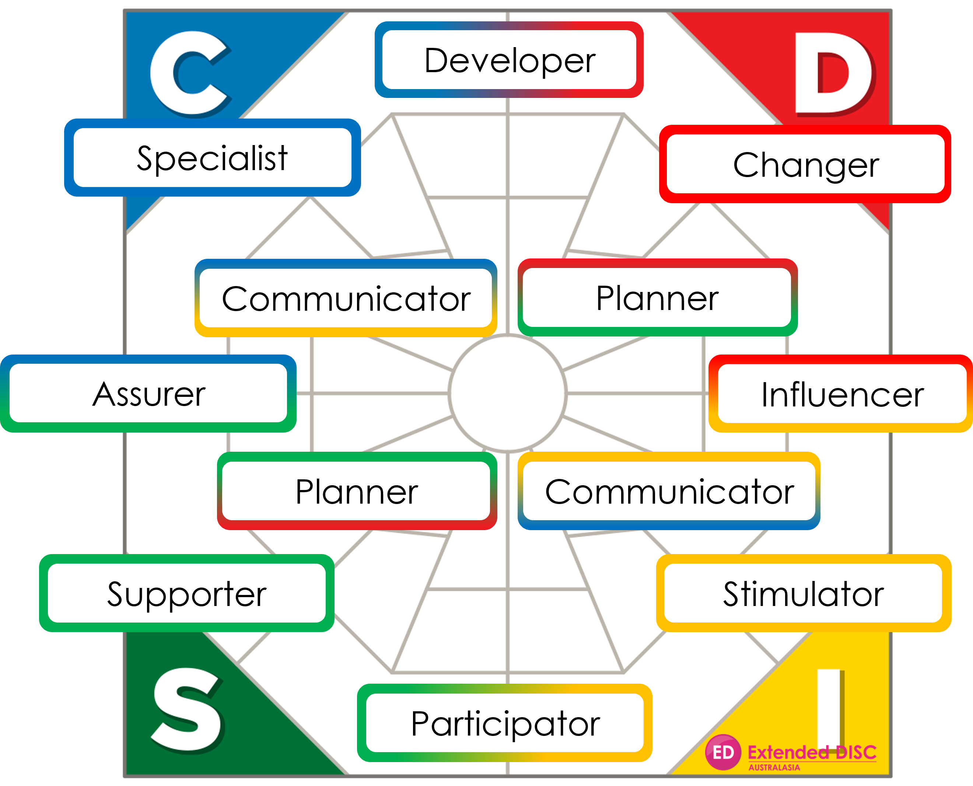
Extended DISC – The 10 Team Roles
Extended DISC Team Roles divide team functions into roles.
Each of the 10 roles has its special strengths and weaknesses.
People sitting next to you on the Diamond tend to work well with you (known as convergent or similar styles)
Opposites on the Diamond -
these people’s development areas will be your strengths (complimentary styles)

Slide 4

Team Roles

Slide 5
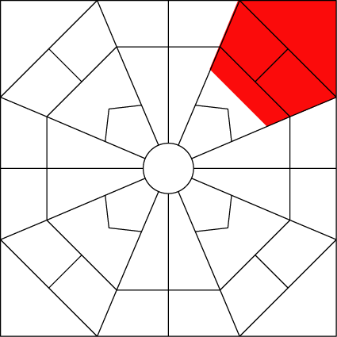
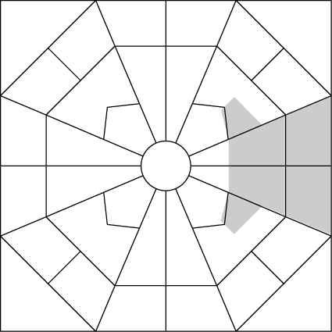
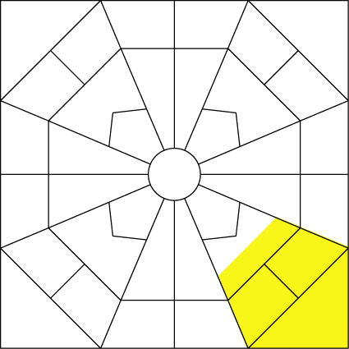
Extended DISC® - Team Roles
Changer
Reformer, to the point, decisive, impatient, tough.
Knows what they want.
Makes quick decisions.
Influencer
Vivid, idea rich, talkative, spontaneous, restless.
Talks people on to their side.
Acts on instinct.
Stimulator
Extrovert, open, sociable, jovial.
Makes things happy.
Ready to go along.

Slide 6
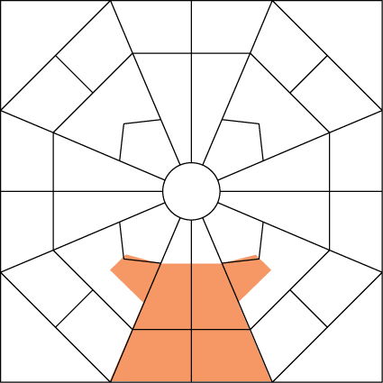
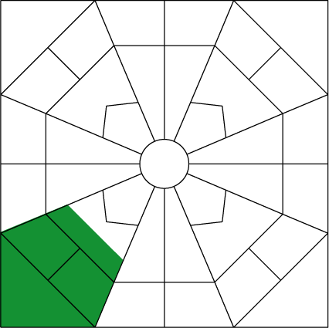
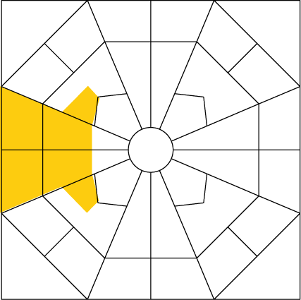
Extended DISC - Team Roles
Participator
Pleasant, friendly, calm, helpful.
Doesn’t put themselves first.
Understands people.
Supporter
Careful, even tempered, trustworthy, calm.
Does not try to attain the impossible.
Wants to help others.
Assurer
Thorough, prudent, accurate, pensive, quiet.
Does not give their own opinion.
Does things the way they should be done.

Slide 7
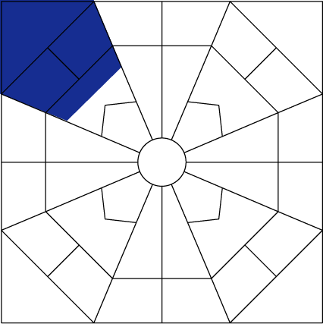
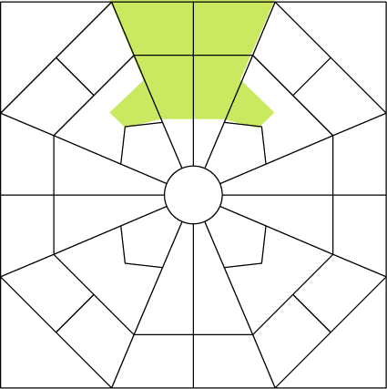
Extended DISC - Team Roles
Specialist
Seeks perfection, pedantic, pertinacious, inquiring.
Examines why things are the way they are.
Notices details.
Developer
Focused on the facts, creative, demanding.
Analytical, distant.
Produces brand new ideas.
Demands a lot from everybody.

Slide 8
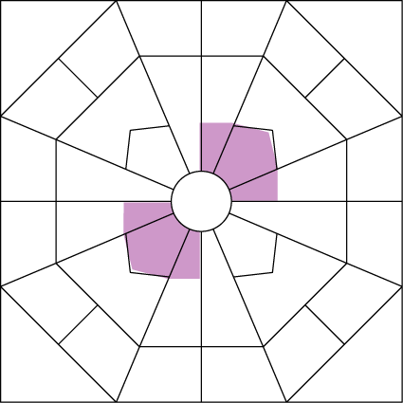
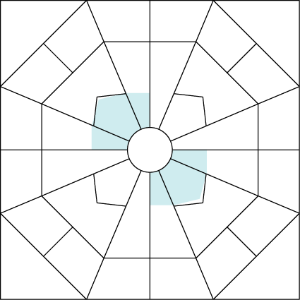
Extended DISC - Team Roles
Planner
Prudent, target-minded, demanding, systematic.
Holds on to their outlook.
Goes where they want.
Communicator
Friendly, accurate, justifying, modest, open.
Understands different opinions.
Explains why things are the way they are.

Slide 9

Team Roles in Detail

Slide 10
Changer
The group's lone wolf who wants to have control over themselves and their actions
Does not care about titles or status, but believes that they’re above them
Has an answer ready for most questions and is not afraid to give their opinion
Some see them as frightening and believe they underestimate others at times; in reality they want others to first show what they can achieve; only then will they give them their attention and accept them into their group
Constantly looks for challenges and isn’t afraid of the unknown; routines bore them quickly
Wants to be in the front line developing new things and creating something unique
Finds it very unpleasant to admit defeat and to go back
As a goal orientated person, they’re ready to adapt to new groups and situations
Does not live in the past

Slide 11
Changer
Their attitude toward teamwork
Real waste of time
A lot of idle talk
A means for getting information from others
  Their role in a team
  Putting across their own message
  Deciding what will be discussed
  Challenging to a debate
    Their role as a decision maker
    Wants to participate in decision making
    Makes courageous decisions
    Does not always listen to others
      Their role as a motivator
      Motivates with toughness
      Rouses to a fight
      Doesn’t let you become exhausted
Their role as a performer
  Does things quickly and suddenly
  Gets bored quickly
  Does things their own way
  The benefit the group receives
    The group doesn’t get stuck
    Brings something new to the group continuously
    Puts an idea on the table and figures it out where the problems lie

Slide 12
Changer
The easiest way to find a joint rhythm
- convergent styles
The most difficult way to find a
joint rhythm – complementary styles
Influencer
Planner
Developer
Influencer
Planner
Developer

Slide 13
Influencer
Someone who creates ideas and wants to move forward
Good at influencing others
Does not hesitate nor deliberate but believes in their instinct and spontaneity
Likes change and taking part in many different kinds of groups, situations and roles
Others see them as an open and sociable person but somewhat superficial and self-absorbed; in reality, they’re so active that they don’t have time to stop and think about others, even if they’d like to
Likes to express their opinions and tries to persuade others to agree
Not a very patient listener
Has to stand out in a group somehow; they find it awful to be an average person in an average group
Concentrating on one thing is difficult for them; they’re better at creating and starting ideas than implementing them

Slide 14
Influencer
Their attitude toward teamwork
  A means to get people's attention
  A way to get the group motivated
  A possibility to delegate boring routines away
  Their role in a team
    The one who gives a push to a conversation
    The one who introduces new thoughts
    The one who stops hesitation
    Their role as a decision maker
      Wants to make quick decisions
      Brings up decisive ideas
      Does not analyse all the alternatives
      Their role as a motivator
        Creates group enthusiasm
        Motivates by speaking
        Supports and encourages
Their role as a performer
  Aims at simplicity
  Does not keep deliberating
  Applies rules
  The benefit the group receives
    The group is able to be renewed - does not get stuck
    The group's atmosphere remains open
    People are included
    where the problems lie

Slide 15
Influencer
The easiest way to find a joint rhythm
- convergent styles
The most difficult way to find a
joint rhythm – complementary styles
Changer
Stimulator
Doer
Assurer
Specialist

Slide 16
Stimulator
An extremely open and positive person who wants to see - and sees - good in every person and in every situation
Seeks positive opportunities and steers away from all negative situations
Lives through their emotions and is able to influence other people's emotions
Others regard them as positive and a person who makes friends easily; some people may also find them superficial and too relaxed
In reality they want to take part in many things; however, they don’t find it necessary to analyse every single thing thoroughly
Knows that reality is different from what we plan it to be
Likes to be included in everything and is happy when there are many things going on
Doesn’t usually speak their mind if they feel it may annoy the other person or if it might lead to an unpleasant conversation
Likes introducing new ideas and attending meetings where new ideas are created

Slide 17
Stimulator
Their attitude toward teamwork
  A means to maintain contact with people
  An important channel for giving data
  A positive way to motivate
  Their role in a team
    The one who discusses and chats
    The one who brings up new thoughts in a positive manner
    The one who maintains a good atmosphere
    Their role as a decision maker
      Wants people to decide things together
      Does not want to close the lid on final decisions
      Wants a solution that everybody is happy with
      Their role as a motivator
        Manages to spend time with people
        Considers their words in the hope that they’ll make a good impact
        Talks a lot and tells stories
Their role as a performer
  Struggles with routine tasks
  Does when there are other people doing
  May stray from assigned work
  The benefit the group receives
    Good atmosphere
    New thoughts
    Being together
    where the problems lie

Slide 18
Stimulator
The easiest way to find a joint rhythm
- convergent styles
The most difficult way to find a
joint rhythm – complementary styles
Influencer
Participator
Communicator
Specialist
Developer
Assurer

Slide 19
Participator
A pleasant and friendly conversationalist who likes to be with familiar people
Likes exchanging thoughts and feelings before moving into action
Finds it important that everyone in the group gets to perform and express their feelings
Others regard them as a person who is easy to be with and who is honest toward everyone, but also someone who does not really express their honest opinion; in reality, they find it extremely unpleasant to bring up negative issues which might offend others, especially if they have to be justified.
Likes working with and being with others
Doesn’t mind if they have to guide, help or listen to others
Their own priorities are not as important to them as having everyone working well together
Does not want to decide for others

Slide 20
Participator
Their attitude toward teamwork
  An extremely important and efficient way to work
  A way to ensure everybody does what they should do
  Teamwork ensures the group stays together
  Their role in a team
    The one who finds compromises
    A listener and a helper
    The one who participates and is present
    Their role as a decision maker
      Makes decisions, at most, after having heard others
      Wouldn't want to be in a decision-making position; makes cautious decisions
      Their role as a motivator
        Understands people extremely well
        Manages to discuss and listen
        Brings up positive thoughts
Their role as a performer
  Does what they’ve promised to do
  Does not always manage to stay away from others
  Is able to act according to other people's instructions
  The benefit the group receives
    Everybody's opinions receive attention
    People are treated equally
    There’s discussion and exchange of thoughts
    where the problems lie

Slide 21
Participator
The easiest way to find a joint rhythm
- convergent styles
The most difficult way to find a
joint rhythm – complementary styles
Stimulator
Doer
Developer
Changer
Specialist

Slide 22
Doer
A calm person
Does their work at their own pace and doesn’t like people who unnecessarily harass or rush them
Appreciates reliability, justice, familiar people and situations where one does not have to act or be overly excited
Others find them extremely reliable and calm but also slow and uncertain; in reality, their apparent slowness is due to the fact that they want to do things in a reliable manner and in a way that does not bother others
Does a lot of invisible work for the benefit of others
It takes them longer to prepare for tasks than it does for other people
Does not mind doing recurring tasks
Even when focusing on their responsibilities, they enjoy being a part of a tight group that offers security
Because they prefer familiar surroundings, they tend not to get involved in multiple groups

Slide 23
Doer
Their attitude toward teamwork
  An extremely important way to work
  A means to ensure that everything goes right
  Creates safety - everybody helps everybody
  Their role in a team
    Takes responsibility for everything they do
    Holds on to joint contracts
    Stays in the background
    Their role as a decision maker
      Does not want to be the first one to decide
      Promotes prudent decision making
      Knows what isn't worth deciding
      Their role as a motivator
        Creates calmness and reliability
        A cautious person who needs to be motivated
        Shows willingness to help
Their role as a performer
  Keeps at their work
  Follows a given work pattern
  Emphasises other people's sense of responsibility
  The benefit the group receives
    Promises are kept; unnecessary risks aren't taken
    Evenly paced progress
    Pace is slowed when necessary; isn't erratic

Slide 24
Doer
The easiest way to find a joint rhythm
- convergent styles
The most difficult way to find a
joint rhythm – complementary styles
Planner
Participator
Assurer
Changer
Influencer
Developer

Slide 25
Assurer
Thorough and calm and concentrates on their work
Does not like when people disturb them, and they do not disturb others
Dreads mistakes and wants to work at their own pace
Others see them as accurate and someone who observes everything
They’re also seen as quiet and private; in reality, they’re a considerate person and often don’t speak out until after the conversation has taken place
Finds it extremely important to know what others expect from them and how they want them to proceed
Finds it uncomfortable to jump into the unknown without the support of others
Wants matters to proceed systematically and does not tolerate surprises unless their effects to the overall context are deliberated upon carefully
Does not find it important to be actively involved with others
Finds it important to be able to rely on others if help is needed

Slide 26
Assurer
Their attitude toward teamwork
  An important means to delegate tasks correctly
  Gets everybody to take responsibility
  A way to make the right decisions
  Their role in a team
    Often adapts to the role of performer
    Ensures that things proceed according to plan
    Keeps to the background
    Their role as a decision maker
      Helps rather than makes decisions
      Makes sure of all possible outcomes to begin with
      Delays as long as possible
      Their role as a motivator
        Motivates by giving information
        Holds on to their own responsibilities
        Often forgets motivation
Their role as a performer
  An extremely trustworthy doer
  Enters into matters carefully
  Stays on the same thing a bit too long
  The benefit the group receives
    Things get done
    Possible errors are recognised
    Things stay on schedule

Slide 27
Assurer
The easiest way to find a joint rhythm
- convergent styles
The most difficult way to find a
joint rhythm – complementary styles
Specialist
Doer
Influencer
Changer
Stimulator

Slide 28
Specialist
Attends to their own matters carefully and lets others take care of their own business
Considers it important to do their work as well as possible
Time and other people's pressures do not bother them
In the group, they’re regarded as someone who knows their business and someone who secures everything, but is, therefore, also isolated and separated from reality; in reality, they’re shy and can’t always find the right words
Has their unique quality criteria which they strictly follow
Since they require a lot from themselves, they don’t want to speak till they’re absolutely certain
when they’re ready, they provide so much detail that people lose patience before fully understanding them
Wants to know the logical progression of things and who is responsible for what
Does not always feel that it is important to be with others; it is more important that others do not interfere with their work

Slide 29
Specialist
Their attitude toward teamwork
  Most of it is a useless waste of time
  A means to calm those who rush
  Suppose it's good for others but not for me
  Their role in a team
    The one who calmly takes care of their own business
    Enters a conversation only at important moments
    Does not always manage to get enthusiastic
    Their role as a decision maker
      Takes a stand only when the matter concerns them; prepares very carefully
      Does not often want to take part
      Their role as a motivator
        Believes that everybody should motivate themselves
        Gives all the information needed when asked
        Creates instructions for everyone
Their role as a performer
  Reliable but still continuously thinking
  Enters into tasks with care
  May be inflexible about changing their habits
  The benefit the group receives
    Full analysis
    Avoidance of unnecessary risks
    Adherence to the organisation's rules

Slide 30
Specialist
The easiest way to find a joint rhythm
- convergent styles
The most difficult way to find a
joint rhythm – complementary styles
Developer
Communicator
Assurer
Stimulator
Influencer
Participator

Slide 31
Developer
A very issue-centred and rational person
Even in a group they emphasise their own individuality, see things their way and do not typically let other people get close to them
Likes an opportunity to develop, plan and create something new
Others see them as someone who knows their business and expects a lot from themselves, but also someone who is critical and particular; in reality, they just do not believe in one truth
Responds according to facts - not feelings
Fears that when others get excited, they lose the ability to think rationally; that is why they usually want to discover something that others have not
Does not want to share tasks with others because they don’t believe others can do them the way they want them done
Finds it important not to identify with 'the masses' because they believe in their own uniqueness

Slide 32
Developer
Their attitude toward teamwork
  An inefficient way to do things
  A means to get more information for oneself
  Sociable people's way of avoiding work
  Their role in a team
    The one who makes analytical summaries
    Maker of new interpretations
    Manager of one's own special field
    Their role as a decision maker
      Wants to have the last word
      Takes notice of facts - not wishes
      Does not take part in joint discussions
      Their role as a motivator
        Thinks it’s up to people to motivate themselves
        Finds own opportunities to develop
        Motivates by leaving in peace
Their role as a performer
  Does everything in their specific area
  In their own estimation, does not do overly easy work
  Does not settle for staying put
  The benefit the group receives
    Continuous evaluation of the individual’s own work result
    Clear opinions and reasons
    A lot of new thoughts

Slide 33
Developer
The easiest way to find a joint rhythm
- convergent styles
The most difficult way to find a
joint rhythm – complementary styles
Changer
Specialist
Participator
Stimulator
Doer

Slide 34
Planner
An extremely methodical and systematic person who wants to know where things are going and how to get there
Prefers people to behave in a professional manner when working in a group
Does not understand joking when the time is wrong
People find them reliable and balanced but also stubborn and principled; initially they often take a negative viewpoint to changes other people may suggest; in reality, they just want to ensure that nothing unexpected will happen
Seeks development and change but wants them to take place with care and consciousness
Finds it very important to stand behind their words and trusts that others will do the same
Likes to work hard until projects are complete because they don’t find it easy to leave things half done

Slide 35
Planner
Their attitude toward teamwork
  A means to ensure the correct assignment of tasks
  A forum to deliver information
  Important from the point of view of the organisation
  Their role in a team
    Critic and questioner
    Defender of principles
    Analyser
    Their role as a decision maker
      Makes principal decisions
      Wants grounds for any decisions
      Wants to accept decisions
      Their role as a motivator
        Shows commitment
        Does not always remember to encourage
        Is sometimes too inflexible
Their role as a performer
  Manages to concentrate on the issues
  Does not give up easily
  Acts according to the instructions
  The benefit the group receives
    Things do not remain unfinished
    The group doesn’t go down the wrong track
    People are treated fairly

Slide 36
Planner
The easiest way to find a joint rhythm
- convergent styles
The most difficult way to find a
joint rhythm – complementary styles
Changer
Doer
Stimulator
Specialist
Communicator

Slide 37
Communicator
A sociable and genial person who also has an ability to understand the group's rules and regulations
Has an excellent ability to make boring matters interesting
Seeks change but not at the expense of people or the organisation
Others find them very genial and easy-going but also a little mysterious and evasive; in reality, they want to avoid quarrels and don’t want to interfere with other people
Is afraid of arguments, which is why they don’t reveal all their feelings to people
Likes the fact that in a team people know what they are expected to do
Meeting different kinds of people in positive situations is ideal for them
Enjoys investigating things, deliberating different points of view and creating new ideas; however, they don’t always want to advance those ideas aggressively with others

Slide 38
Communicator
Their attitude toward teamwork
  A pleasant way to meet people
  A place to ask and get information
  A means to ensure a good atmosphere remains
  Their role in a team
    The one who corrects errors positively
    Presents a familiar matter in a new way
    Is a team player
    Their role as a decision maker
      Cautiously and willingly gives responsibility to others
      Emphasises the meaning of information
      Wants to hear everybody's opinion to begin with
      Their role as a motivator
        Manages to see things in a positive way
        Guides people and at the same time praises positively
        Brings new ideas
Their role as a performer
  Wants to avoid errors
  May stay to discuss and think
  Gets bored if the job gets too routine
  The benefit the group receives
    Positive energy
    Disagreements are levelled down
    Everybody receives information

Slide 39
Communicator
The easiest way to find a joint rhythm
- convergent styles
The most difficult way to find a
joint rhythm – complementary styles
Stimulator
Specialist
Changer
Doer
Planner

Slide 40
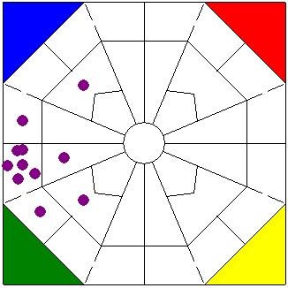
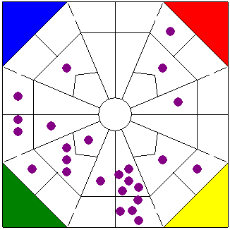
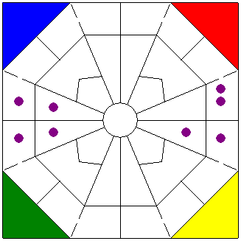
Team Types – Strengths and Challenges
Homogeneous Teams
Members have similar traits & attributes
Advantage of cohesion and communication
High productivity and goal accomplishment
But excessive cohesion can turn into groupthink
Heterogeneous teams
Members have diverse orientation
Agreement in such teams may be difficult
Leads to more innovative solutions
In situations where creativity is important - planning or research or ad teams, heterogeneous teams should have an advantage over homogeneous teams
Diverted teams
Members are made up of opposite traits and attributes.
Agreements in the team can be conflicting and potentially pushed through based on sub team vs sub team.
Delegation is strong and can be a good use of team strengths
However, if sub-teams form there is the risk of team cohesion falling apart
Homogenous Team
- Strength: communication
- Challenge: flexibility
Heterogeneous Team
- Strength: division of labour
- Challenge: communication
Diverted Team
- Strength: delegation
- Challenge: sub-teaming

Slide 41
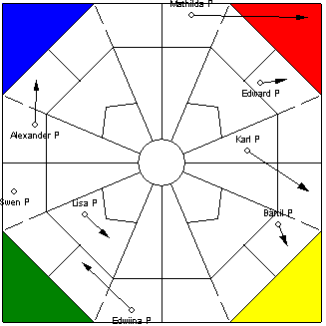
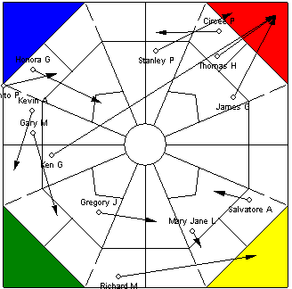
Arrow Map Explanation
1. No arrow
Shows no pressure from the environment
Does not mean everything is OK
2. Part arrow
There is no pressure on the team
There’s pressure from inside or outside towards some team members
2023 Copyright HR Profiling Solutions

Slide 42
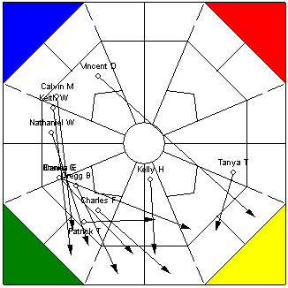
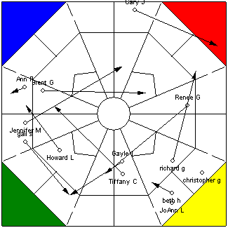
Arrow Map Explanation
3. Full arrow
There’s a strong pressure target on the team
Team feels pressured
4. Mixed arrow
The team may not be treated
as a team
This team may experience challenges working as a team
2023 Copyright HR Profiling Solutions

Slide 43

Tailored solutions to enhance organisational performance.
Contact
info@hrprofiling.com
NZ: 0800 333 668 | AUS: 1800 518 217

