Slide 1

Open 360
Open 360 is a tool for providing feedback on an individual’s performance.
It is used to measure the skills, competencies and behaviours of an individual.
It combines an individual’s self-assessment with feedback from managers, peers and direct reports anonymously in one report.
Open 360 feedback is used to plan and map specific paths in an individual’s performance and / or development.

Slide 2
Open 360 Uses
Leadership & Management Development
Performance Appraisals
Skills Development
Training Needs Identification
Team Evaluations

Slide 3








Increased Self-awareness
Identification of problem areas
Self-perception vs Reality (Blind Spots)
The Benefits of using Open 360s:
Improved Communication
Improved Performance
Professional Development
Improved team dynamics
Compare feedback year on year to see development

Slide 4
The Open 360 Process
Create Questionnaire
Customise your own questionnaire, or
Use one of our ‘off-the-shelf’ solutions
Create Project
Set the parameters of the Open 360 (start & end date, personalise email invites etc.)
Send out Automated Emails
Reminder emails
View a summary of who has completed/not completed the questionnaire
Generate Report
Scoring is colour coded
View and download results
Add different graphs
Upload respondent’s information

Slide 5









Open 360 Features
“Play” around with the results until you find a format that is applicable
Brand reports with your company logo
The process is automated once set up
A single email is sent to respondents assessing multiple individuals
Personalise invite and reminder emails
Results can be generated immediately
Add or delete assessors during the process
Results can be viewed in tables and graphs
Passwords can be generated

Slide 6
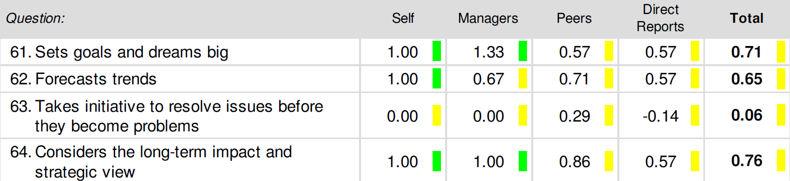
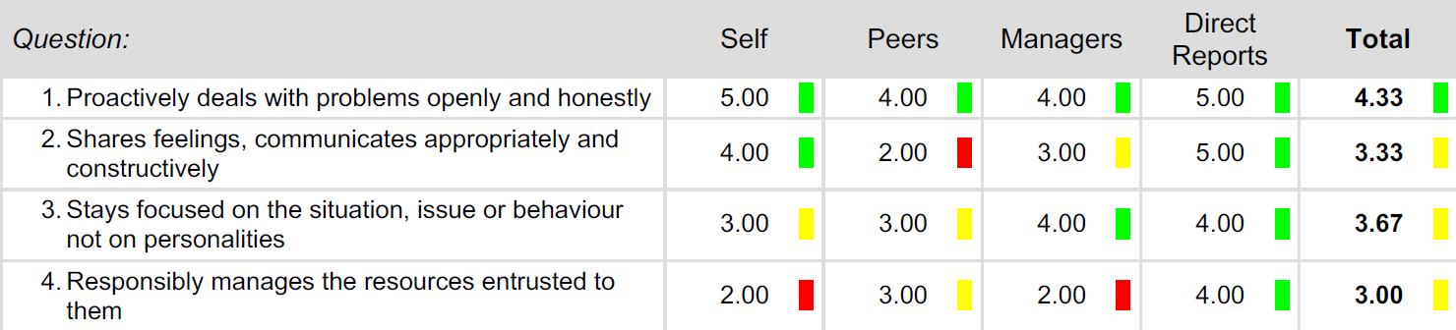
Create the Questionnaire
Select from two answering scale options and additional question features, including open feedback, single and multi-choice questions.
Likert Scale:
Answer Scale 3: -1, 0, +1
Answer Scale 5: -2, -1, 0, +1, +2
Answer Scale 7: -3, -2, -1, 0, +1, +2, +3
Open Scale:
This question type has a scale of any number between 1 and 10.

Slide 7
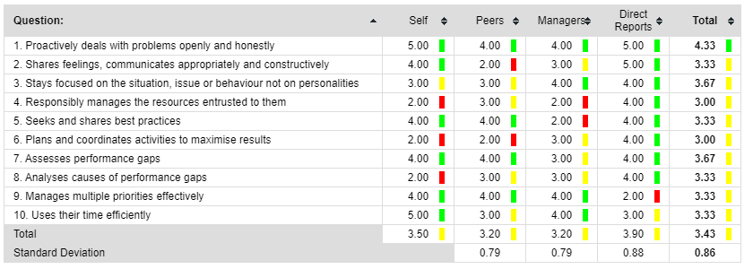
Viewing the Results
Green indicates that the assessed has scored highly in the measured competency.
It represents the top 25% of the scale.
Yellow indicates there is some room for improvement.
Between 25% - 75% of the scale.
Red indicates a definite area to improve.
The bottom 25% of the scale.
The Open 360° Feedback displays the results using numbers and traffic light colours.

Slide 8
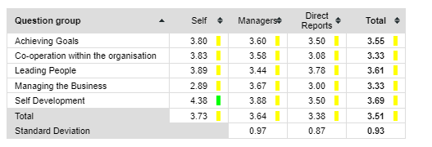
Report Types
Download Sample Report
Results by Question Groups

Slide 9
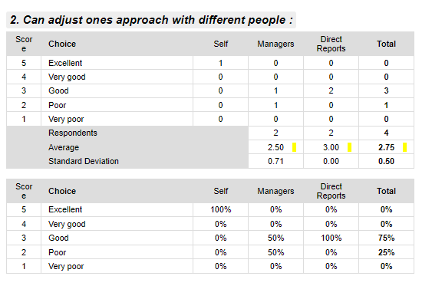
Report Types
Download Sample Report
Results by Individual Questions

Slide 10
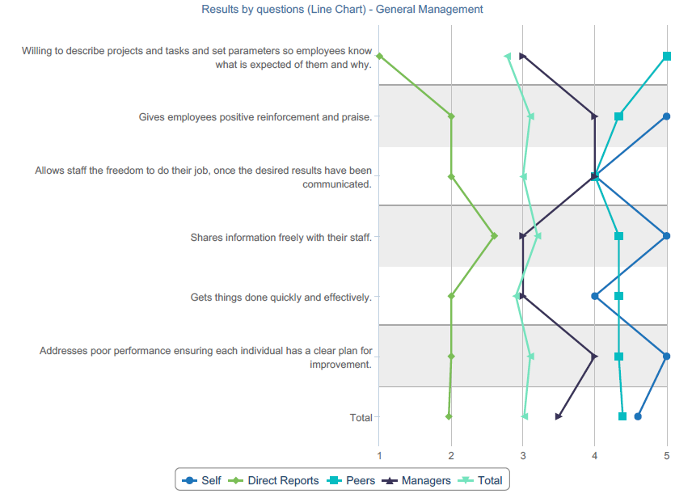
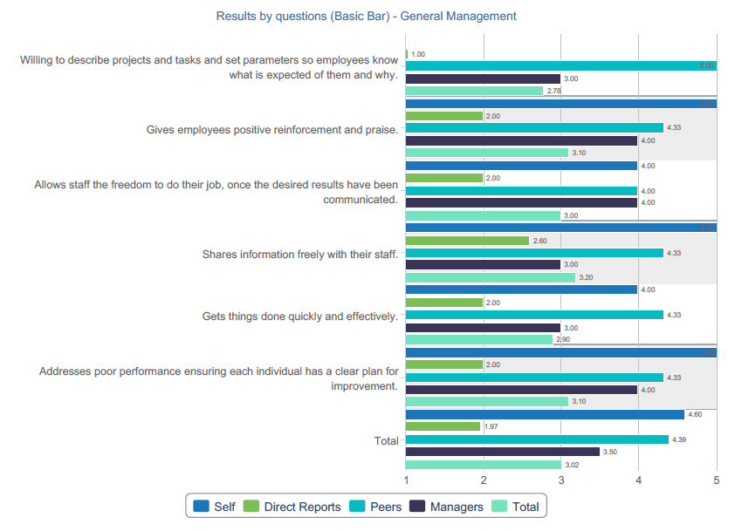
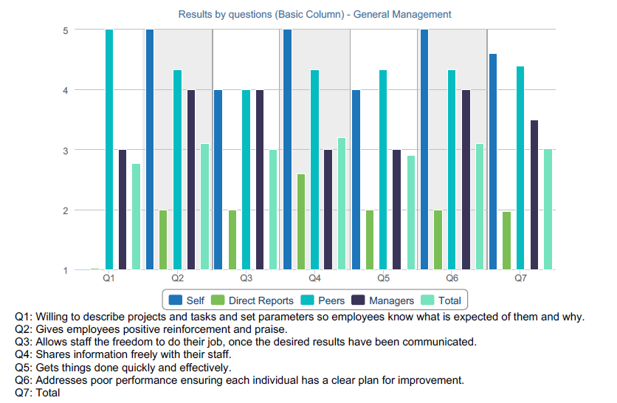
Graph Types
Download Sample Report

Slide 11
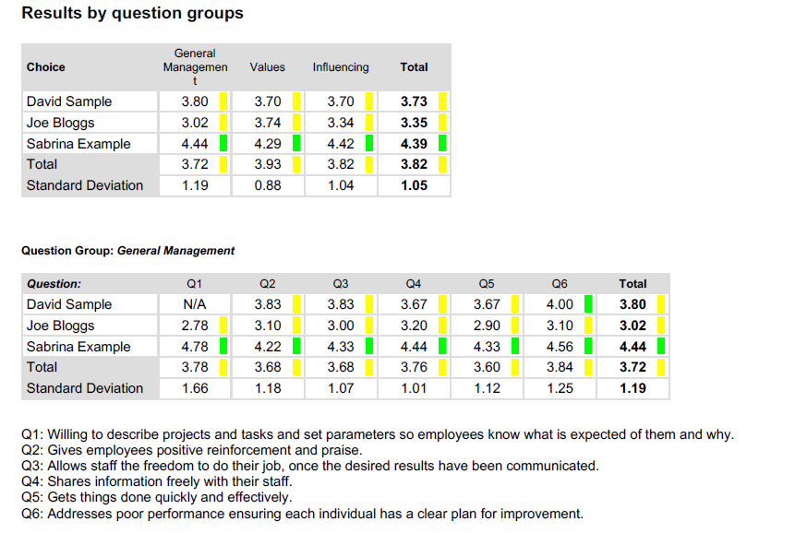
Multi-Person Report Types
Download Sample Report

Slide 12
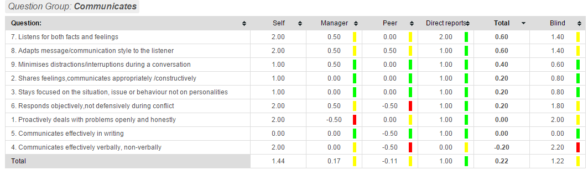
Blind Spots/Gaps Analysis
Download Sample Report
This report measures the difference between self-perception and the perceptions of others against a measured competency or group of competencies.
Red indicates a big difference between the self-assessment score and the score received from other assessors.
Green indicates the scores align.
Yellow indicates there is a moderate difference between the self–assessment and that of the assessors.

