Slide 1


Recruiting and Developing
High Performing Individuals and Teams

Slide 2

Reasoning Analysis
The FinxS Reasoning Analysis is a set of tests designed to measure an individual’s reasoning skills
Total of 9 tests. (Each test takes between 7-20 minutes to complete).
Each test can be administered alone or in combination with any of the other tests.
Reasoning skills are essential to many intellectual activities, such as critical thinking, problem-solving, creating and applying.
The tests identify an individual’s potential to grasp new skills.
They provide a structured and measured look at an individual’s thinking skills.
They measure a person’s natural ability to perform tasks where no prior specialist knowledge, training or experience is required.
Download Sample Report

Slide 3
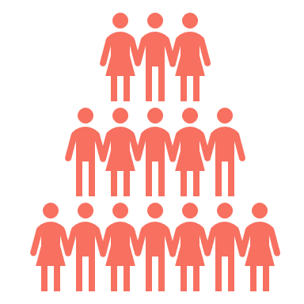

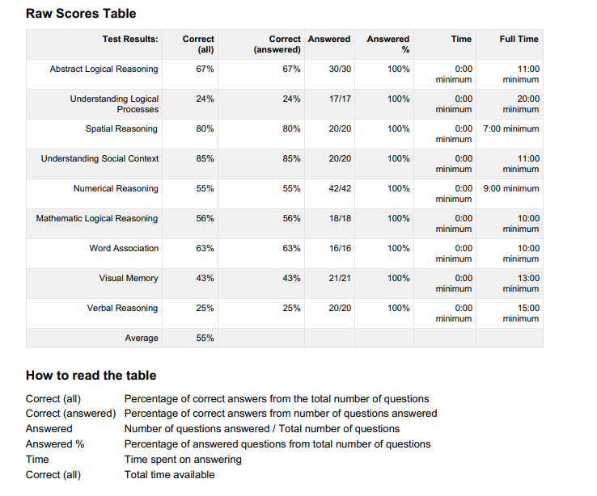
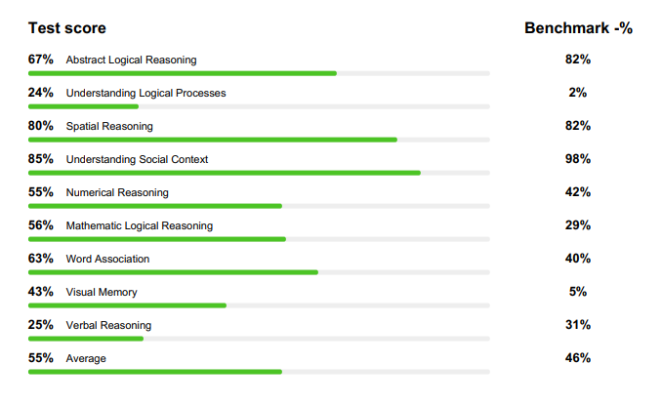
%
Results are presented as percentages of correct answers overall and of correct responses to attempted questions only.
Using the percentages alone is not recommended as only by comparing them to a wide benchmark population are we able to see how the person compares against other people.
Additional information detailing the number of questions answered and the amount of time spent answering is also given.

Slide 4









Nine Reasoning Assessments
FinxS Reasoning is made up of 9 tests, each measuring a different element of a person’s reasoning skills.
Abstract Logical Reasoning
Understanding Logical Processes
Spatial Reasoning
Understanding Social Context
Numerical Reasoning
Verbal Reasoning
Mathematic Logical Reasoning
Word Association
Visual Memory

Slide 5
Abstract Logical Reasoning
Abstract Logical Reasoning measures the individual’s ability to understand the interrelationship between different concepts and to combine them on a higher level under one concept.
It reflects the person’s ability to understand how different phenomena relate to each other.
It also measures how well the person understands “the big picture” and its composition.
Abstract Logical Reasoning correlates with general learning skills and can be quite easy to develop.
Typically, it correlates with tasks like:
  Planning
  Organising
  Delegating
  Creating systems
  Data analysis
A high score indicates ability to:
  See trends and identify deviations
  Separate important information from non-important
A low score may result in:
Difficulties distinguishing important facts from non-important ones
Attention being paid to unnecessary details

Slide 6
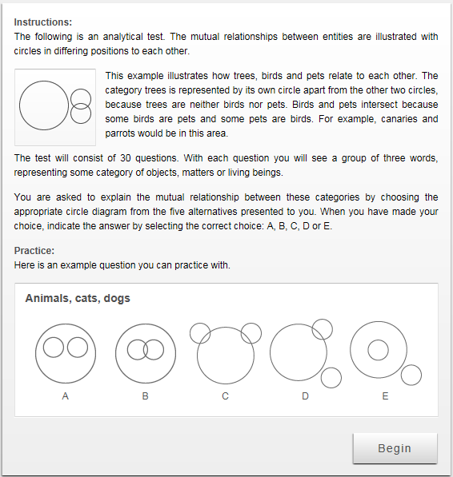
Abstract Logical Reasoning
6

Slide 7
Understanding Logical Processes
Understanding Logical Processes measures the individual’s ability to understand cause-effect relationships.
It reflects the person’s ability to understand how the information available influences the future and what the consequences of the present information could be.
It measures how systematic the person’s thinking process is.
Understanding Logical Processes correlates with general learning skills; however, this can take a while to develop.
Typically, it correlates with tasks like:
  Problem solving
  Business negotiations
  Predicting/Influencing behaviour
  Negotiating
  Researching
A high score indicates ability to:
  Solve new and complex problems
  Identify underlying reasons for conflicts and misunderstandings
A low score may result in:
Relying on old solutions to solve new problems
Drawing incorrect conclusions based on received information

Slide 8
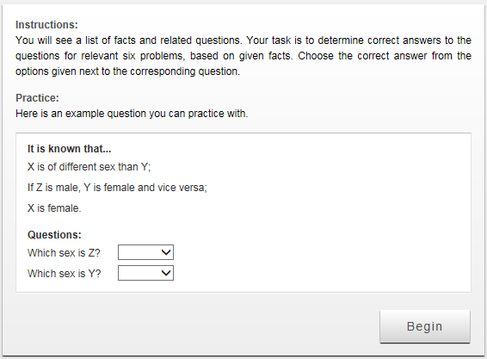
Understanding Logical Processes
8

Slide 9
Spatial Reasoning
Spatial Reasoning measures the individual’s ability to comprehend visual entities and the components they consist of.
It reflects the person’s ability to manage the information collected by visual perception.
Visual Reasoning skills are often connected to the skills required by architects and visual designers.
Typically, it correlates with tasks like:
  Architecture
  Design
  Pharmacy
  Art
  Engineering
A high score indicates ability to:
  Understand how individual processes relate to each other
  Participate in multiple simultaneous processes
A low score may result in:
  An inability to visualise with the mind's eye
  Limited imagination

Slide 10
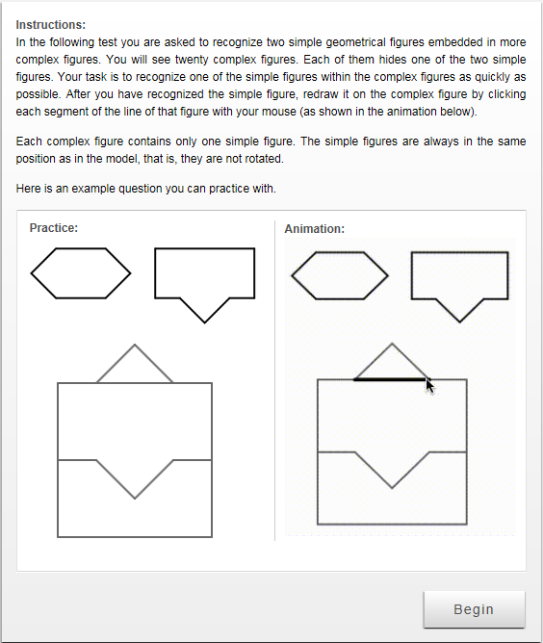
Spatial Reasoning
10

Slide 11
Understanding Social Context
Understanding Social Context measures the individual’s general sensitivity to observed social phenomena.
It reflects the person’s ability to sense conflict situations and to reason how interpersonal relationships influence a situation.
It correlates with skills needed in jobs that require social understanding and an ability to adapt one’s response to the way social interactions develop.
Typically, it correlates with tasks like:
  Managing human relations
  Selling
  Motivating
  Counselling
A high score indicates ability to:
  Read between the lines
  Anticipate people’s reactions
A low score may result in:
  More direct behaviour in conflict situations
  Defensive behaviour

Slide 12
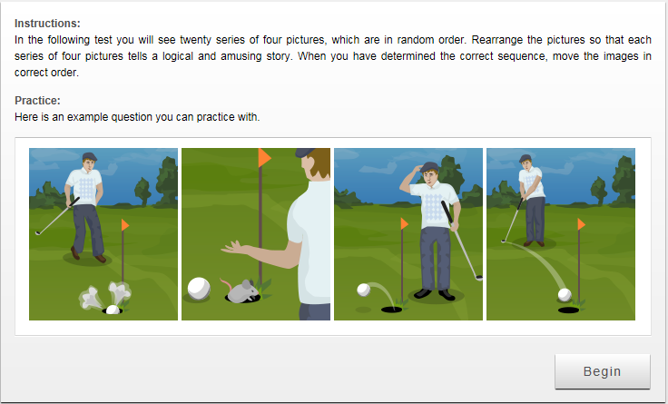
Understanding Social Context
12

Slide 13
Numerical Reasoning
Numerical Reasoning measures the individual’s ability to perceive the relationships between numerical information.
It correlates with skills needed in jobs requiring an ability to follow a logic presented by numbers.
Typically, it correlates with tasks like:
  Analysing data
  Processing statistics
  Accounting
A high score indicates ability to:
  Analyse statistical trends
  Estimate future trends
A low score may result in:
  An inability to concentrate on details
  An inability to interpret numerical information

Slide 14
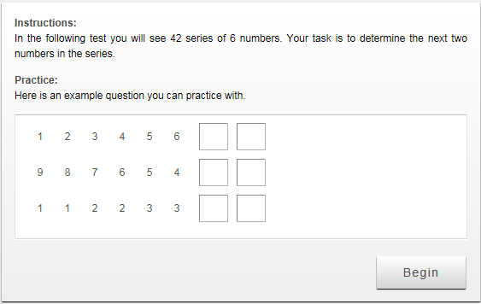
Numerical Reasoning
14

Slide 15
Verbal Reasoning
Verbal Reasoning measures the person’s ability to understand written information, conceptualise it and find causal relationships.
It relates to the person’s ability to identify the essential information and understand how it relates to the problem being solved.
It correlates with tasks where word meaning and interpretation are important.
Typically, it correlates with tasks like:
Journalism
Data collection and analysis
Problem identification and solving
Research
A high score indicates ability to:
Comprehend and interpret verbal information
Recognise strong and weak arguments and find counter arguments
Work with written information to solve problems
Draw conclusions
A low score may result in:
Difficulty in fully understanding written text
An inability to distinguish essential information from non-essential
Difficulty drawing conclusions based on information given

Slide 16
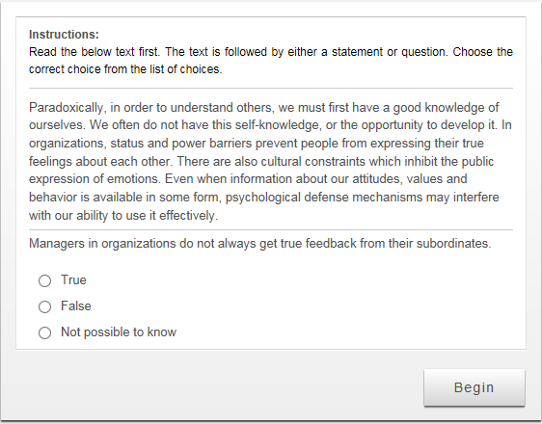
Verbal Reasoning
16

Slide 17
Mathematic Logical Reasoning
Mathematic Logical Reasoning measures the ability to understand logical applications of mathematics, evaluate arguments and detect false reasoning. It is the ability to apply mathematics, logic, and/or statistics to help make decisions.
It correlates with the ability to set up logical connections between everyday phenomena and abstract systems.
It is the ability to distinguish between a valid and invalid deductive argument and to prove invalidity by providing a counter example.
Typically, it correlates with tasks like:
Research
Analysis of data
A high score indicates ability to:
Use and criticise numerically based arguments
Understand, interpret and criticise statistical results
A low score may result in:
Superficiality in decision making
Actions based on wrong conclusions

Slide 18
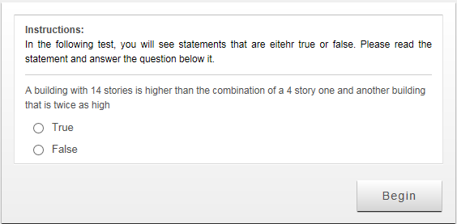
Mathematical Logical Reasoning
18

Slide 19
Word Association
Word Association measures the ability to understand relationships between different concepts.
It relates to the ability to classify information, combine data that relates to each other and understand differences between concepts.
It correlates with creative performance and the ability to produce completely new solutions to old problems.
Typically, it correlates with tasks like:
Journalism
Marketing planning
Politics
Negotiation
A high score indicates ability to:
Identify relationships between items of information received
Understand links between different concepts
Draw logical conclusions
A low score may result in:
An inability to understand logical entities
An inability to understand causal relationships

Slide 20
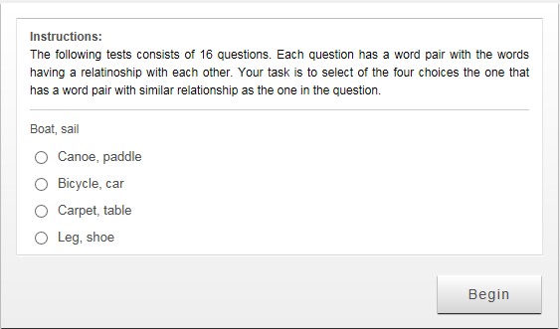
Word Association
relationship
20

Slide 21
Visual Memory
Visual memory measures the ability to visualise and mentally store multiple visual objects, like graphical images.
It measures how quickly a person can identify small differences in seemingly similar images.
It correlates with the ability to perform well in tasks requiring extensive working memory.
It also correlates with the person’s working memory capacity.
Typically, it correlates with tasks like:
Planning details
Architectural design
Graphical planning
Research
A high score indicates ability to:
Pay attention to important details
Keep track of multiple instructions at the same time
A low score may result in:
An inability to conceptualise and memorise details
An inability to distinguish important information from non-important
Difficulty mastering a large amount of details

Slide 22
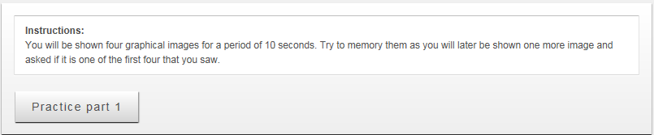
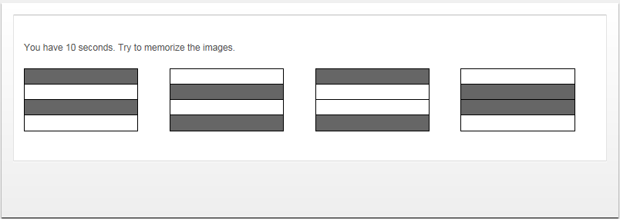
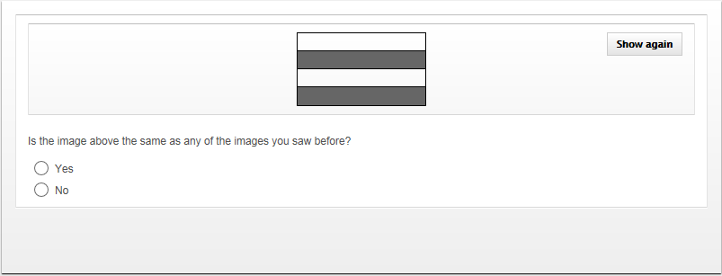
Memory Test
22

