Slide 1


Recruiting and Developing
High Performing Individuals and Teams

Slide 2



The Sales Competence Assessment
The questionnaire measures the current level of proficiency of the respondent in 18 key behaviours in the sales process
Salesperson’s Effectiveness
It consists of 99 forced questions
20 - 30 minutes to complete
Natural Predisposition
Attitude
Competences

Slide 3

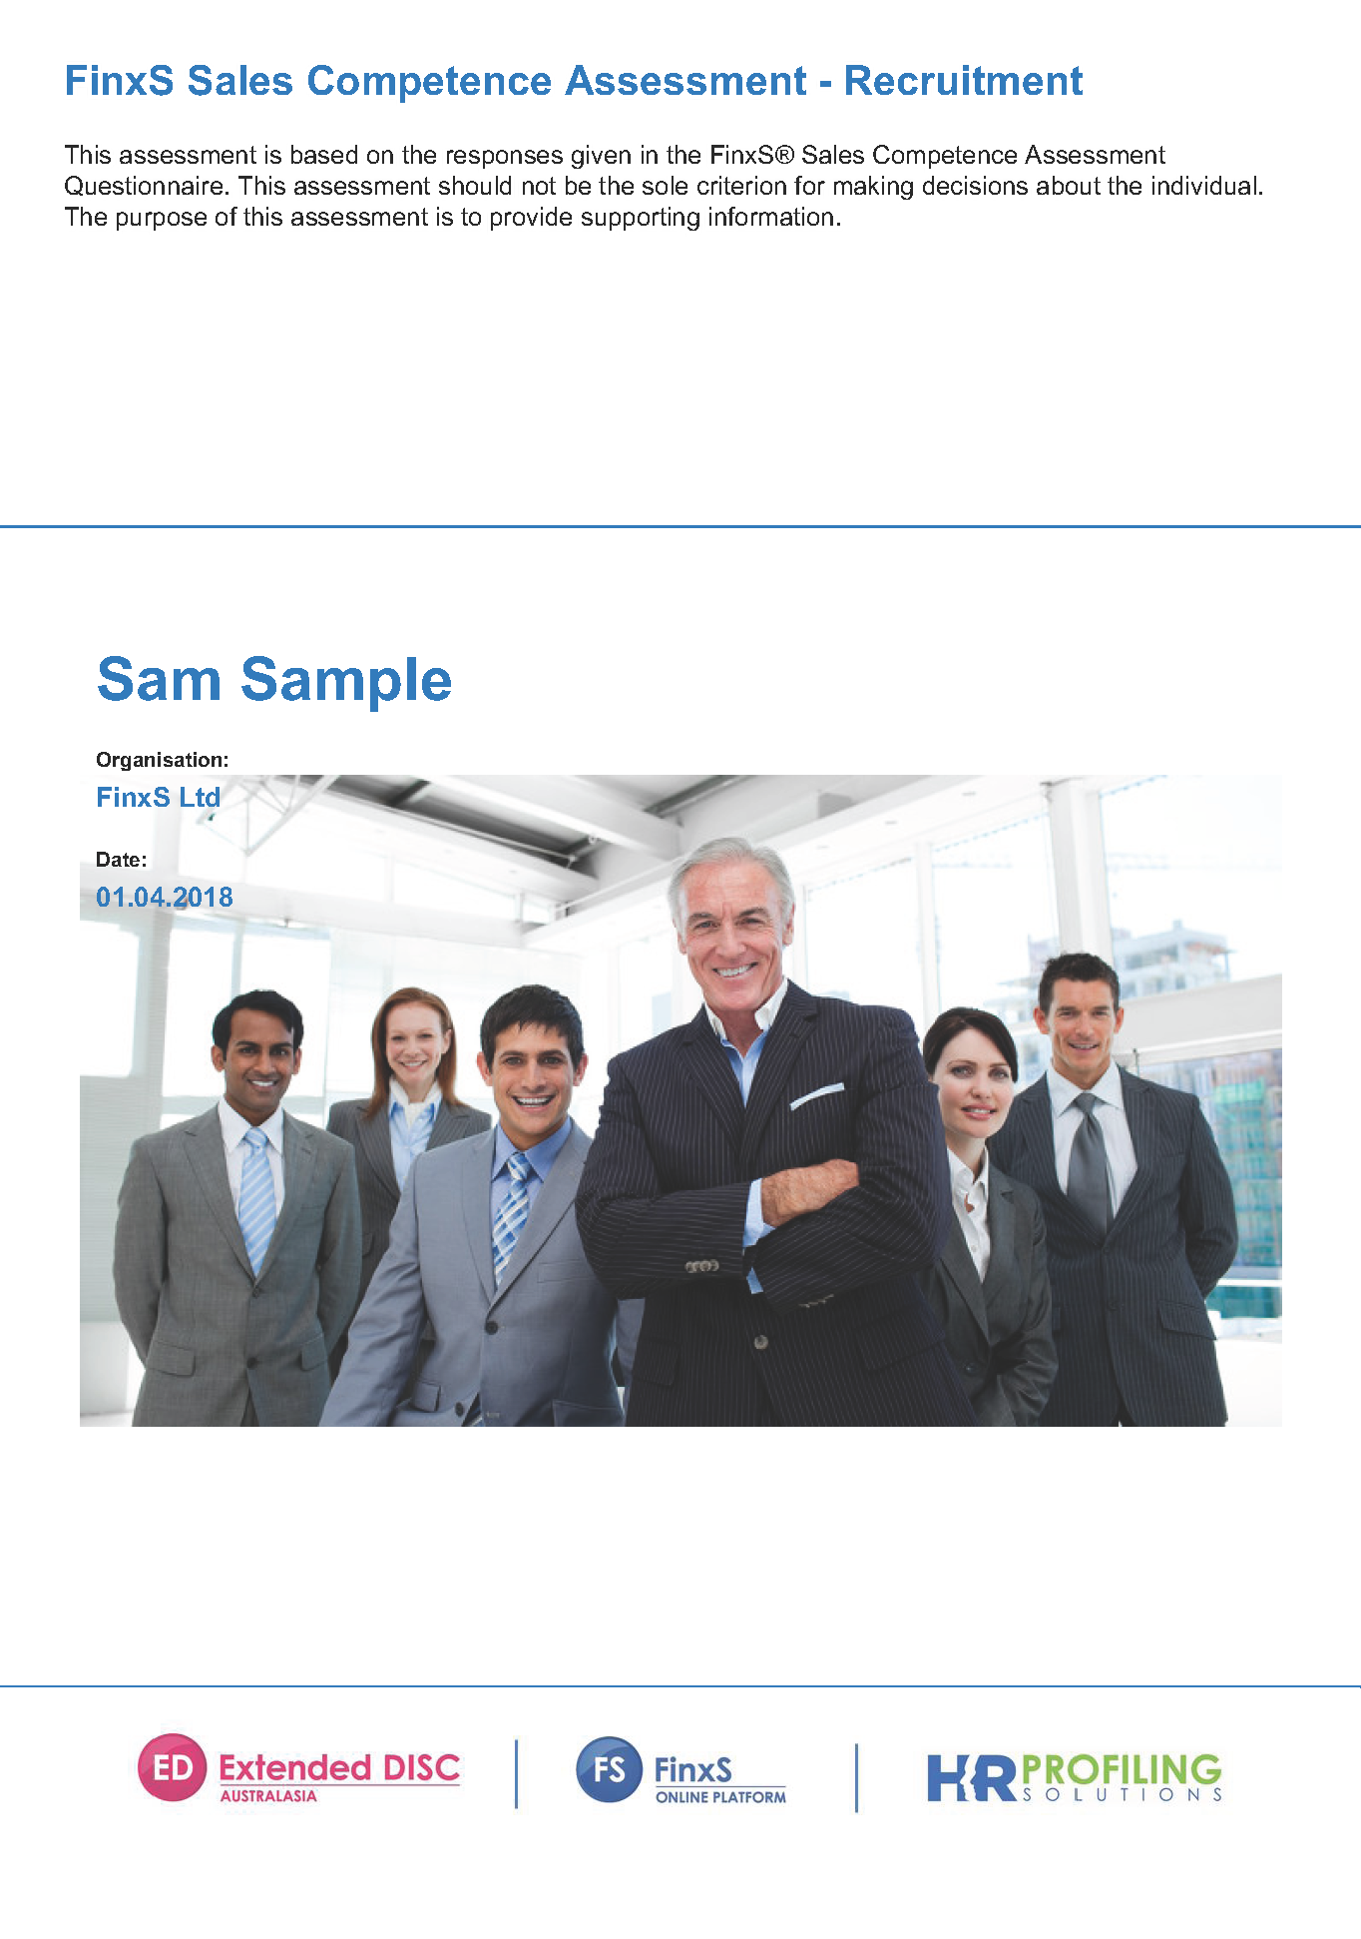
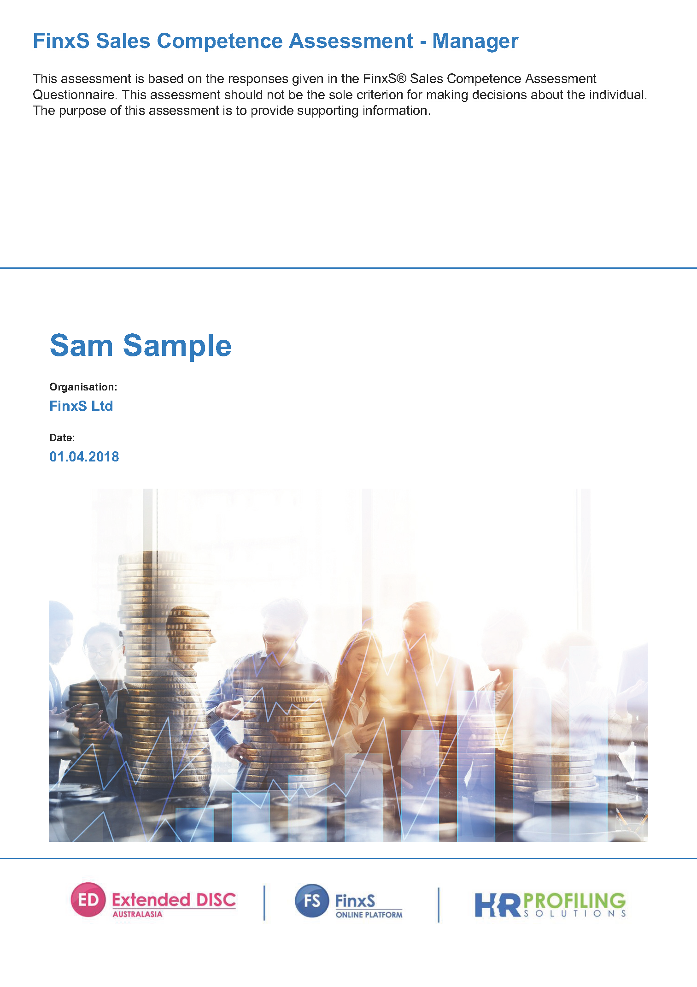
Sales Competence Report Types
1
2
Recruitment Report
Development Report
Provides practical & clear information to create a sales development plan for an individual
Provides a % match for different types of sales roles for an individual
Download Report
Download Report
3
4
Manager Report
Team Report
Applying Sales Competences to the Sales Process of the individual
Identifying Trends in Sales Teams
Download Report
Download Report

Slide 4
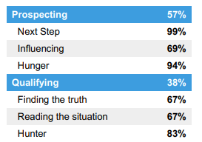
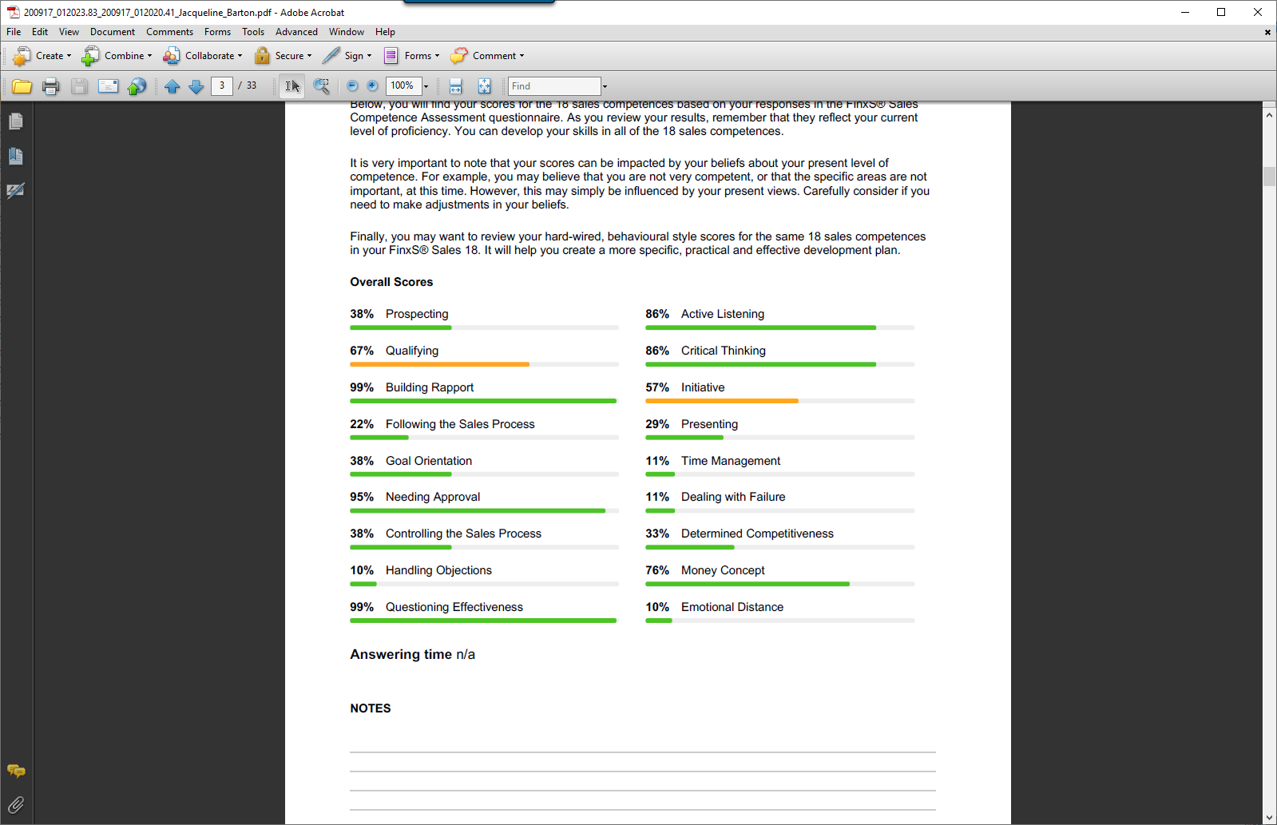
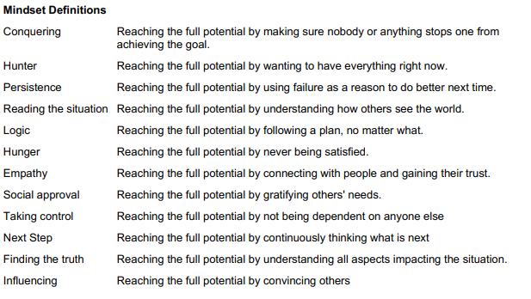
Sales Competence Measurement
1
2
How an individual’s mindsets may be holding them back from success in sales
The individual’s strengths and development areas in each of the 18 critical sales competences

Slide 5
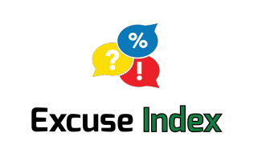
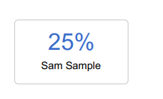


Sales Competence Measurement
3
Calculates the likelihood of a salesperson to make choices leading to avoidance of sales tasks.
LOW Excuse Index:
High initiative to sell.
They are not afraid to contact and meet people and to persuade them to take action.
They consider sales to be an essential task and often feel the need to prioritise selling over other activities.
HIGH Excuse Index:
Less motivation to sell.
They are likely to make excuses as to why they should prioritise other activities over sales tasks.
They need to mentally prepare for selling and it usually exhausts them.
They may miss sales opportunities while procrastinating.

Slide 6
Need
Sales Cycle
Relationship
Job Role
Match
Short Relationship
REVEALER
Short Sales Cycle
4
Long Relationship
CREATOR
Latent Need
Job Roles
Long/Complex Sales Cycle
Short Relationship
FORERUNNER
Long Relationship
INNOVATOR
Percentage match of a respondent against different Sales Roles
Short Relationship
DEALER
Short Sales Cycle
Long Relationship
PROVIDER
Expressed Need
Short Relationship
COUNSELOR
Long/Complex Sales Cycle
Long Relationship
PARTNER

Slide 7
FinxS® Sales 18 Report
Extended
DISC
Sales
Competence
Measures a salesperson’s attitude towards key behaviours in the sales process and their current skills in 18 Sales Competences
Measures a person's Natural and Adjusted Behavioural Styles
FinxS
Sales 18
Download Here
The FinxS Sales 18 combines an individual’s Sales Competence results with their Extended DISC Assessment.
It identifies a sales professional’s natural, hard-wired DISC behavioural tendencies in the same 18 competences viewed in the FinxS Sales Competence Assessment.
Each of the 18 competences is deconstructed into individual DISC behavioural competences to allow for a very clear identification of an individual’s unique sales strengths and development areas.
FinxS Sales 18 very clearly identifies if sales professionals are performing better than their natural style predicts or if they are not using their full potential.

