Slide 1

15.4cm
Report cover: middle image size
18.6cm

Slide 2
8.2cm
Report cover: header size
21.2cm
Report cover: footer size
4cm
21.2cm

Slide 3
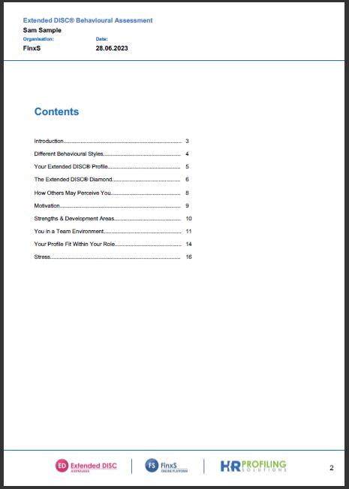
4.8cm
Report content: header size
21.2cm
2.2cm
Report content: footer size
21.2cm

Slide 4
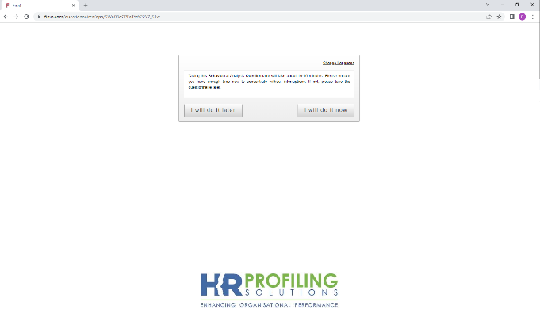
15.4cm
Answering Interface: image size
The answering interface image will appear as a background throughout the questionnaire.
18.8cm

