Slide 1



Adjusting Our Styles
Leading Others
Extended DISC®

Slide 2
Agenda
01. About the Styles
02. Leadership & the Styles
Learn more about the individual behavioural styles and how to identify them
Different behavioural styles make different leaders – learn about each leadership approach
03. Decision Making
04. Motivating
05. Adjusting our Style
Discover how the different behavioural styles make decisions
Learn how to motivate people based on their behavioural style
Different styles like to communicate in different ways – learn how to adjust your communication style to achieve better results

Slide 3

About The Styles

Slide 4

D-Style
Decisive, tough
Strong-willed
Competitive, demanding
Independent, self-centred
Under pressure - lack of concern
Fear - loss of control

Slide 5
Gen. Patton
Madonna
J.R. Ewing of Dallas
Coach Bobby Knight
Jennifer Lopez
Pink
Venus Williams
John McEnroe
Captain Kirk
Hillary Clinton
Charles Barkley
Dr. Phil
D-Styles

Slide 6

I-Style
Sociable
Talkative, open
Enthusiastic
Energetic
Persuasive
Under pressure - disorganised
Fear - social rejection

Slide 7
Robin Williams
Bill Clinton
Jay Leno
Ashton Kutcher
Will Smith
Serena Williams
Dr. McCoy
Dolly Parton
“Hawkeye” Pierce
Arnold Schwarzenegger
Jim Carrey
Arsenio Hall
I-Styles

Slide 8

S-Style
Calm, steady
Careful, patient
Family-orientated
Good listener
Modest
Trustworthy
Under pressure - too willing
Fear - loss of stability

Slide 9
Gandhi
Mr. Sulu of Star Trek
Princess Diana
Dr. Carter of ER
Tom Cruise
Halle Berry
Magic Johnson
Ron Howard
Michael J. Fox
Tom Brokaw
Mother Teresa
S-Styles

Slide 10
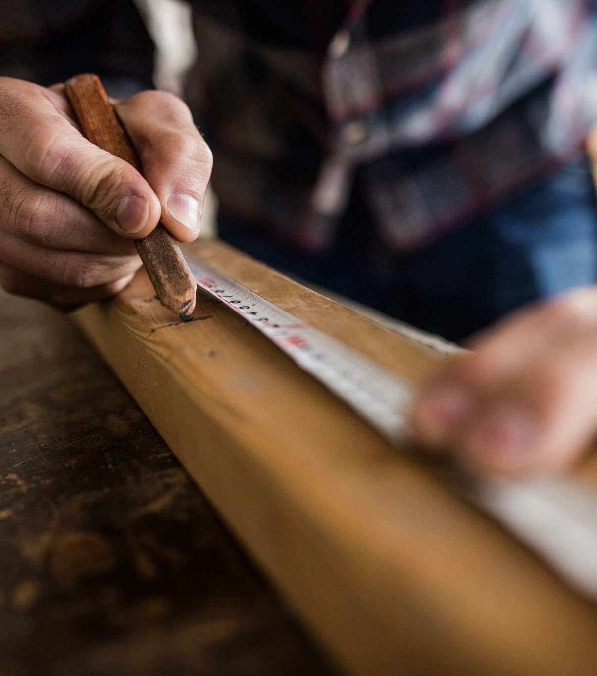
C-Style
Precise
Follows rules
Logical, careful
Formal, disciplined
Under pressure - overly critical
Fear - criticism of work

Slide 11
Spock
Al Gore
Albert Einstein
Johnny Depp
Tiger Woods
Keanu Reeves
Jack Nicklaus
Jimmy Carter
Ted Koppel
Bjorn Borg
Clint Eastwood
C-Styles

Slide 12

Identifying
Different Styles

Slide 13
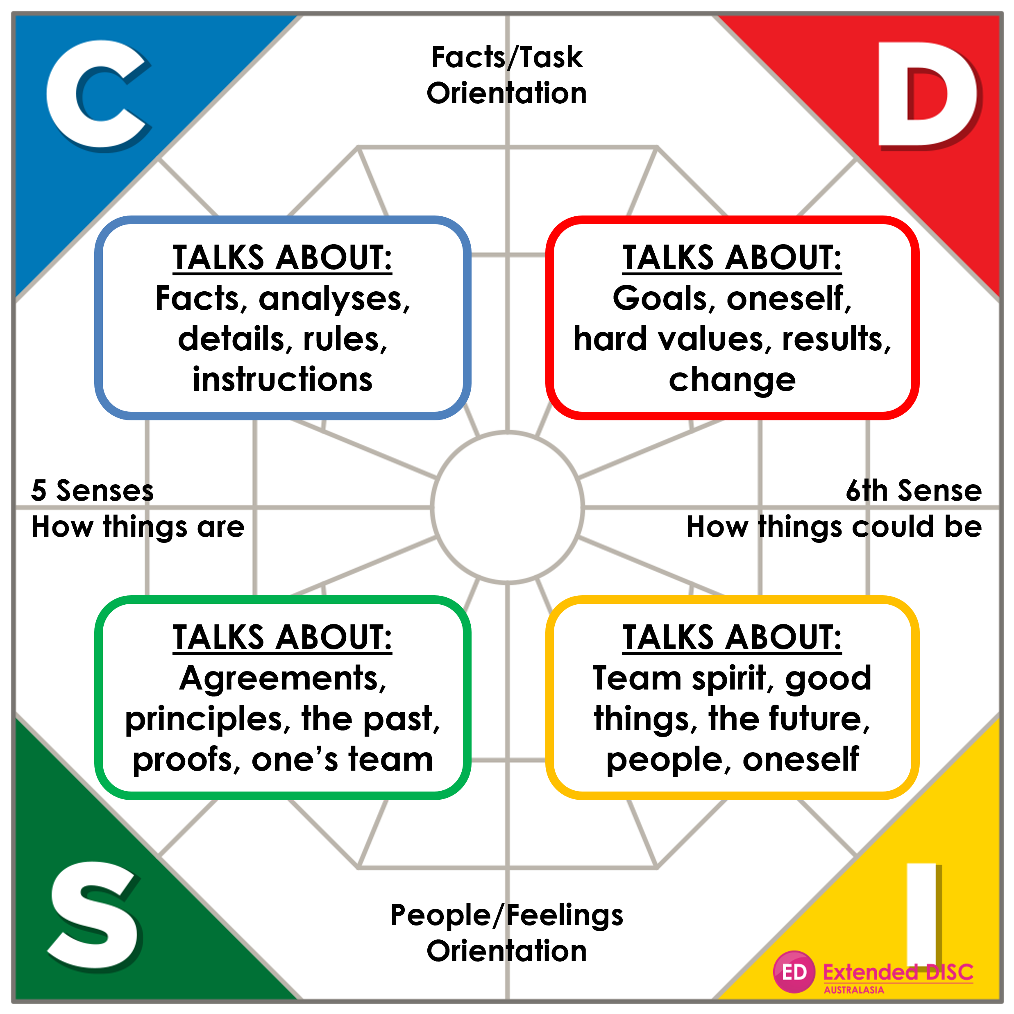
Identifying Behavioural Styles

Slide 14
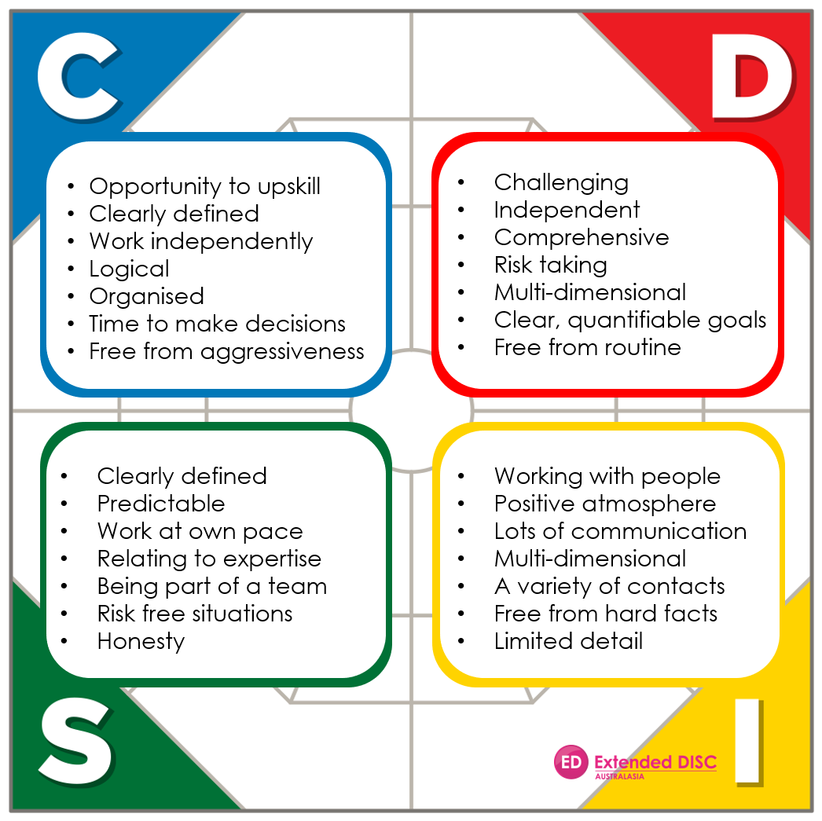
Preferred environment

Slide 15
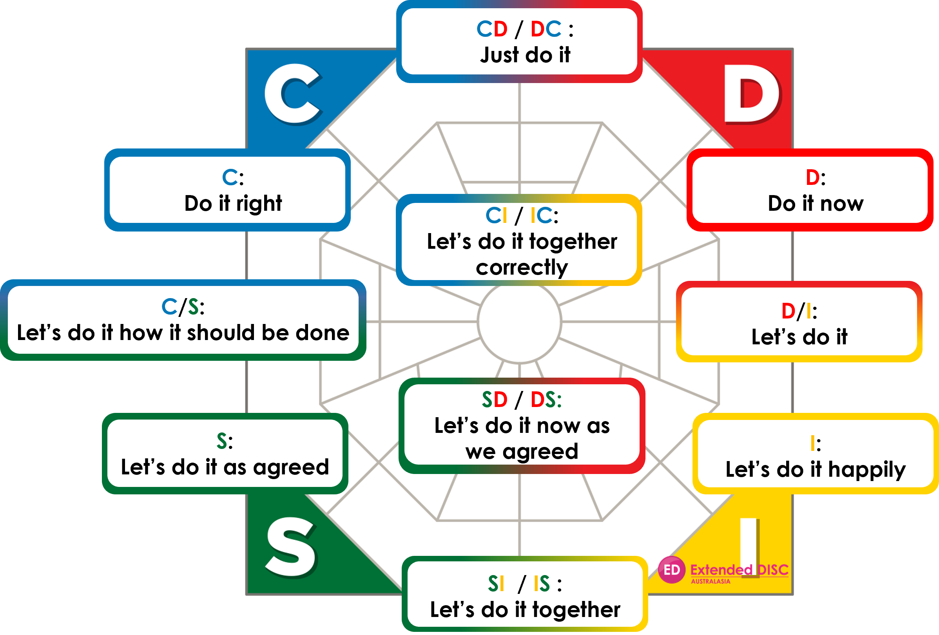
Doing

Slide 16
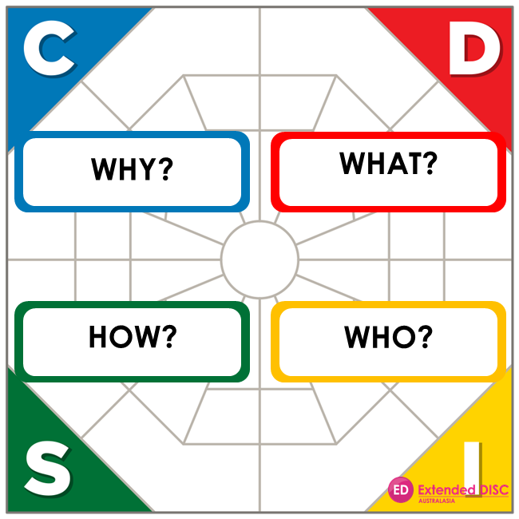
Questions the Styles Ask

Slide 17

Leadership

Slide 18

Leadership and the Styles
D-style:
Authority based on fear, power and distance
Comfortable with crisis situations and changes
“Things” leader: looks for results, the big picture, may see people as any other resource

Slide 19
Leadership and the Styles
I-style:
Authority based on charisma,
motivation and good atmosphere
Comfortable creating a positive atmosphere in new and evolving organisations
“People” leader: wants and needs a lot of contact with people

Slide 20
Leadership and the Styles
S-style:
Authority based on experience, expertise and bureaucratic status
Comfortable maintaining routines, stable and service- orientated
“Small teams” leader: participative approach to leadership

Slide 21
Leadership and the Styles
C-style:
Authority based on rules, standards, and distance from people
Emphasises rules and quality focus
“Things” leader: interested in facts, details and analyses

Slide 22

Decision Making

Slide 23
Decision Making and the Styles
D-style:
Wants to make quick decisions independently
Comfortable with difficult decisions
Keeps the big picture in mind
May exceed authority level
May forget people aspects

Slide 24
Decision Making and the Styles
I-style:
Relatively fast decision maker
Looks for a favourable solution
Does not need a lot of supporting information
May overlook details
Optimistic about the outcomes

Slide 25
Decision Making and the Styles
S-style:
Approaches decision making cautiously
Thinks about previous similar decisions
Double-checks before making decisions
Prefers support when making decisions
Is cautious in new situations

Slide 26
Decision Making and the Styles
C-style:
May not make the final decision
Concentrates on facts and details
Needs a lot of supporting information
Able to consider a large amount of information when making a decision
May forget the BIG Picture

Slide 27

Motivating the Different Styles
This Photo by Unknown Author is licensed under CC BY-ND

Slide 28
Motivating the Different Styles
D-style:
Do:
Give immediate feedback
Concentrate on the subject
Maintain result orientation
Don’t:
Frustrate their desire to start action
Restrict their power
Spend time on non-essentials
I-style:
Do:
Be responsive and listen
Give assurance
Be optimistic
Be with them all the time
Don’t:
Set unnecessary restrictions
Put down their enthusiasm
React negatively

Slide 29
Motivating the Different Styles
S-style:
Do:
Give organised feedback
Provide supporting material
Let them finish their work
Maintain continuity
Don’t:
Be restless
Make sudden changes
Work against what was agreed
C-style:
Do:
Give detailed information
Be open to questions
Give time to think and prepare
Don’t:
Keep information to yourself
Pressure for immediate answers
Force them to use power

Slide 30

Adjusting Our Communication

Slide 31
How the D-style communicates:
Remember when communicating with a D-style:
Communication tips for D-styles:
D-style:
Direct, even blunt
Dominates the communication
In one direction: from them to others
Focuses on results; little small talk
Impatient listener; may not listen at all
Communicates own views and opinions as facts
D-style:
Be direct
Provide alternatives
Ensure they win
Disagree only on facts
Enjoy the battle
Do not be emotional
Do not dominate
Act quickly; they decide fast
Do not “walk over” them
D-style:
Be more patient
Talk less, listen more
Allow time for “small talk”
Slow down your presentation
Focus more on feelings and emotions
Be careful not to dominate the interaction
Be careful not to come across as blunt and impolite

Slide 32
How the I-style communicates:
Remember when communicating with an I-style:
Communication tips for I-styles:
I-style:
Very talkative
May not be direct
Avoids unpleasant issues
Inspiring and selling style
Does not listen for very long
Speaks about people and feelings
Talks about the pleasant and fun issues; avoids details
I-style:
Be a friend; do not ignore
Schedule time for chatting
Have fun and be lighthearted
Let them speak
Give them recognition
Speak about people and feelings
Remember to follow up
Move closer
I-style:
Be more direct
Keep to the subject
Talk less, listen more
Remember to follow up
Do not get too emotional
Slow down your presentation
Focus more on details and facts
Be careful not to move too close to others

Slide 33
How the S-style communicates:
Remember when communicating with an S-style:
Communication tips for S-styles
S-style:
Creates trust
Talks calmly
Talks about issues they’ve mastered
Often in one direction: they listen
More comfortable communicating one-on-one
Can see things from many viewpoints; patient listener
S-style:
Slow down your presentation
Build trust
Focus on people
Provide the information they need
Present issues logically
Secure commitment piece by piece
Be sincere; do not dominate
S-style:
Talk more
Focus a little less on details
Speed up your presentation
Keep emotions under control
Be more expressive and animated
Be careful not to come across as too opinionated
Be more results-oriented in your communication

Slide 34
How the C-style communicates:
Remember when communicating with a C-style:
Communication tips for C-styles:
C-style:
May lose the essentials
Fairly quiet and reserved
Focuses on providing detailed information
Does not talk about personal issues openly
Critical listener if issues not presented logically
Does not easily talk about own view and opinions
C-style:
Provide facts
Do not touch them
Be patient; slow down
Give plenty of detailed information
Control your own activity
Do not talk about personal issues
Do not pressure them
Focus on the issues
C-style:
Talk more
Be more expressive
Spend more time chatting
Focus on being more inspiring
Speak more about people and emotions
Talk less about detail, facts and figures
Be careful not to appear cold, impolite and distant

Slide 35

Tailored solutions to enhance organisational performance.
Contact
Info@hrprofiling.com

