Slide 1
Extended DISC
Debrief

Slide 2

A Little About Behaviour
Human behaviour is experienced throughout
an individual’s entire lifetime. It includes
the way we act based on different
factors, such as: genetics, social norms, core faith and attitude.
The individual's unique traits impact behaviour. The traits vary from person to person and can produce different actions or responses from each person.
Notes:
1. Most of the time we act routinely, repeating our adapted ways of doing things. It is simply easier to repeat our adapted ways than to learn new ways.
Example: Think about how you approach meeting a whole room of new people. How do you behave? Do you always follow a similar pattern of talking, moving, feeling, thinking?
“What are some of your habitual ways of doing things?”
2. We attempt to predict situations. We do this both consciously and unconsciously - utilising ways we’ve found successful in the past.
Example: If the history between you and another person is always testy, jovial or competitive, you predict it will be the same the next time you meet.
3. We typically form an opinion of another person almost immediately - whether we want to or not. Whether you view someone as open, friendly or powerful – you are likely to be making fast assessments.

Slide 3

Behaviour: Theory of Human Capacity
Conscious Behaviour
Behavioural Filters
Attitudes
Values
Skills
Knowledge
Experience
Expectations
Physical Condition
Mental Condition
Unconscious Behaviour – Natural response
Cultural Heritage - upbringing
Notes:
The Theoretical Basis of Extended DISC looks at a number of ‘areas of influence’ on a person’s behaviour. These areas overlap and modify one another. This model is an attempt to describe these broad areas of influence and show which areas the Extended DISC psychometric assessments are focused on looking at.
1.Cultural Heritage - this includes everything that we have adopted during our lives in terms of:
cultural norms
values
ethics
morals
Our cultural heritage forms the basis of much of our unconscious behaviour.
2. Unconscious Behaviour
This is the way we prefer to respond to a stimulus.
How we naturally express ourselves.
It requires the least energy expenditure to exhibit.
It’s often displayed when we have the least control of ourselves (under pressure or when an immediate response is required).
It is what differentiates individuals from the same cultural background.
The modifiers between our unconscious behaviour and our conscious behaviour are called our ‘behavioural filters’.
3. Behavioural Filters
They restrict or widen our options for responding, behaving and communicating.
They are distinctly individual.
They can be utilised and changed quickly e.g. taking on more education in a specific area.
Negative connotations direct us towards a more negative and destructive direction.
Positive connotations make us more flexible and effective.
They all affect our…..
4. Conscious Behaviour
This is learned and connected to the situation and the people involved.
It’s the best possible approach to stimuli (when external or internal pressures don’t hinder us).
It is a combination of environmental requirements and inner behavioural motivation.

Slide 4

Behaviours: What do our reports measure?
Conscious behaviour
Unconscious behaviour
Role (work) behaviour
Spontaneous behaviour
Adjusted behaviour
Pressure behaviour
Desired behaviour
Less stressful behaviour
Requires more energy
Less energy
Corporate
Culture
Natural behaviour
Notes:
Profile II illustrates a person’s natural response to an external stimulus.
It is the behavioural style that takes the least energy and effort, requires the least amount of concentration, and is usually the most pleasant to the individual. It illustrates a person’s natural reaction mode and it’s the mode most frequently exhibited outwardly in one’s behaviour.
Profile I illustrates how the person feels they need or want to adjust their behaviour to cope with the requirements of their present environment. Profile I demonstrates the individual’s conscious understanding of themselves and their own behaviour in the present situation (their conscious self image).

Slide 5
The Four Quadrant Model
See Page 10 of your Workbook
Reserve-paced:
They may take more time to decide, speak in a slow and calm manner, and use few physical gestures when communicating.
Active-paced:
Fast decision-makers, they often speak quickly and may reinforce their words with physical gestures.
Reserved-paced
Sensing
Active-paced
Intuition
Sensing: They analyse using their five senses. They look to the past and prefer to analyse correctly and spend time making sure every action is right.
Intuitive: They feel their way through issues. They look for freedom, achievement, renewal and creativity.
Notes:
This slide is VERY important! Take time to ensure the trainees understand the concepts.
The Four Quadrant Model (4Q) is based on a concept of opposite behaviours. The 4Q Model is like a behavioural map, but to learn to use it we need to understand the extremes.
HORIZONTAL AXIS
Active-paced: extroverts are often rapid decision-makers, their speech may be quick, they may complement their speech with physical actions.
Intuitive: extroverts may feel their way through an issue, even one they haven’t experienced before. They often look for challenge, freedom, achievement, renewal and creativity. Starting new projects and explaining new ideas is fascinating for them. They rely on a ‘sixth sense’ (insight). They are interested in the ‘outer world’.
Reserved-paced: introverts may take longer to make decisions; they may speak more slowly and calmly and exhibit few physical actions when speaking.
Sensing: introverts tend to analyse using their 5 senses (touch, smell, taste, sight & hearing). They may call upon past experiences that are similar, to assist them in making sense of a situation. A sensing person prefers to analyse things properly and spend time making sure every action is the correct one. They are interested in the ‘world of ideas’.

Slide 6
The Four Quadrant Model
Task-Oriented / Thinking
Task-Oriented:
Some people are focused on getting things done.
THINKING:
They want to work for personal goals and to do so independently. Efficiency is essential to them. They may distance themselves to achieve this.
People-Oriented:
Some people are more tuned into the people around them and their emotions.
FEELING:
They need to know others’ opinions before making decisions as to “how it affects others”. They are team workers who share information and responsibility.
People-Oriented / Feeling
Notes:
VERTICAL AXIS
Task or thinking-oriented: value is seen in facts, goals, rules, achievements and personal freedom. This type of person wants to work independently towards personal goals. Their decisions are often based on facts.
People or feeling-oriented: this type likes to know the opinions of others before making decisions; they consider how their decisions might affect others. Exchanging opinions and feelings is important. Opinions are often emotion-based.
STOP HERE AND REVIEW AGAIN TO ENSURE THE TRAINEES UNDERSTAND! ASK SOME QUESTIONS ABOUT THE 4Q MODEL.

Slide 7
The Four Quadrant Model
Task-Orientated
Thinking
Logic
Systems
Analyses
Facts
Hard values
Results
Compliance
Dominance
Examining
Instructions
Change
Renewal
Reserved-Paced
Sensing
5 senses
Fast-Paced
Intuition
6th sense
Traditions
Checking
Influencing
Generating ideas
Steadiness
Influence
Friendliness
Considering others
Emotions
People
Communication
Openness
People-Oriented
Feeling
Notes:
Then we overlay our Extended DISC Model.
D – Red - Dominance
I – Yellow - Influence
S – Green - Steadiness
C – Blue – Compliance
Each part of the Quadrant is given a name and a colour, so we can identify the attributes of each part of the quadrant as a group.
Let’s start with the top right-hand side of the quadrant – the “D” behavioural style. It’s the most dominant of the 4 behavioural styles - being extroverted, fast-paced, intuitive and task- focused.
The “ I “ behavioural style is extroverted , fast-paced, yet people-oriented. They need a variety of people to interact with.
The “S” behavioural style is more reserved than the “D” and “I” behavioural styles. The “S” are also people-oriented, but they prefer familiar people - people they know and trust.
The “C” behavioural style is the most reserved of the four styles. The “C” is reserved and task-focused. Quite often, they’re the people in your office who have their door shut.
Only .04% of the population are 100 percent one single behavioural style. Most of us have a combination of two or three behavioural styles. Extended DISC measures 160 different behavioural styles. There are 40 different combinations for each quadrant.

Slide 8
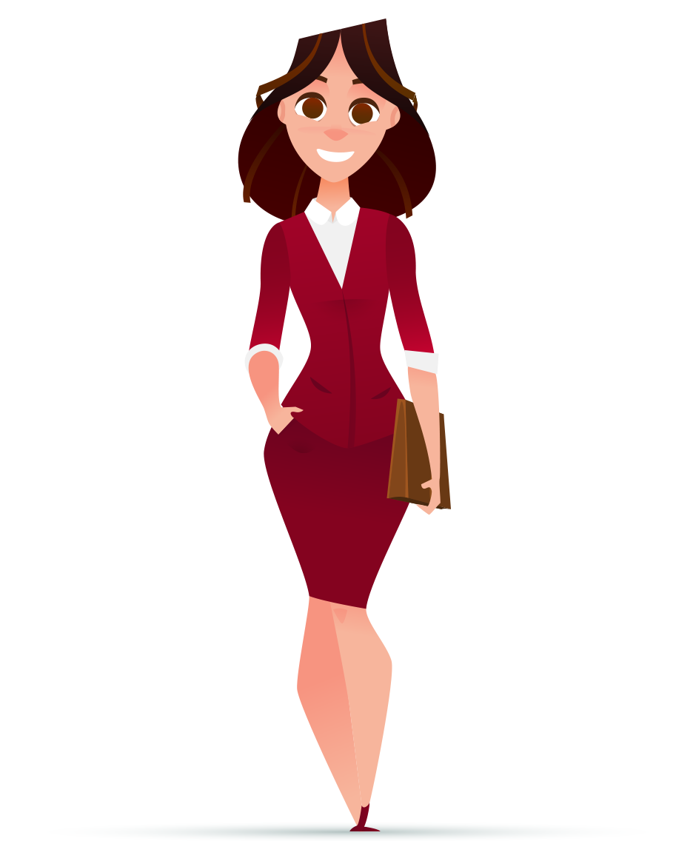
Style D – Results-oriented
Style
D
Decisive, tough
Strong-willed
Competitive, demanding
Under pressure
Independent, self-confident
lack of concern
Fear
loss of control
Notes:
High D personality styles are competitive, aggressive, decisive and results-oriented. They prefer to move fast, take risks and get things done now. D-styles also like to be in charge, in control and hold the power. They want change and challenges. They're not the warmest and fuzziest people; they are no-nonsense and can come across as very direct. People often turn to type-D personality styles to drive projects, as they get things done.
The DISC D personality fears failure and losing control. A high D personality type avoids losing control at all costs. Being out of control is scary for DISC D types. When they find themselves losing control their reaction is to be volatile and abrupt.
D-styles under pressure can also be impatient, overbearing and even rude. They are often not very good listeners and are prone to making snap decisions. Others may perceive D-styles as somewhat self-centred, demanding, blunt, and overly aggressive.
If a “D” were a bird, they’d be an eagle!
Ask the trainees: “Do you know anyone who is like this?”

Slide 9
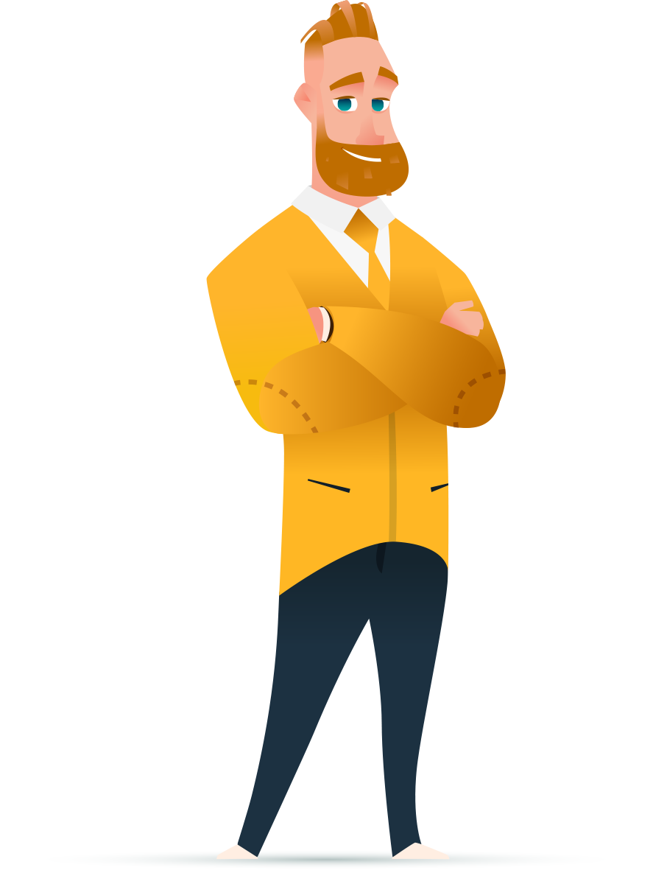
Style I – People-oriented
Style
I
Sociable, talkative, optimistic
Likes to talk, open
Enthusiastic and energetic
Under pressure
Persuasive, inspiring
Disorganised
Fear
Social rejection
Notes:
I-styles are talkative, sociable, optimistic and lively. They are people-oriented, spontaneous, energetic and enthusiastic. I-styles tend to be positive and good at influencing others. Social acceptance is very important to I-styles – they like to be liked.
An “I”’s biggest fears are social rejection (being ignored), becoming involved in conflict, losing the ability to influence others or becoming insignificant, disapproval from others or not being liked.
Under pressure I-styles can also be inattentive to details, overly talkative and emotional. They may over-promise because they are so optimistic and are eager to be popular. Others may perceive I-styles as somewhat careless, impulsive and lacking follow-up.
Ask if anyone knows someone like this.
If an “I” were a bird, they’d be a peacock!

Slide 10
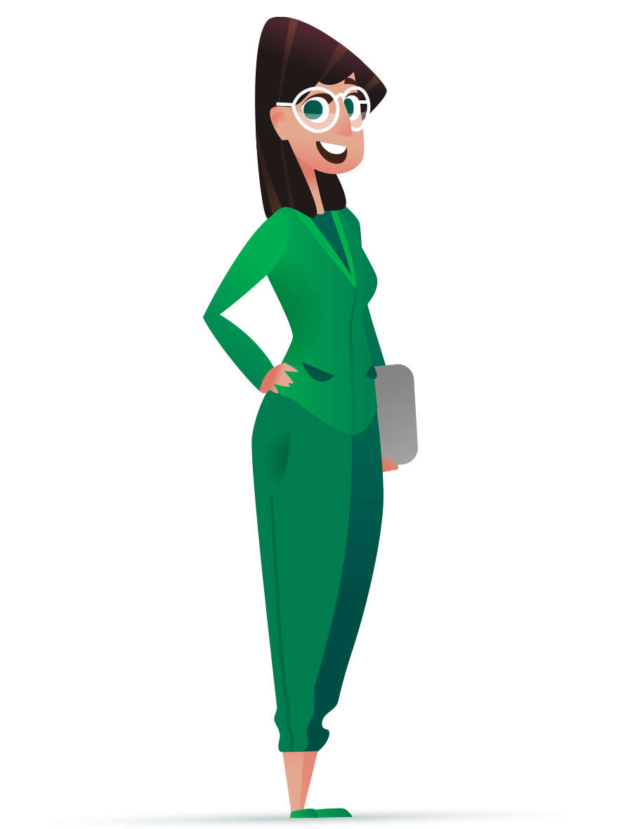
Style S - Steady
Style
S
Calm, steady, unhurried
Careful, patient
Good listener, modest
Under pressure
Trustworthy
Too willing
Fear
Loss of stability
Notes:
DISC Profile S styles are calm, modest, and laid-back. They are the team-builders of the world. They care about everyone else, even at their own expense, in some cases. S-styles tend to be patient listeners, trustworthy, and persistent. They are balanced between tasks and people. DISC Profile S styles are reliable and stable and are particularly willing to co-operate with whoever is in charge, in order to carry out tasks.
An “S’s biggest fear is loss of stability, unplanned changes, and offending others. An”S” behavioural style does not like to feel used or lose face.
S-styles need stability and security and, therefore, need help with change. They may be too willing to pitch in, and at times may be taken advantage of. Others may perceive S-styles as being too slow, stuck on the status quo, indecisive, stubborn and even quietly resentful.
Ask if anyone knows someone like this.
If an “S” were a bird, they’d be a dove!

Slide 11
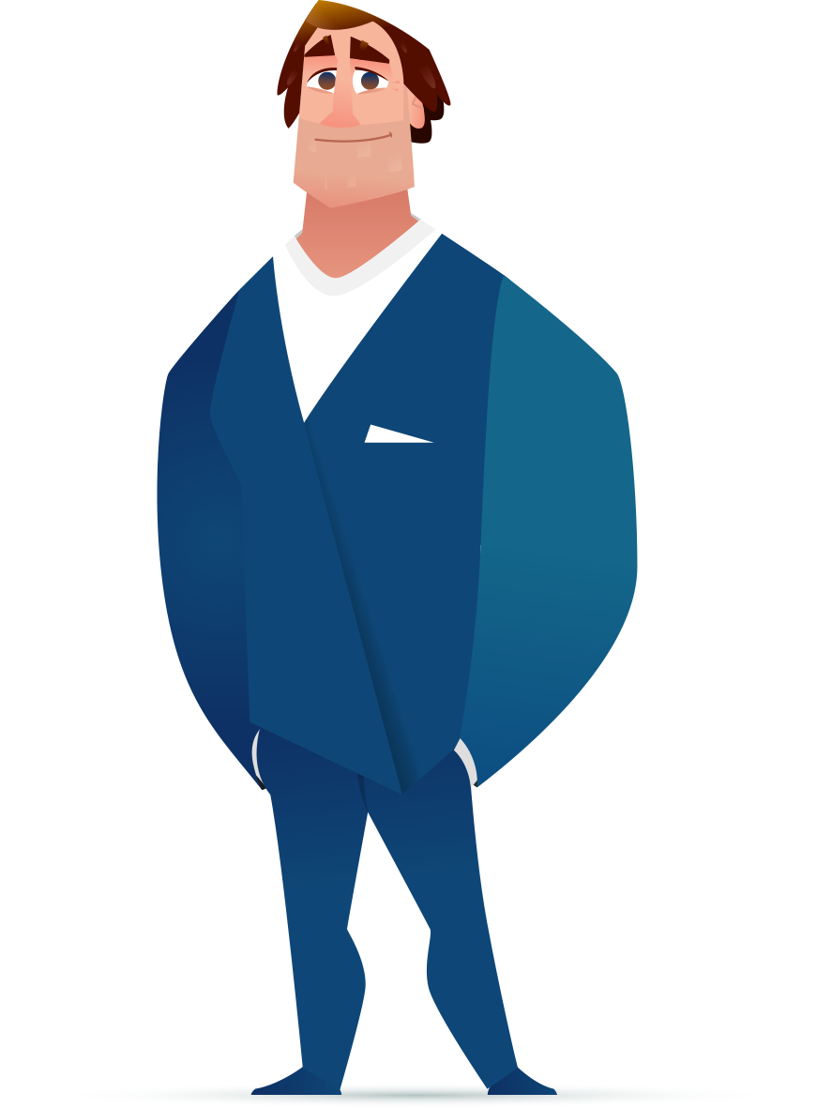
Style C - Precise
Style
C
Precise, pedantic
Follows rules
Logical, careful
Under pressure
Formal, disciplined
Overly-critical
Fear
criticism of work
Notes:
C-styles are the most cautious.
The C-styles are precise, logical, matter-of-fact, analytical and careful. They need data, information and analyses. They are focused on tasks and ensure things get done correctly. C-styles tend to produce high quality work.
A “C” style’s biggest fear is criticism of their work. This fear of being wrong leads them to avoid making mistakes at all costs. A “C” fears chaos, unorganised ways of working and a lack of accurate information or instructions.
C-styles may also focus too much on the details, becoming nit-picky, slow and losing the bigger picture. At times they get lost in the analysis, focusing too much on the trees and not enough on the forest. Others may perceive C-styles as being too critical, distant, pessimistic, and even cold.
Ask if anyone knows someone like this.
If “C” were a bird, they’d be an owl.

Slide 12
Extended DISC Behavioural Assessment
What does it measure?
What isn’t doing?
It measures natural (spontaneous) reactions of the respondent to the external stimulators.
It does not classify people into good or bad categories or more or less intelligent.
It is not a test that a person can pass or fail.
It does not limit a person’s possibilities to develop

Slide 13
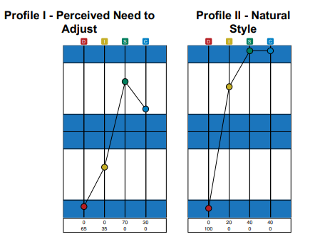
Profiles: About Profile II
Profile II (Who we are) - Also described as Natural Behaviour or Unconscious Self Image
Profile II identifies your “natural style”. It is the most comfortable style for you and requires the least amount of concentration, energy and effort. It is also the behavioural style that others are most likely to observe in you. In other words, it is your “true style”. It is usually the most pleasant to exhibit but often our ‘reaction mode’. Most frequently exhibited outwardly in your behaviour.
It is interpreted looking at its size, shape and position. It provides the basis of the report.
Replace with a screenshot of your client’s profiles here
Page 5 in
your Report
Notes:
13
Profile II
Extended DISC System’s most accurate and lasting illustration of a person’s natural behaviour - also considered a measure of a person’s unconscious self-image.
It is comparatively stable over time (with D and C factors being slightly more stable than I and S). Any significant and large changes in Profile II usually means a significant life event forcing him or her to seek new ways to succeed. It is quite rare that someone's natural style changes dramatically.
The data collected the creates Profile II (using algorithms) form the natural behavioural style which forms to bases of the Behavioural (or Personal) Analysis Report.

Slide 14
Profile: About Profile I
Profile I (Perceived Need to Adjust) - Also described as Learned Behaviour or Conscious Self Image
Profile I shows how you feel you need to adjust your behaviour to better meet the requirements of your present work environment. As a result, this profile is dependent on the environment and will change as
the environment changes. Changes such as a new job position, new supervisor, and a new job in another company are very likely to change the Profile I. We can call Profile I your “adjusted style”.
Replace with a screenshot of your client’s profiles here
Page 5 in
your Report
Notes:
14
Profile I illustrates how the person feels he/she has/wants to adjust his/her behaviour to better cope with the requirements of the present environment. Profile I demonstrates the individual’s conscious understanding of one’s self and own behaviour in the present situation (conscious self-image).

Slide 15
Analyse the Adjustment
  Significant differences from Profile II
  A change in the shape of the Profile
  A change in the dominating type
  Shifting of a type (D I S or C) over the middle line i.e. D now above the line
  ^{Other significant changes}
Replace with a screenshot of your client’s profile here

Slide 16
The Diamond
Mapping Energy Use

Slide 17
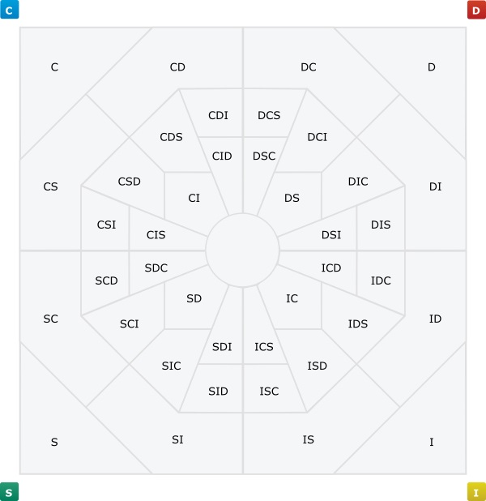
Extended DISC Combination Styles on the Map
Logic
Systems
Analyses
Facts
Hard values
Results
Examining
Instructions
Change
Renewal
Traditions
Checking
Influencing
Generating ideas
Friendliness
Considers others’
emotions
People
Communication
Openness
Notes:
The Extended DISC diamond is a graphical representation of the different Behavioural Styles.

Slide 18
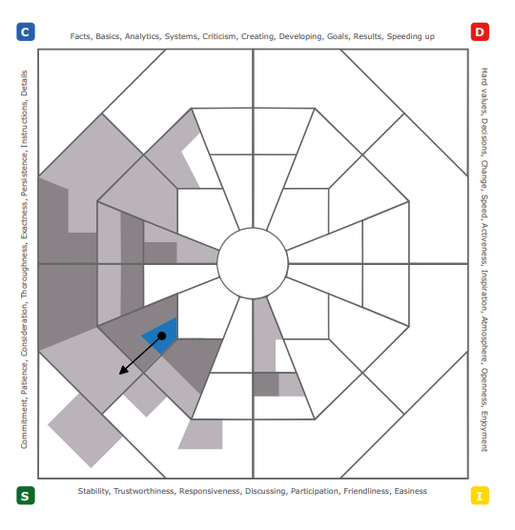
Extended DISC Diamond: Flexibility/Comfort Zones
Flexibility zones – areas of comfortable behaviour and low energy consumption
– coloured sectors
The most comfortable style
– dot
Adjustment the person feels they need to make
– arrow
Areas requiring the most energy – high energy consumption
– white sectors
Replace with a screenshot of your client’s diamond here
Notes:
The Flexibility Zones Page demonstrates how much and in what direction the individual’s behaviour is the most flexible, as well as in what areas the person is the farthest from their natural style. It is important to note that when we describe an individual’s behaviour, we don’t say they can or cannot do something. We all have the potential to do everything; it is just that some things are more natural to us than others.
Dark shade/Coloured area:
This is the most natural and comfortable behavioural style area. It doesn’t require a lot of energy. It’s the Comfort Zone.
Lighter shades:
Where one can easily develop without too much energy expenditure. Where one can ‘rubber belt’.
White:
This is where the most energy, effort and concentration is required. When entering the white area, the energy consumption increases and the person needs to concentrate more. It doesn’t feel as natural as it felt in the coloured areas and the person is most likely to get tired and start making mistakes earlier than they would in the coloured area tasks.
The pink shading is where the candidate sits on the Diamond, based on their Profile II.
The end of the arrow represents Profile I. This shows how the candidate feels they need to adjust to meet the current demands of their work environment.
Reasons for there being no arrow:
Profiles I and II are similar shapes.
Profile I is tight (all four styles are close to the midline).
There are some Diamonds that can be selected from the FinxS platform that do not have arrows.

Slide 19
Debriefing
Supporting Pages

Slide 20

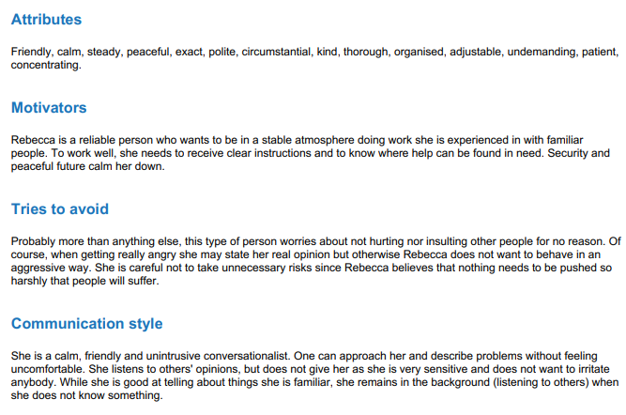
Individual Reports Extended DISC
Text Page
Description of typical behaviours of people with a similar style
–Ask others for feedback and comments!
Replace with a screenshot of your client’s text here
Page 8 in
your Report
Notes:
The Text Page (p.6) in the reports describes the typical behaviour of the individual. When reading the text, use it to develop an overall picture. In evaluating specific sentences, it is important to consider a person’s conscious ability to adapt their behaviour. The descriptions on this page are specifically designed to be concise.
When reading the Text Page, it is important to keep in mind that it describes how this type of person is typically seen by others. What it doesn’t take into account is what the person has learned to do in contrast to their most natural style. A typical example could be a person with a very high I-style, who has made an effort to learn to be much more systematic and detailed than their natural style would indicate.
The Text Page is easy to read, but we recommend it not be used before thoroughly going through the Profile and Diamond Pages. The Text Page gives a good overall picture of the person, which is how it should be used. A few of the applications of the results include:
To help in interviews
To allow other people to comment and give feedback
To get a quick overall image of a person
To assist in self-analysis
To help in managing an individual
Are there words that the person doesn’t recognise in themselves?
Is this something I have learned to do/avoid?
Why do I not see that in my behaviour?
What about others? Can they see it in my behaviour?
How do the Text Page and the requirements of my job fit together?
Is there something that I would like / be good at that my job doesn’t include?
Is there something in my job that is contrary to the Text Page text?
How might I alter or adjust my job description to better integrate with the Text Page text?

Slide 21
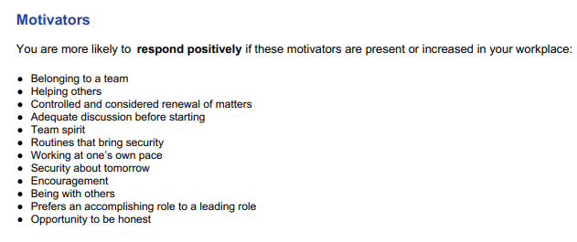
Extended DISC Motivators
Motivators
You are like to respond positively if these are increased in your workplace environment.
Replace with a screenshot of your client’s motivators here
Page 9 in
your Report
Notes:
The ‘Motivators’ section describes things that typically motivate this type of person. It is to be expected that they will respond positively to an increase in these factors in their work environment.
The Motivators Page (p.7) is very direct in style. At the same time, it is suggestive by nature. It lists items for discussion, but doesn’t state that all of them describe the person as they are today. A few of the applications of the results include:
Learning to better understand one’s own behaviour and that of others
To compare the person and their job
To find more efficacious ways of managing the person
To identify ways of increasing organisational effectiveness by better utilisation of the person’s strengths
To solve communication issues
Comparison to an individual’s present work environment
What Motivators, and Situations that Reduce Motivation (p.8), can be found in the person’s current work environment?
How significant or relevant are the Situations that Reduce Motivation to their current work?

Slide 22
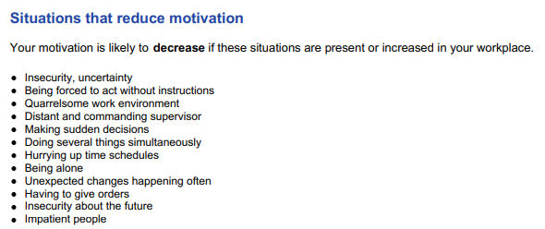
Extended DISC Situations that reduce motivation
De Motivators
Replace with a screenshot of your client’s de-motivators here
Page 9 in
your Report
Notes:
The ‘Motivators’ section describes things that typically motivate this type of person. It is to be expected that they will respond positively to an increase in these factors in their work environment.
The Motivators Page (p.7) is very direct in style. At the same time, it is suggestive by nature. It lists items for discussion, but doesn’t state that all of them describe the person as they are today. A few of the applications of the results include:
Learning to better understand one’s own behaviour and that of others
To compare the person and their job
To find more efficacious ways of managing the person
To identify ways of increasing organisational effectiveness by better utilisation of the person’s strengths
To solve communication issues
Comparison to an individual’s present work environment
What Motivators, and Situations that Reduce Motivation (p.8), can be found in the person’s current work environment?
How significant or relevant are the Situations that Reduce Motivation to their current work?

Slide 23
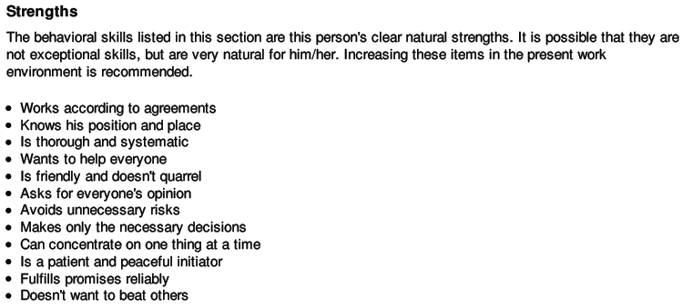
Individual Reports Extended DISC
Strengths
Replace with a screenshot of your client’s strengths here
Page 10 in
your Report
Notes:
The behavioural skills listed in the Strengths section are this person’s clear natural strengths. It may be that they are not exceptional skills, but it is very natural for this individual to do these things and in doing them, they don’t burn up as much energy as other people might. Developing processes and opportunities where the individual can use their strengths in their work environment would be ideal.
Utilising a person’s strengths
Does the person have the opportunity to use all their strengths in their present work?
Has the management team identified them as being this employee’s particular strengths?
Is there a way of utilising their strengths more efficiently and effectively?

Slide 24
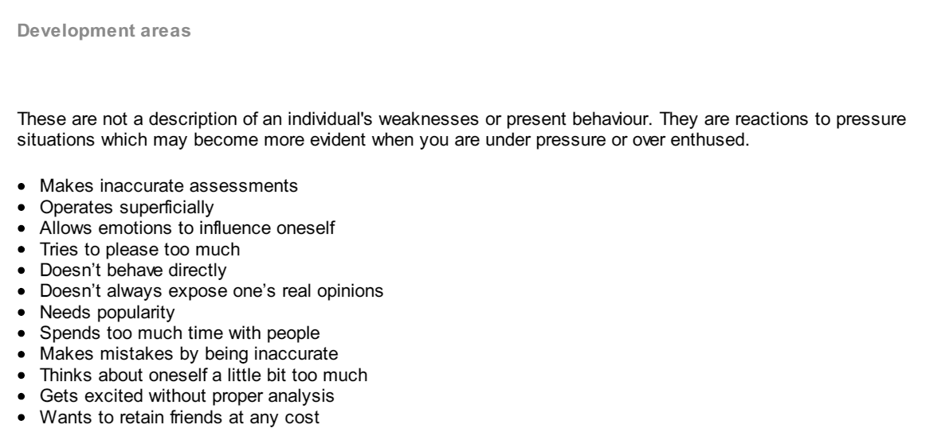
Individual Reports Extended DISC
Replace with a screenshot of your client’s developmental here
Development Areas
This is a description of the potential risks.
And not the current style of behaviour!
Page 10 in
your Report
Notes:
It is important to note that this is not a description of this person’s weaknesses or present behaviour. It is a list of things the person should be cautious about. If he/she gets overly excited or stressed these weaknesses may become active. From management’s perspective, the person should not be pushed towards using these reactions to pressure situations
Identification of personal development areas
How many of the Development Areas does the person identify in their own behaviour?
How many of the Development Areas do other people identify in the person’s behaviour?
Under which circumstances do the Development Areas become visible?
Is there anything management could do to strengthen the development areas?

Slide 25
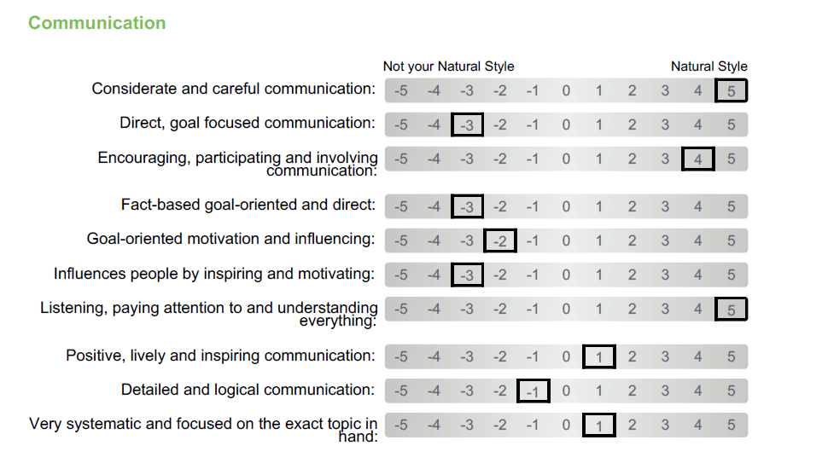
Debriefing: Competencies
Competencies relate to a specific Behavioural style
Below -2: Competency would require significant energy.
Between -1 to 1: Individual can develop the competency comfortably.
Above 2: Competency requires very little energy from the candidate.
Non-natural
Natural
Page 14 in
your Report
Replace with a screenshot of your client’s communication competencies here
Notes:
Competencies relate to a specific behavioural style
Black boxes on the left side of the page - items in this column are behaviours that are not natural to the person’s style. As a result, they may be considered the individual’s development areas.
Black boxes on the right side of the page - items in this column are behaviours that are natural to the person’s style. As a result, they may be considered the individual’s strengths.
Black boxes in the middle of the page - items in this column are behaviours that are neither clear strengths nor development areas for the individual. They are of average comfort level to an individual. The person can consciously increase or decrease these behaviours with relative ease. However, the adjustment will require energy.
The Behavioural Competencies become useful when there is something to compare them with, either an existing job or one that a candidate is applying for. Note that it is not a “can – cannot” scale, but a “natural – non-natural” scale. A few of the applications of the results include:
To compare an individual with the requirements of a job
To assist in designing the future career of a person
To assist in sharpening a job description
To help identify training needs
High scores
Look at the items that are on the right-hand side of the scale.
Interpretation:
These items describe the type of work behaviour that is easiest for the person, takes the least energy and is most natural. People are likely to be able to work longer when concentrating on these items.
When reviewing the high scores consider:
How well do the high score items correlate with the individual’s current job?
How well do the high score items match with the job they are applying for?
Do the high scores highlight anything that we haven’t realised and utilised yet?
Low scores
Look at the items that are on the left-hand side of the scale.
Interpretation:
These items describe the type of work behaviour that is not natural for the person, takes more energy, and is likely to cause the person to tire more easily than the items on the right side of the scale do.
When reviewing the low scores consider:
How often and to what extent, in my daily work, do I need to do the items on the left?
How much emphasis needs to be given to the left-side items when a person is applying for a job?
Is there an option to delegate some of the items that have come in with a left-side score?

Slide 26

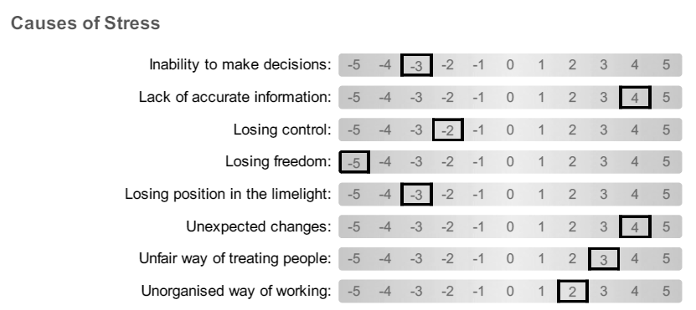
Stress: DISC Styles and Stress
Under stress or pressure we can revert back to our natural behavioural style because it is the style that requires the least amount of energy.
Below are some indicators that may or may not become apparent when under stress:
Replace with a screenshot of your client’s causes of stress here
Notes:
Do you have any questions?
Different styles have different tendencies to recognise, react and reveal stress.
In your own reports you will have three sections:
Causes of stress
Signs of stress
Stress relief
The boxes on the right-hand side indicate items that may cause you some stress
While the boxes on the left-hand side are not likely to cause you stress

Slide 27
Extended DISC
Special Cases

Slide 28
Step 3: Special Cases = Expressed Feelings
The SHAPE we know gives us people’s style, now let’s introduce
two more areas we look at in debriefing: SIZE and POSITION
In both Profile I and II we can find patterns in the SIZE and POSITION in which we are then able to relate to key feelings (emotions).
    Stress
    Pressure
    Frustration
    Moral / ethical issues
    Uncertainty of role
    Insecurity
    Helplessness

