Slide 1
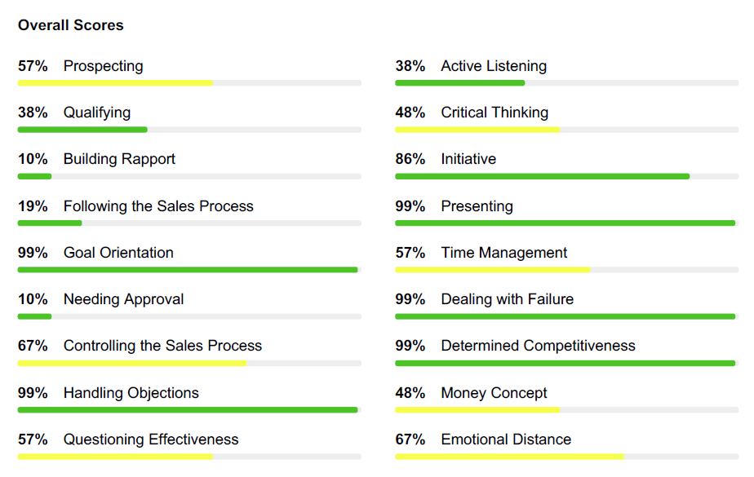
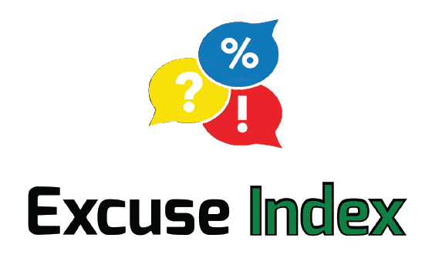

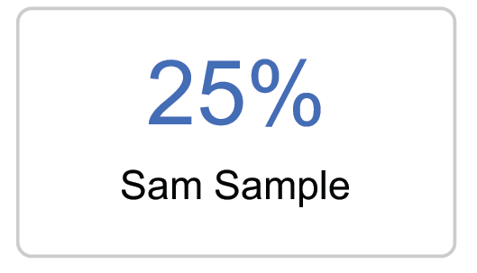
FinxS® Sales Competence Assessment
Weakness
Close Match
Excessive
Challenge
Match
Over Focus

Slide 2
The questionnaire measures the attitude of the respondent towards key behaviours in the sales process and their perception of their current sales competences.
What does the questionnaire measure?
Salesperson’s Effectiveness
Natural Predispositions
Attitude
Competences

Slide 3

18 Sales Competences
The Sales Competence Assessment measures a person’s self-perception against 18 sales competences.
The report displays an overall score for each competence.
This is a
Zero-Sum game
Colour Interpretation: The two colours help separate a middle from a high and low score. A green score is either high or low and a yellow score is a middle score.
Remember, a high, middle or low score is neither good nor bad. You need to judge the scores in relation to the sales needs of your organisation.
Replace with your candidate’s competences
Page 3 in
your Report
Notes:
It measures the candidate’s self perception againts 18 different sales competences.
Each of the 18 sales competences are described in the report. There are descriptions for high and low scoring behaviours.

Slide 4
Sales Mindsets
A mindset is a set of beliefs, attitudes, and assumptions that shape how we think, feel, and act in different situations. It influences how we interpret the world, approach challenges, and make decisions.
They are like basic instincts.
 | Description
Conquering | Reaching their full potential by making sure nobody and nothing stops them from achieving their goal.
Hunter | Reaching their full potential by wanting to have everything right now.
Persistence | Reaching their full potential by using failure as a reason to do better next time.
Reading the situation | Reaching their full potential by understanding how others see the world.
Logic | Reaching their full potential by following a plan, no matter what.
Hunger | Reaching their full potential by never being satisfied.
Empathy | Reaching their full potential by connecting with people and gaining their trust.
Social approval | Reaching their full potential by gratifying others' needs.
Taking control | Reaching their full potential by not being dependent on anyone else.
Next Step | Reaching their full potential by continuously thinking what next.
Finding the truth | Reaching their full potential by understanding all aspects influencing the situation.
Influencing | Reaching their full potential by convincing others.
Notes:
A mindset is an established set of attitudes and thought patterns held by someone.
Sales Mindsets are your natural ways of approaching sales. They are spontaneous, hard to change and likely to be emphasised when you are under pressure.
Mindsets are "ways to succeed", "ways to approach challenges", maybe even "ways to survive in pressure"

Slide 5
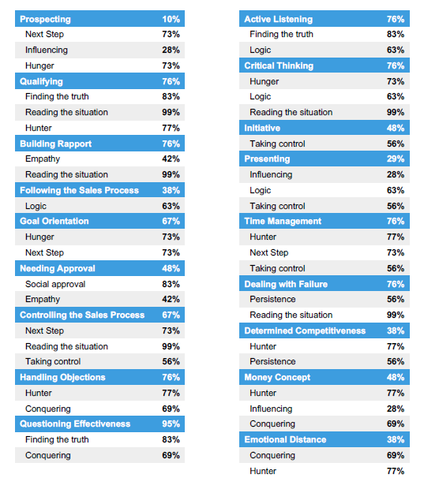
Mindset Summary Table
Replace with your candidate’s mindsets
Each of the Sales Competences is based on one to three Mindsets.
The competence score is derived not only from the mindsets, but also from questions not connected to the mindsets.
The table below shows how the respondent’s Mindsets create the 18 Sales Competence Scores.
Page 8 in
your Report

Slide 6

Excuse Index
Replace with your candidate’s mindsets
The Excuse Index measures the actual tendency to look for excuses to not engage in sales activities.
The LOWER the Excuse Index®
The more likely the person is to ignore non-sales activies
Instead focus on actions that directly produce sales results
The HIGHER the Excuse Index®
The MORE excuses a person is likely to make to not engage in sales activities
Page 27 in
your Report
Notes:
Not everyone enjoys a job in selling. In sales, we are more likely to succeed when we are spending our time on our current prospects and developing business potential. However, there are times when we procrastinate or prefer to focus our energies on non-sales related activities.
The current average is 37%; this means that the average sales professional spends 37% of their time on non-sales related activities and 63% on the sales process.
if you're a sales manager, it's a great place to start reviewing your team member's Sales Competence Result. If one of your sales people has a higher than average excuse index, do you need to provide additional support and feedback? If you have a sales person with a low Sales Excuse score, then you know that person is focusing his/her energies on the sales process.

Slide 7
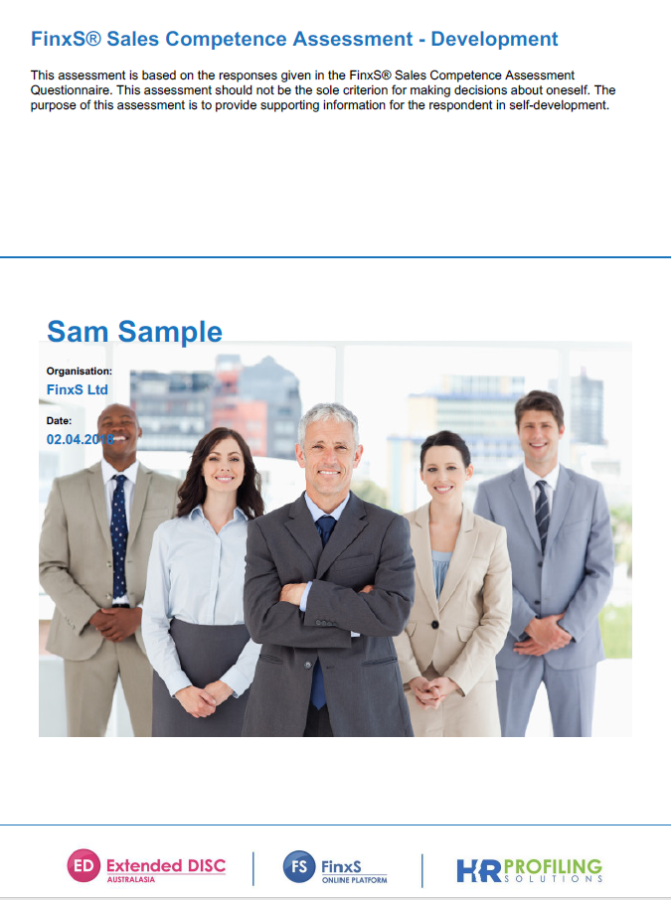
Development Report

Slide 8

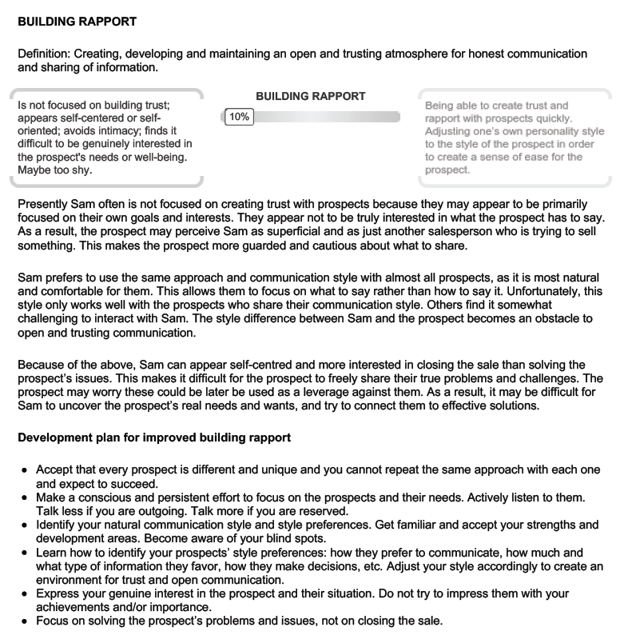
Development Plan Pages
The Development Plan pages offer a unique, detailed description of the results for each competency, along with a dynamic development plan.
Description
These 3 paragraphs are dynamic and change out depending on high, medium and low scores.
Development Tips
Pages 9-26 in
your Report
These tips are unique to a person whether they scored, high medium or low.
Notes:
The report is able to generate 3 different ‘descriptions’ and ‘development tips’ for a high, medium and low score for each of the 18 behavioural competences. The system automatically generates the descriptions and tips relevant to the candidate score.

Slide 9
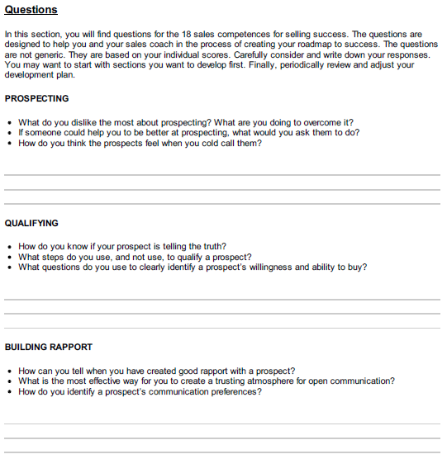
Development Questions Pages
There are development questions for effective reflection and coaching for each of the 18 competences.
Pages 28-33 in
your Report

Slide 10
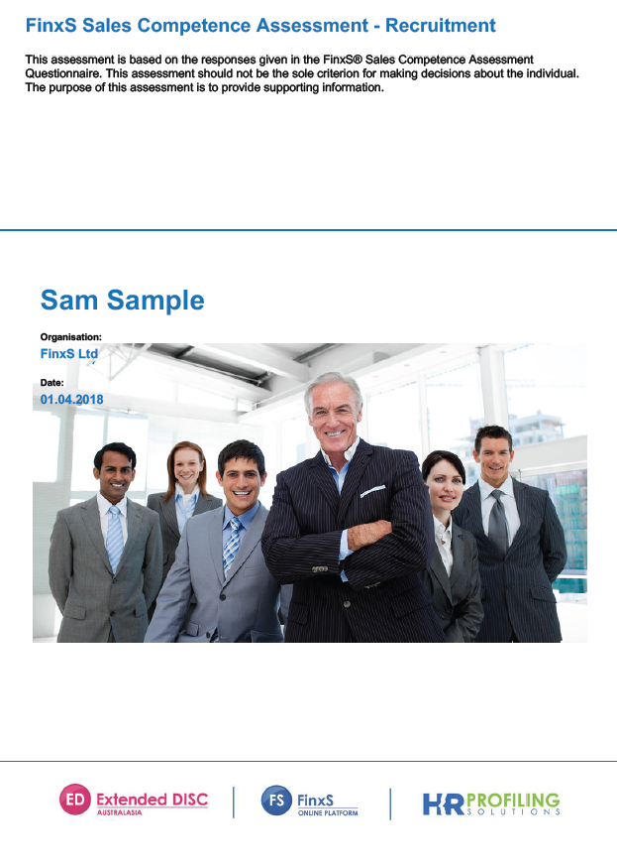
Recruitment Report

Slide 11
Replace with your candidate’s scores
Sales Roles Description
Need
Sales Cycle
Relationship
Job Roles
Short Relationship
REVEALER
51%
Short Sales Cycle
Long Relationship
CREATOR
56%
Latent Need
Long/Complex Sales Cycle
Short Relationship
FORERUNNER
74%
Long Relationship
INNOVATOR
80%
Short Relationship
DEALER
66%
Short Sales Cycle
Long Relationship
PROVIDER
66%
Expressed Need
Short Relationship
COUNSELOR
73%
Long/Complex Sales Cycle
Long Relationship
PARTNER
65%

Slide 12
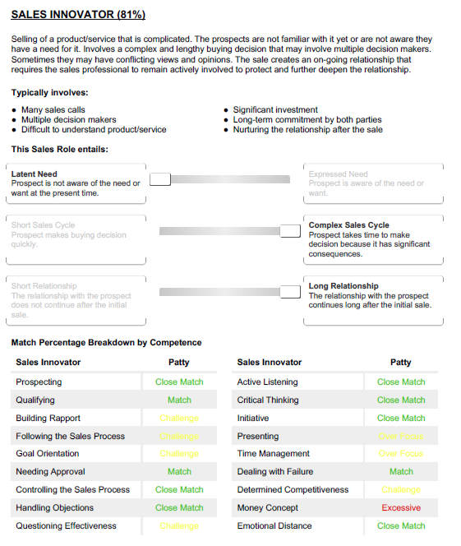
Sales Job Roles
Match Percentage
Competence Match
Challenge
Challenge
Over Focus
Page 10-17 in
your Report
Challenge
Over Focus
N.B. colour key on following slide
Challenge
Challenge

Slide 13
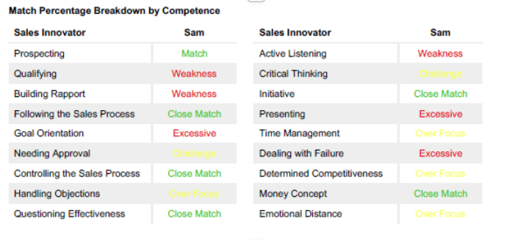
Challenge
Close Match
Close Match
Over Focus
Excessive
Weakness
Match
Green = Your score matches the ideal
Yellow = Your score is above or below the ideal
Red = Your score is far below or far above the ideal

Slide 14
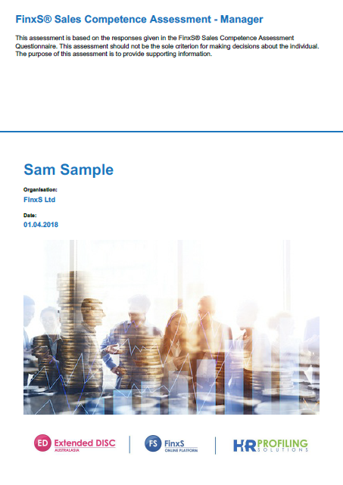
Manager Report

Slide 15
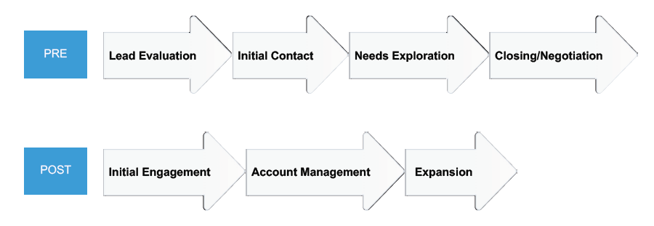
Pre- and Post Sales Process
The Sales Manager Assessment reports on a salesperson’s ability to adapt to the main requirements of each step in the sales process.
The sales process is broken into two separate sections: pre and post-sale.
Page 3 in
your Report
Notes:
The Sales Manager Assessment reports on a salesperson’s ability to adapt to the main requirements of each step in the sales process. The sales process is broken into two separate sections: pre and post-sale. The pre-sale steps include… *read screen* and the post-sale steps include.. *Read screen*
The report helps managers and coaches to understand why some salespeople may lose their way when it comes to following the sales process and allows you to highlight areas in which salespeople need extra development to help them perform and adjust to the main requirements of each step in the Sales Process.

Slide 16
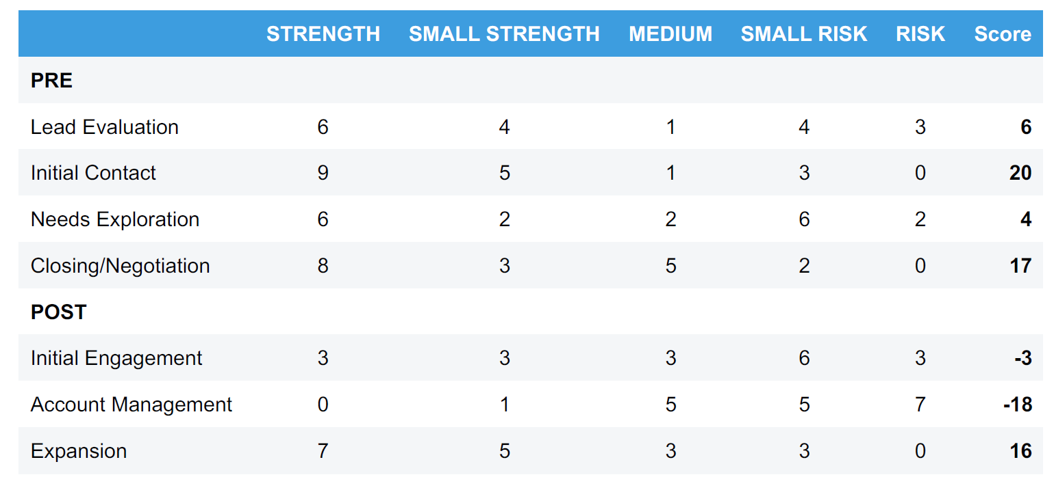
The following table provides a summary of this person’s competence match at different steps of the sales process.
Replace with your candidate’s scores
Page 4 in
your Report

Slide 17
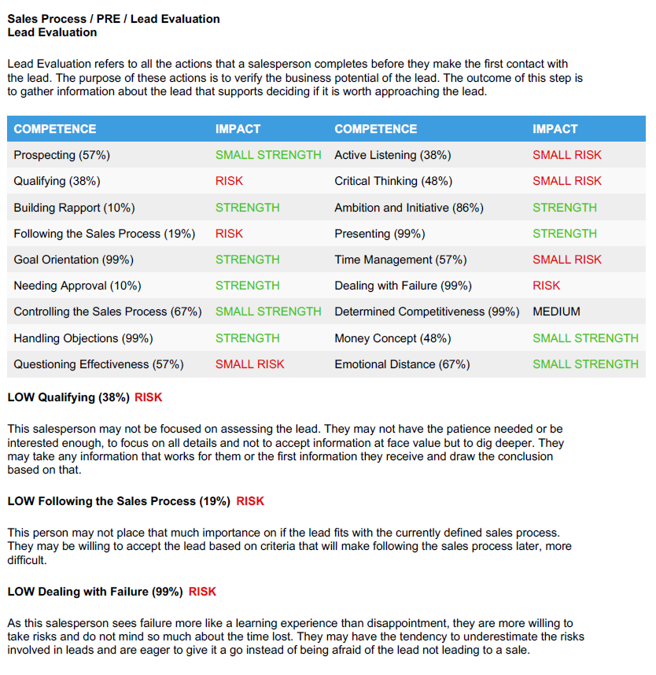
Manager Report: Sales Process
Pages 5-14 in
your Report
Each step in the sales process is broken down in a description page. The pages provide a description of the step in the sales process.
The Competence Match table shows whether the score is a strength or a risk to performance in the related step in the sales process.
By defining the ”risk” competencies, managers can easily identify where development is needed in order to improve sales performance in the particular step in the sales process. This text is dynamic.
Description
Competence
Match
RISK
Descriptions
Notes:
Each step in the sales process is broken down in a description page. The pages provide a description of each step in the sales process.
The Competence Match table shows whether the score is a strength or a risk to performance in the related step in the sales process. By defining the Risk competencies, managers can easily identify where development is needed in order to improve sales performance in the particular step in the sales process.
NOTE – Page numbers affected by amount of risk competencies

Slide 18
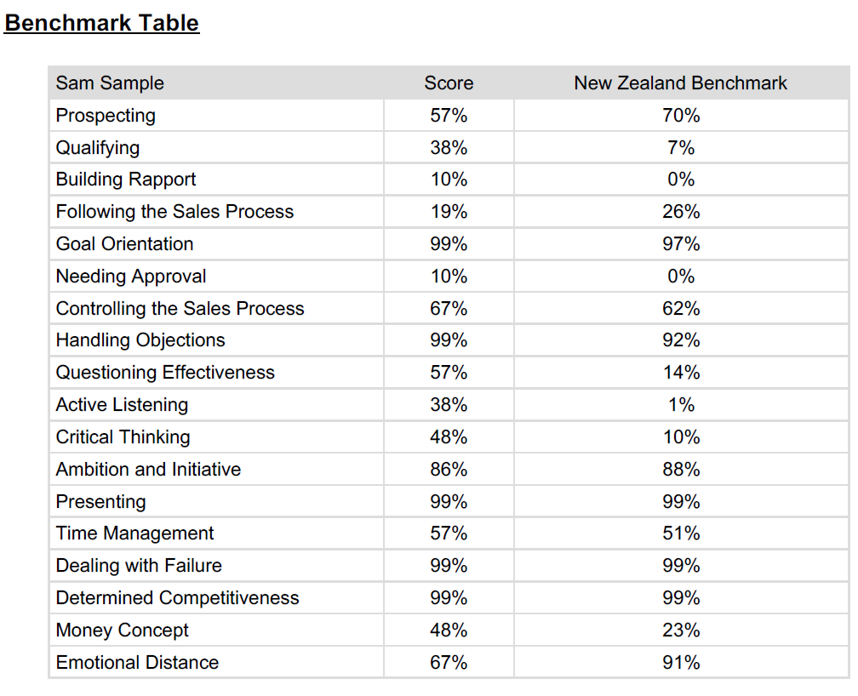
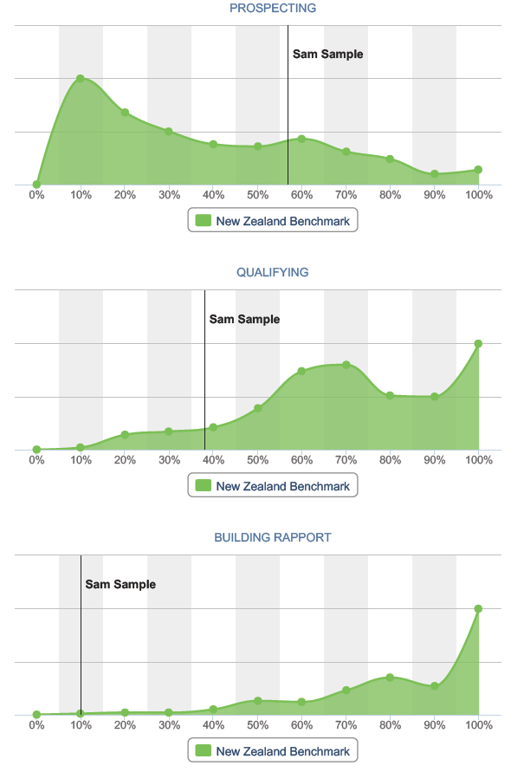
Replace with your candidate’s scores
Benchmark Comparisons
The purpose of a benchmark comparison is to identify how this person compares against a selected population.
The benchmark does not directly tell us anything about this person’s sales skills, only how they compare against another group of people.
Pages 15-21 in
your Report
The percentage indicates the percentage of the population that scored less than this person.
Notes:
The Sales Manager report also includes the ability to compare results against a benchmark. The purpose of a benchmark comparison is to identify how this person compares against a selected population. The benchmark does not directly tell us anything about this person’s sales skills, only how they compare against another group of people.
Remember, it is important to use a benchmark population that this person could be part of (based on the selection criteria of the population).
The percentage indicates the percentage of the population that scored less than this person. For example, 25% would mean that 25% of the population has a lower score than this person, and 75% has a higher score.
The Benchmark Scores are presented as a summary table and also graphically.

Slide 19
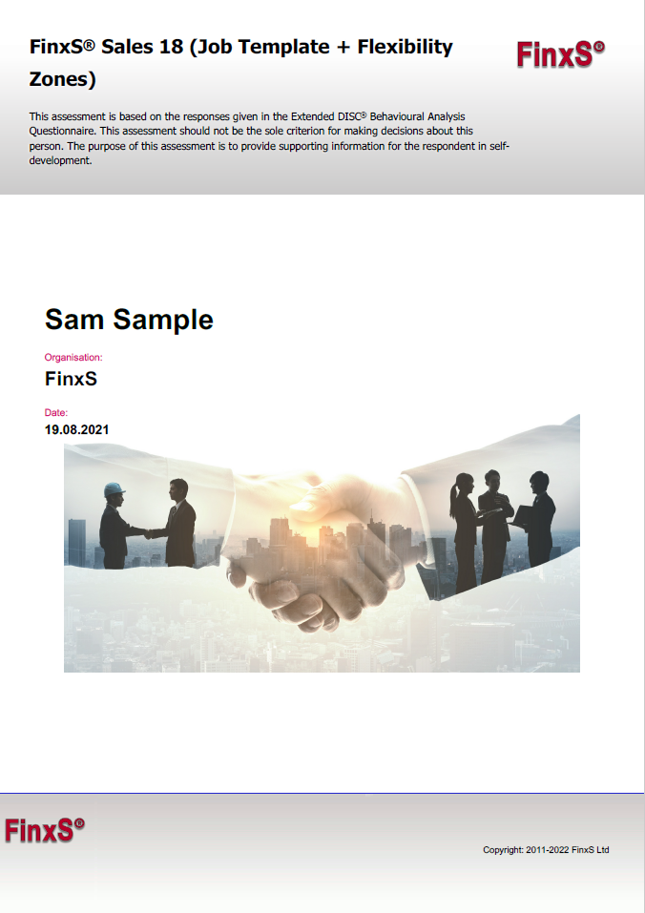
FinxS Sales 18
(Extended DISC®)

Slide 20
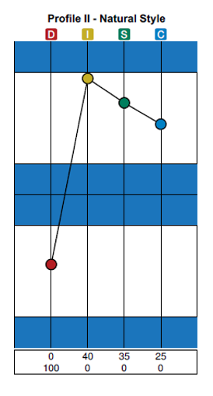
Extended DISC® Assessment
Compliance
Dominance
Measures an individual’s natural hard-wired DISC behavioural style in the 18 sales competences:
    24 questions
    8-12 minutes to complete
    For individuals from any profession
Steadiness
Influence
FinxS® Sales 18 Report

Slide 21
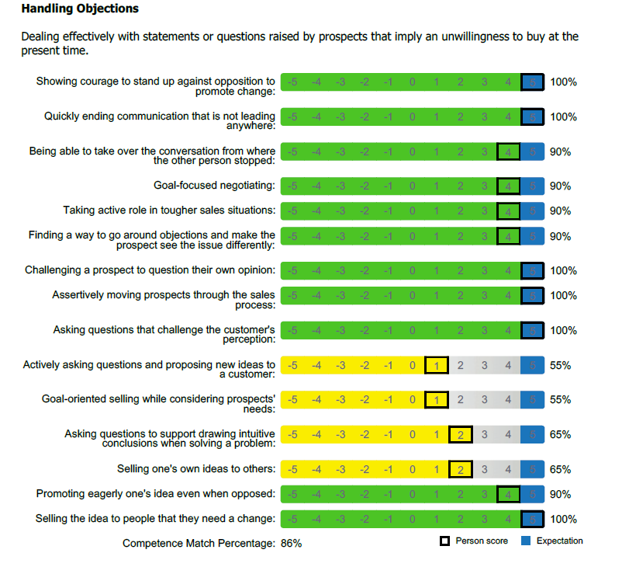
FinxS® Sales 18 – DISC Match Percentage
Red - Below -2: Competency would require significant energy and is not natural to your style.
Yellow - Between -1 to 1: Individual can develop the competency comfortably.
Green – Above 2 Competency requires very little energy from the candidate.
Each Extended DISC® behavioural sales competences are listed and scored.
An overall Extended DISC® competence percentage match is calculated to identify an individual’s natural behavioural tendency in that competency.
Page 4-21 in
your Report

Slide 22
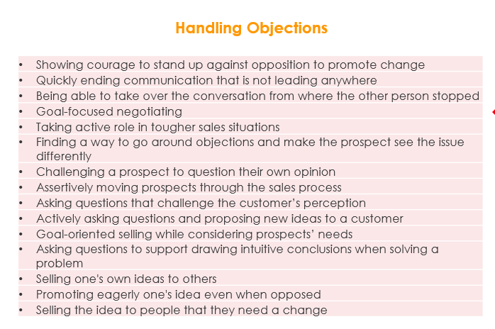
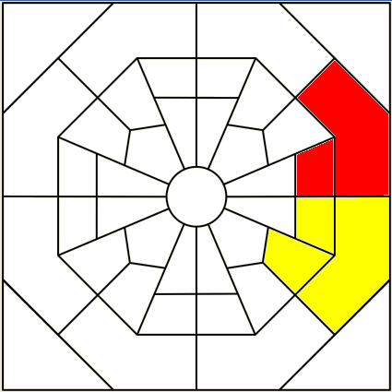
FinxS Sales 18 – Flexibility Zones
The 18 sales competences can be mapped on the Extended DISC® Diamond using the 15 behavioual competences matched to each one.
Refer to Report:
FinxS Sales 18 (Job Template + Flexibility Zones)
Pg 19

Slide 23
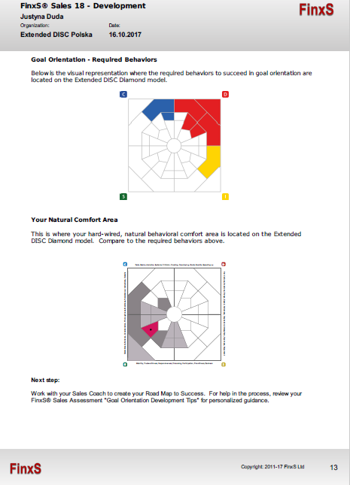
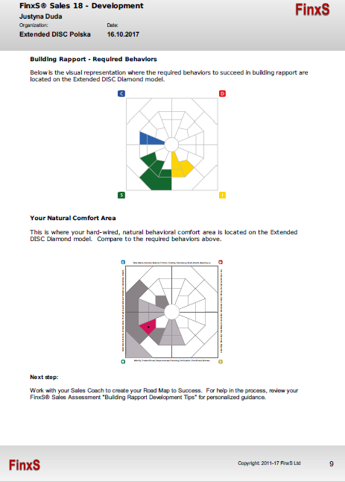
FinxS Sales 18: Flexibility Zones
Replace with your candidate’s page
Required sales competence behaviours on the Extended DISC® Diamond.
The respondent’s flexibility zones on the Extended DISC® Diamond

Slide 24
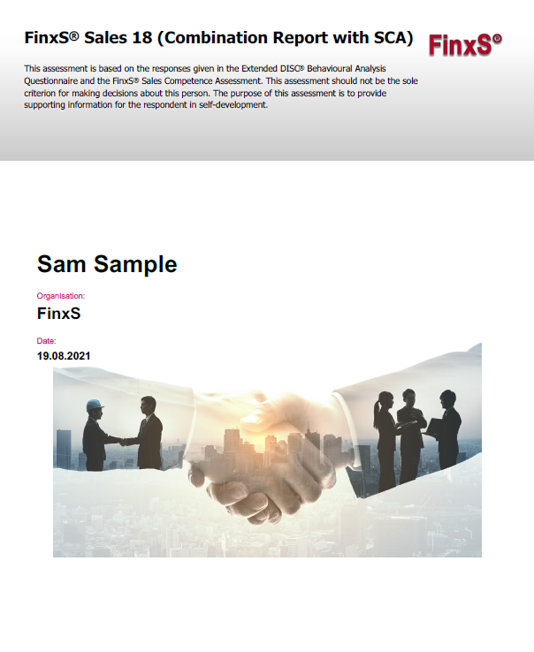
FinxS Sales 18
(Combination report with SCA)

Slide 25
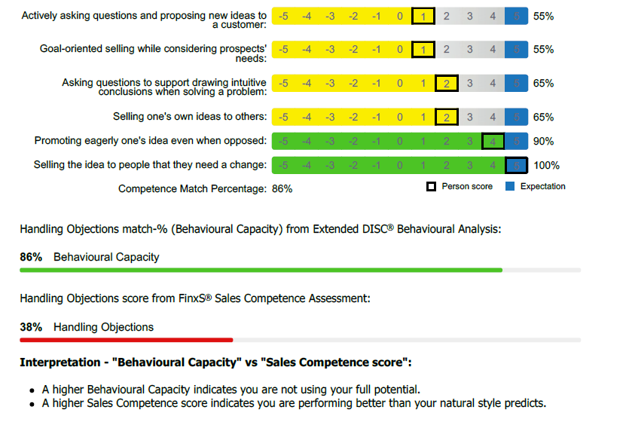
FinxS® Sales 18 (Combination with SCA)
Replace with an example from your candidate’s report
You have a high natural behavioural capacity for this competency, but you have scored low in the sales competence assessment.
You can easily develop this competency with coaching and training
You are not using this competency to their full potential.

Slide 26
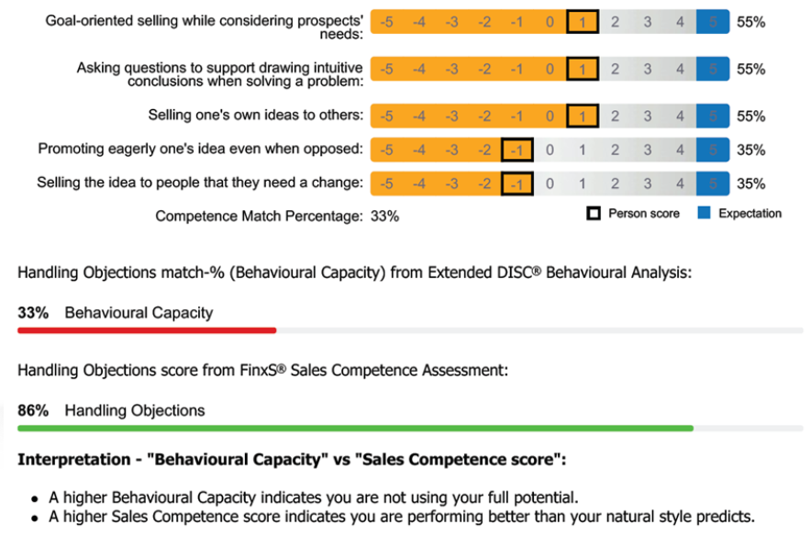
Replace with an example from your candidate’s report
You have a low natural behavioural capacity for this competency, but you have scored highly in the sales competence assessment.
This indicates you may have received training and development around this competency and therefore has learned behaviour.
You are performing better than your natural style predicts.

