Slide 1
Instructions: How to modify this PowerPoint presentation
1. This presentation can be modified to display your brand colours. Please click HERE to watch a short tutorial on how to make updates on PowerPoint.
2. Delete the HR Profiling Logo on the next slide and add your own logo.
3. Add your contact details to the last slide.
4. This PowerPoint is a guideline; you are welcome to change it as you see fit.
Delete this slide when your presentation is ready to go.

Slide 2


Recruiting and Developing
High Performing Individuals and Teams

Slide 3
The Four Quadrant Model
Task Orientated
Thinking
Logic
Systems
Analyses
Facts
Hard values
Results
Examining
Instructions
Compliance
Dominance
Change
Renewal
Introverted
Reserved Pace
Sensing
5 senses
Extroverted
Fast Paced
Intuition
6. sense
Traditions
Checking
Influencing
Generating ideas
Steadiness
Influence
Friendliness
Considering others
Emotions
People
Communication
Openness
People Orientated
Feeling
3

Slide 4
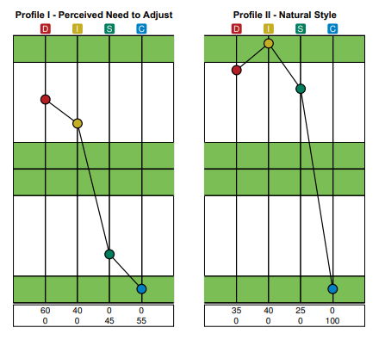
What does Extended DISC measure?
Behavioural Assessments are self-assessments that identify the strengths and development areas of an individual.
Profile I
Your Conscious Behaviour
Tells us what your adjusted style is to your work environment
Profile II
Your Natural Behaviour
Tells us what your natural behavioural style is
Download the Standard Behavioural Assessment

Slide 5







In both Profiles I and II we can recognise patterns in the SIZE and POSITION of the graphs. We can then relate these patterns to key feelings (emotions).
What makes Extended DISC® different from other assessments
Stress
Pressure
Frustration
Moral / Ethical Issues
Helplessness
Insecurity
Uncertainty of Role

Slide 6

Extended DISC Assessments
Send Link
Your candidates are sent a URL and access code to complete the assessment online.
Complete Assessment
The Behavioural Assessment takes 8 – 12 minutes to complete.
Send Results
Report results are sent within minutes of completion to a nominated email address/es.

Slide 7






Applications of Extended DISC
Organisation Applications
Leadership Development
Team Development
Recruitment
Sales Development
Identify strengths and development areas
Learn about motivators
Learn how your people approach tasks and goals
Identify communication styles
Manage and reduce conflict
Identify stress/pressure behaviours

Slide 8
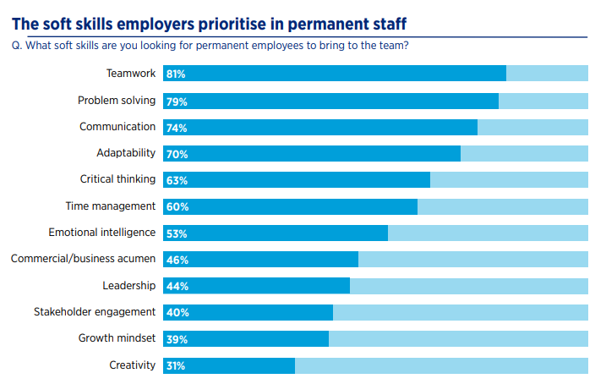
Teamwork is the number ONE soft skill employers value in employees right now
*Source: Hays Salary Guide FY21/22

Slide 9




Common Communication Problems Within Teams
Communication is the THIRD soft skill employers value in employees right now
Not Actively Listening
Misinterpreting the message
Lack of Communication
Assuming Your Message Has Been Understood
Letting Emotions Dictate the Response
9

Slide 10

Improve Communication Skills
Identify Team Culture
Team-task more effectively
Reduce Conflict
Build Cohesive Teams
Download Team & Build Report
Download Communication Report
Download Team Culture
Report
Reduce the amount of time spent on non-productive people issues
Understand team strengths and potential pitfalls
Recruit for your team weaknesses

Slide 11
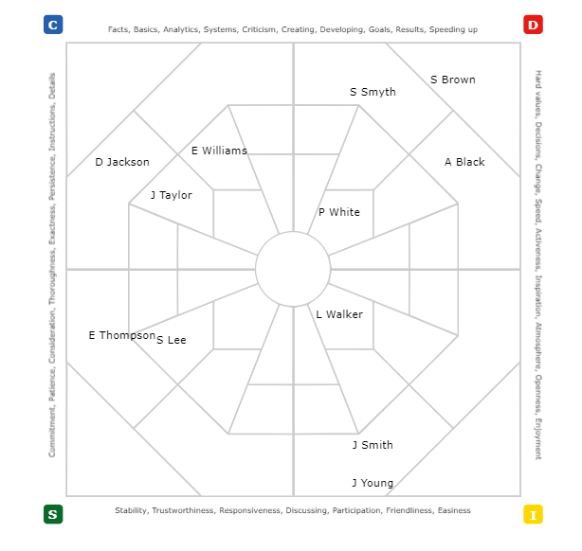
Is there a concentration of people in one quadrant?
Is it necessary to have people in each quadrant?
What are the pros and cons?
Team Analysis Reports
The Shotgun Map demonstrates where the natural behavioural styles of the team members fall on the Extended DISC Diamond.

Slide 12

Leadership Development
More than 70% of employees in New Zealand said their direct manager lacked some sort of management or leadership skill, indicating that too many New Zealand companies do not invest in developing people before promoting them to leadership positions.
Download Lead & Manage Report
Identify a candidate’s natural leadership style and provide development tips on how to improve performance..
Assist managers to develop an understanding of themselves and their team.
Source: Newshub - Business culture expert Shane Green

Slide 13

Improve Recruitment Outcomes
84% of our clients have indicated that recruiting the right people for the right roles is a business issue they are facing.
Download Recruitment Report
Save time and money. Make informed decisions by recruiting the right job fit.
Download On-Boarding Report
Provide the right kind of support during the on-boarding process.

Slide 14

Manage Remote Working more effectively
Almost 50% of managers are calling for more help when it comes to managing their teams remotely
47% of managers are finding staff WFH difficult, with 26% saying it’s exceptionally difficult.
Identify DISC styles virtually.
Understand the IDEAL Work Environment for each style and also what demotivates them.
Understand the attitudes and mindset of each behavioural style.
Download Remote Worker Report
Source: Human Resource Director NZ

Slide 15
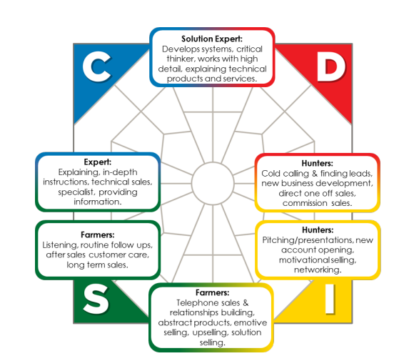
Sales Development
Download Sales & Service Report
Identify your natural sales style.
Identify your customers’ behavioural styles.
Adjust your sales style for improved sales performance.
Understand the buying decisions of the DISC styles.

Slide 16






16
FinxS Online Platform
FinxS is the web application used to create, brand and administer questionnaires. It is also the database where the results of the questionnaire are saved.
Customisable content or create your own reports
Add branding to white label
Admin Account Management
Gender Neutral options
Multilingual Options – FinxS is used globally and is available in over 80 languages
API Integration

Slide 17
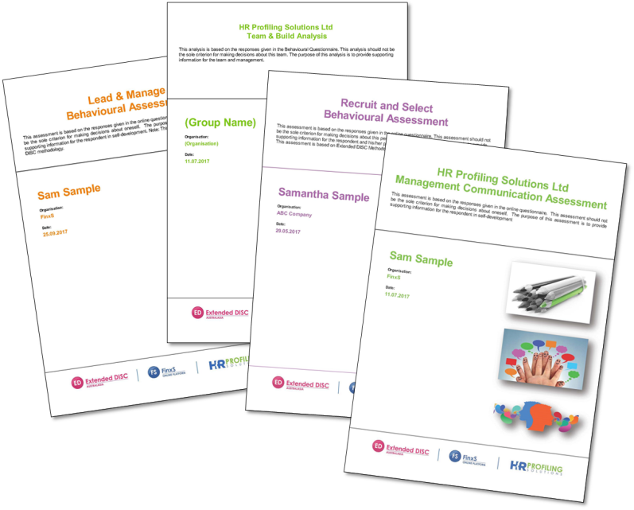
Lead and Manage
Sales and Service
On-Boarding
Recruit and Select
Team and Build
Communication
Remote Worker
Re-Order DISC Results Against Different Reports

Slide 18
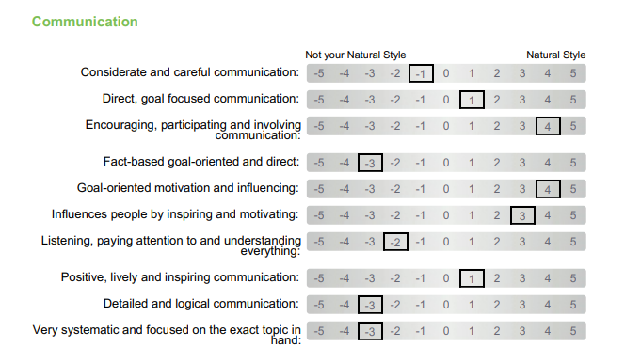
FinxS has 1600 competencies within its database and each competency relates to a specific behavioural style.
New competencies are added regularly to the FinxS platform.
Competencies
Shows candidates’ scores against a particular competency, within competency groups.
The left side shows the least natural traits
The right side shows the most natural traits

Slide 19
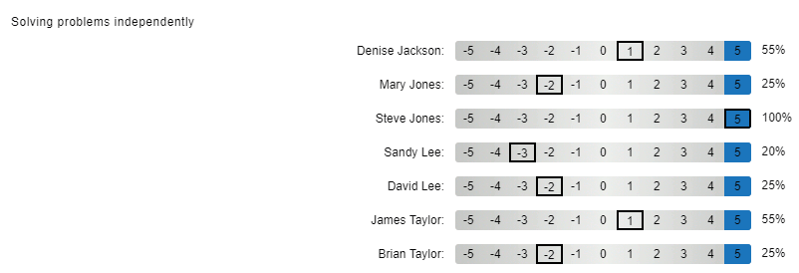
Job Templates
Use the competencies to create a Job Template based on a job description. Competencies can be scored and results between candidates can be compared.
The left side shows the least natural traits
The right side shows the most natural traits

Slide 20




Reasoning Analysis
Sales Competence
Other Assessment Tools on FinxS
Open 360
Surveys

Slide 21
Product Pricing
The FinxS system uses a point-based system. Points are purchased and can be utilised on any of the available products in FinxS.
Points Purchased | Price per point +GST
xx-xxx | $$$
xxx-xxx | $$$
Product |  | Point usage
DISC Behavioural Analysis |  | 10
Open 360 Feedback |  | 9
Reasoning Analysis |  | 8
Sales Competence |  | 7
Survey | 1-100 responses | 100
 | 101-500 responses | 200
 | 501-1000 responses | 300
 | 1001 - 5000 responses | 400
 | 5001-10000 responses | 500
 | 10001+ responses | 1000
Minimum Purchase of xx Points
Alternatively annual license fees can also be negotiated

Slide 22

Do you have any questions?
Contact us!

